Slide 1
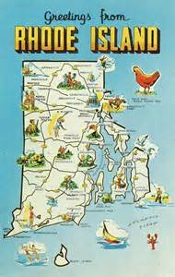
Our 50 States: Rhode Island
Lucy
7-29-15

Slide 2
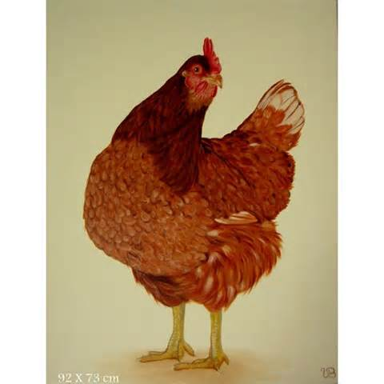
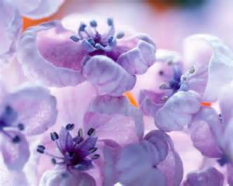
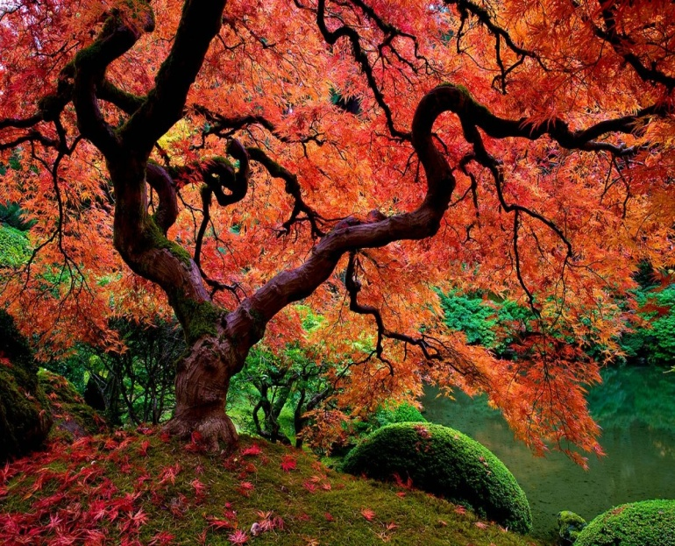
Symbols of RI
The state bird is: red hen
The state flower is:violet
The state tree is: red maple tree
Add a picture here.
Add a picture here.
Add a picture here.

Slide 3
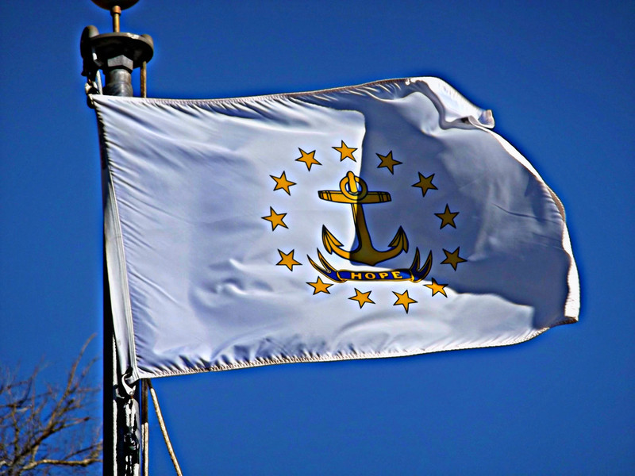
State Flag
It has an anchor because we’re the Ocean State.
Add a picture here.

Slide 4
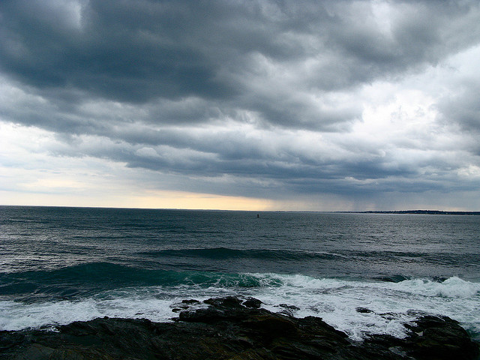
State Nickname
We are the Ocean State because we’re near water.

Slide 5
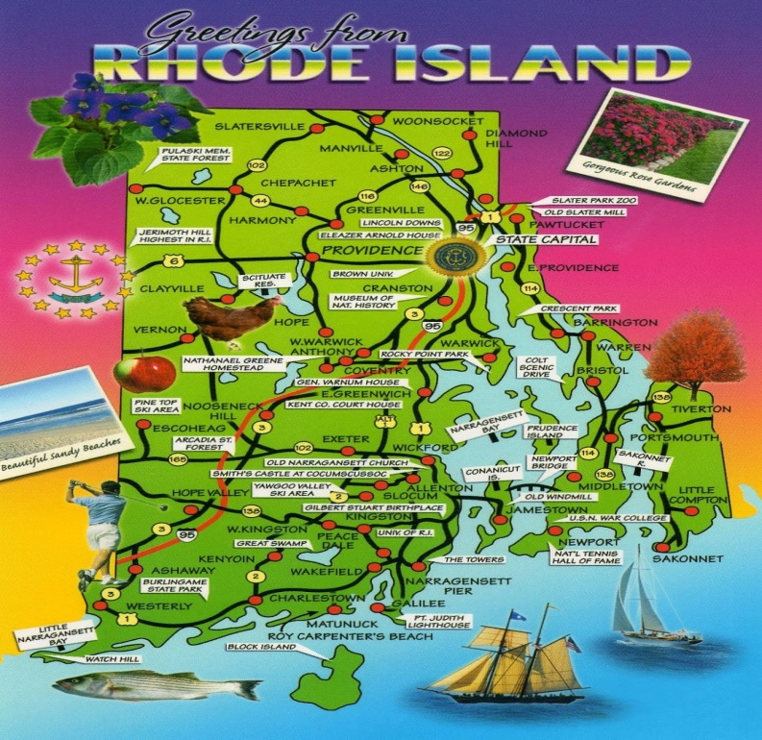
Statehood
This state became the 13 state in the United States in 1790.
The first Governor of the state was Nicholas Cooke.

Slide 6
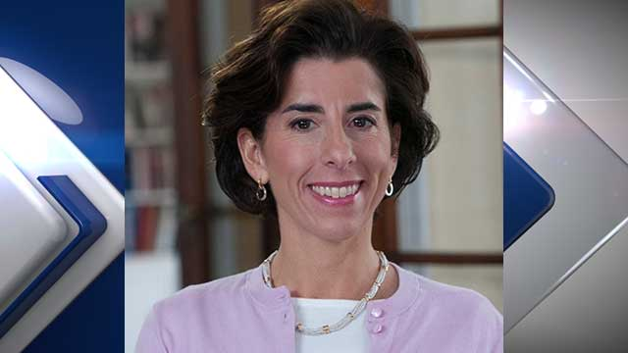
Government
Gina Raimondo

Slide 7
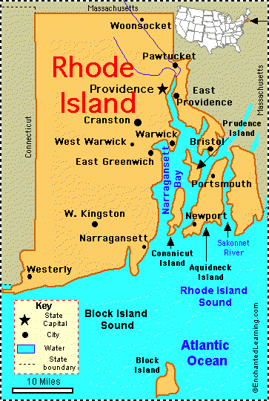
Maps

Slide 8
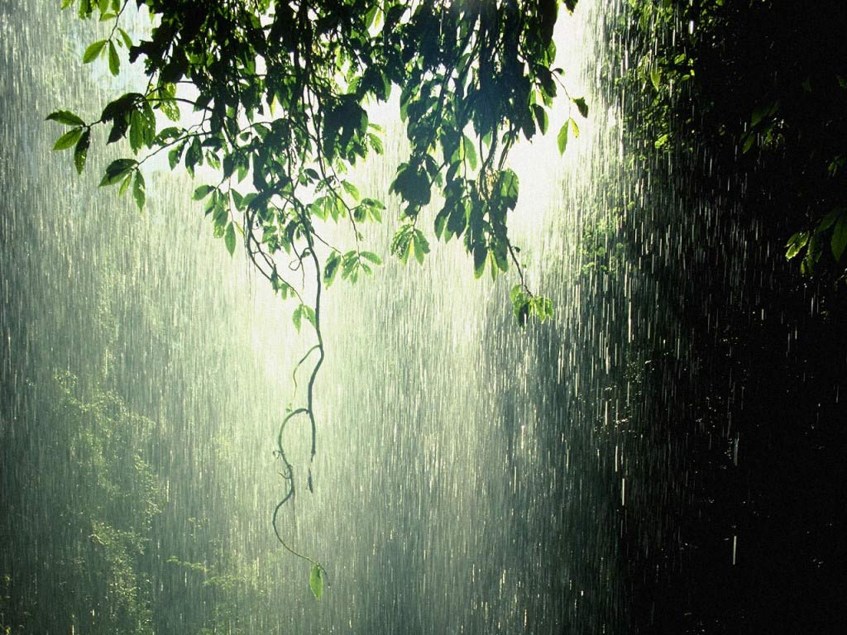
Weather
The average high temperature in July is: 83 degrees
The average high temperature in January is: 37 degrees
The average yearly precipitation is: 48.5 inches

Slide 9
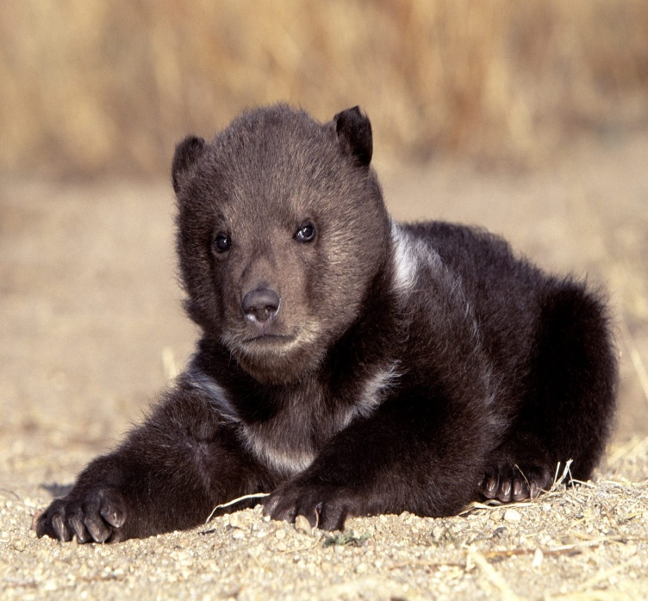
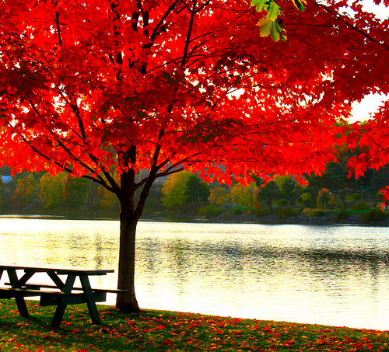
Natural Resources
Plant Life- pine, red maple
Animal Life – wolf, bear

Slide 10
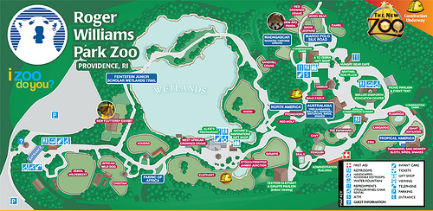
Places to Visit
Roger Wiliams Park Zoo

Slide 11
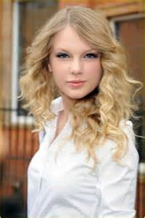
Famous People

