Slide 1
Our 50 States: Rhode Island
Katie
July 2015

Slide 2
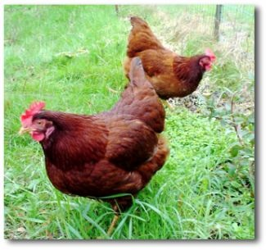
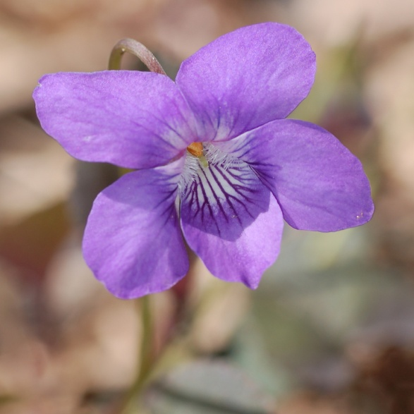
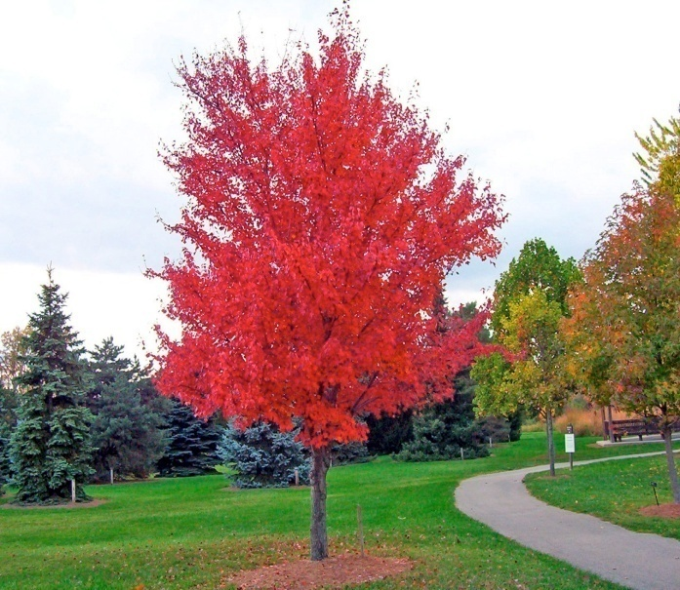
Symbols of R.I
The state bird is: The Red Hen
The state flower is: Violet
The state tree is: Red Maple
Add a picture here.
Add a picture here.
Add a picture here.

Slide 3
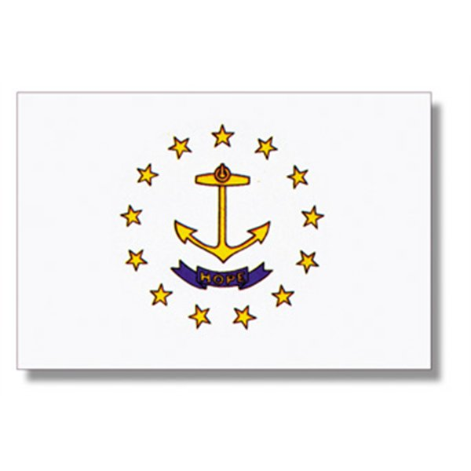
State Flag
They have a anchor on the flag because we are the Ocean State.
Add a picture here.

Slide 4
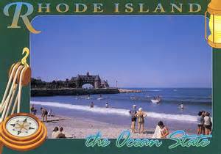
State Nickname
We are the Ocean State. It got its nickname from all the beaches and oceans.

Slide 5
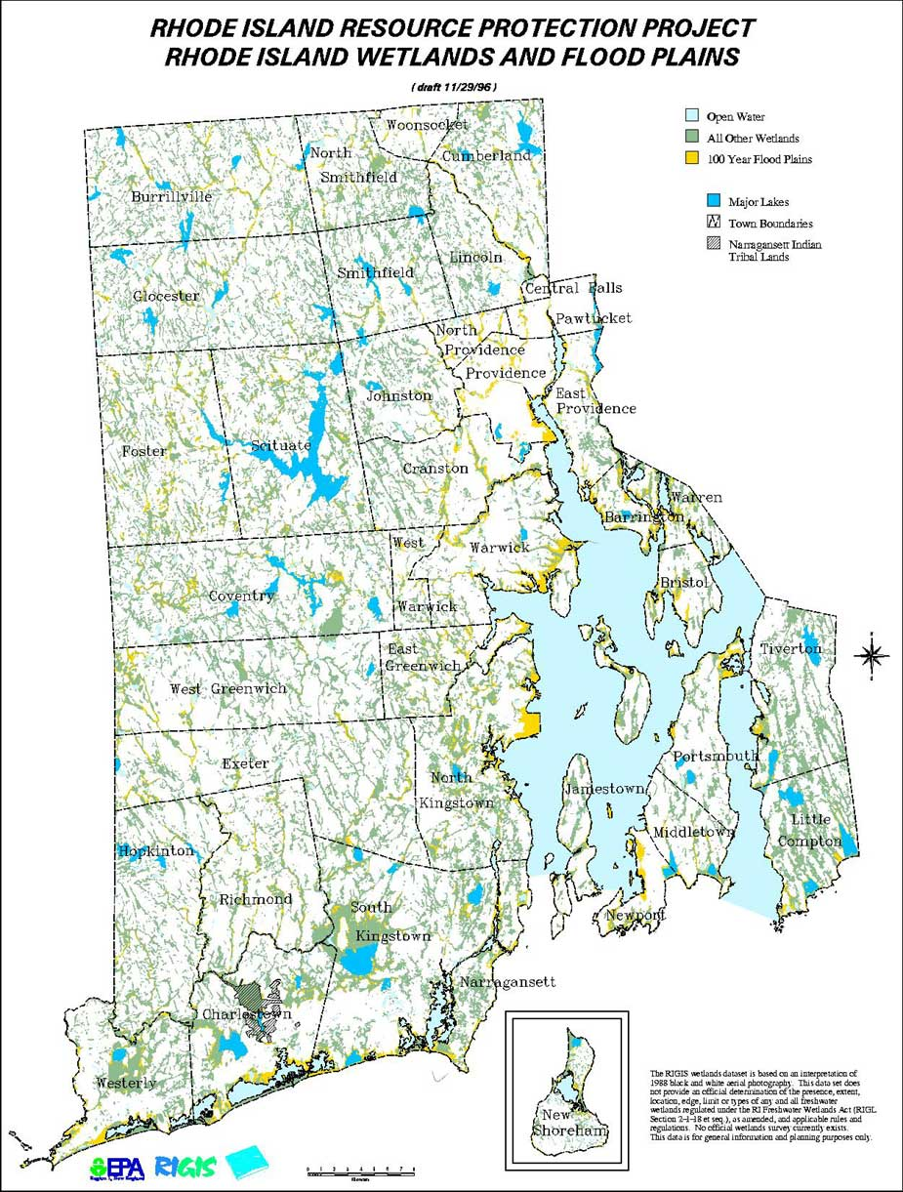
Statehood
This state became the 13 state in the United States in 1790.
The first Governor of the state was Nicholas Cooke.

Slide 6
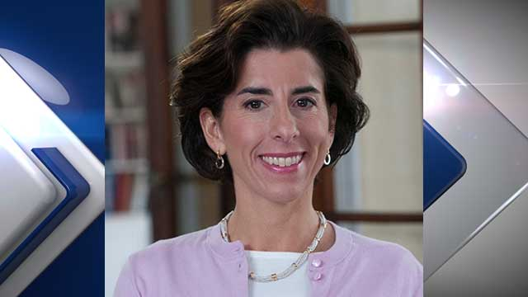
Government
The governor is Gina Raimondo.

Slide 7
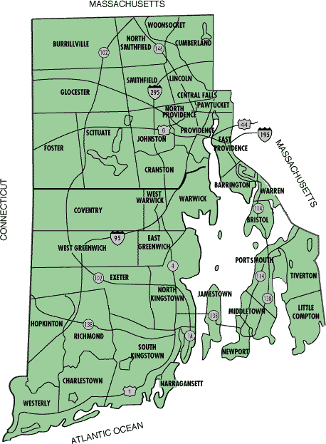
Maps

Slide 8
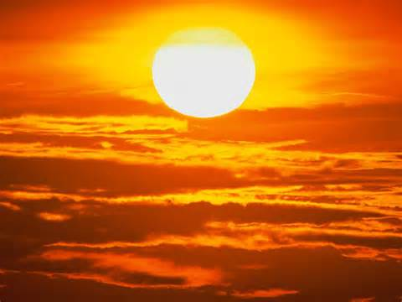
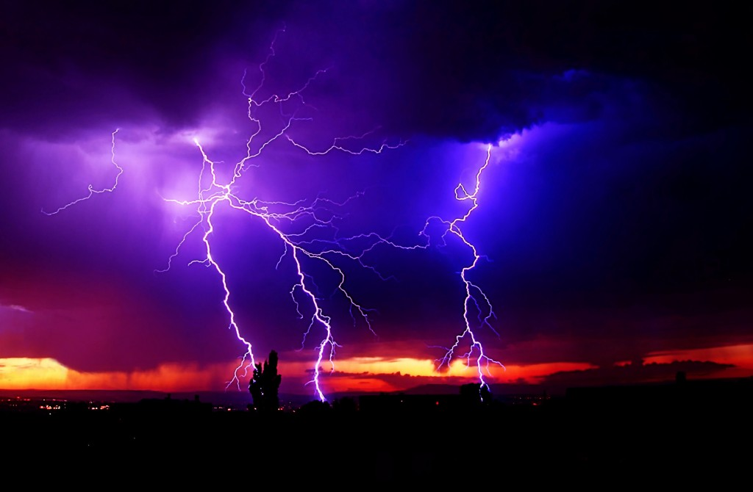
Weather
The average high temperature in July is: 82 F
The average high temperature in January is: 38 F

Slide 9
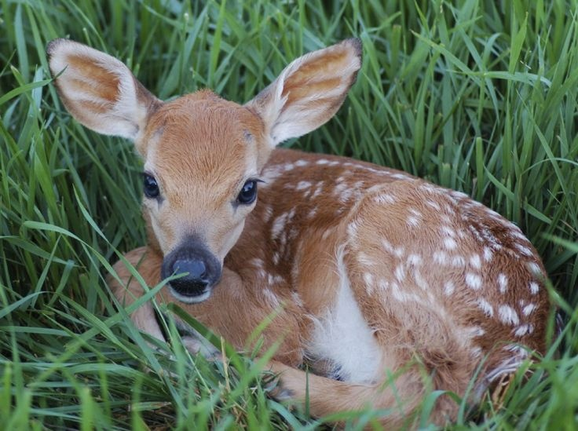
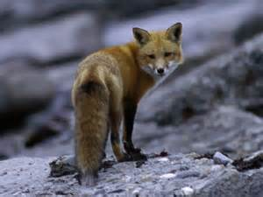
Natural Resources
Plant Life: Maple tree, Pine tree, Oak tree, Birch
Animal Life: Rabbits, Foxes, Deer, Squirrels,

Slide 10
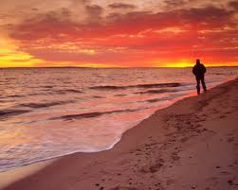
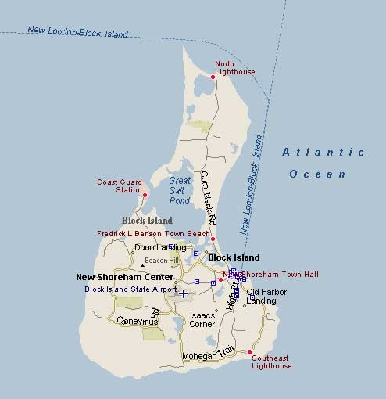
Places to Visit
South Shore, Luke’s Inn, Fog Land, Block Island

Slide 11
Famous People
Elisabeth Hasselbeck
Tanya Donnelly

