Slide 1
Our 50 States: Rhode Island
Ellis
July 2015

Slide 2
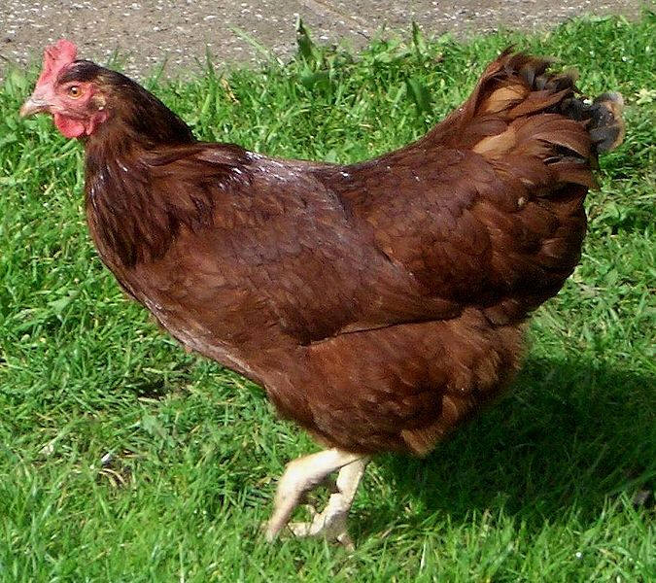
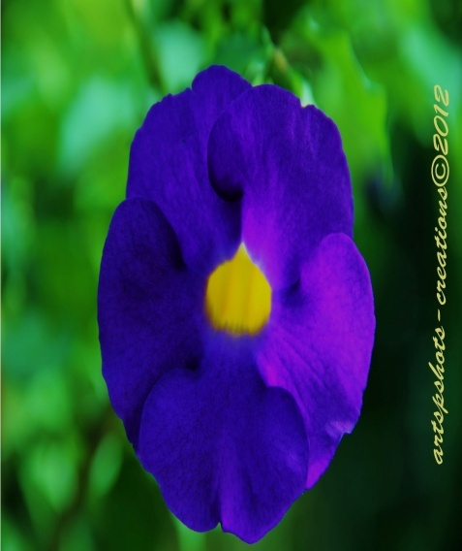
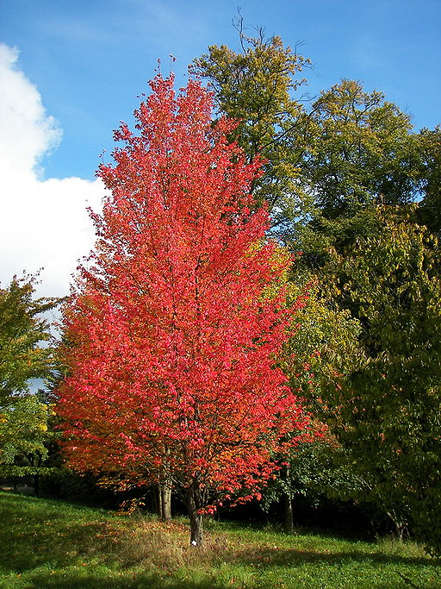
Symbols of Rhode Island
The state bird is: Rhode Island red
The state flower is: blue Violet
The state tree is: Maple
Add a picture here.
Add a picture here.
Add a picture here.

Slide 3
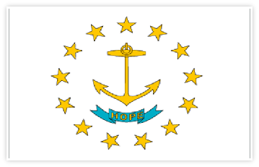
State Flag
Rhode Island’s state flag is white, blue and yellow. Also our flag has a yellow anchor and it stands for hope.
Add a picture here.

Slide 4
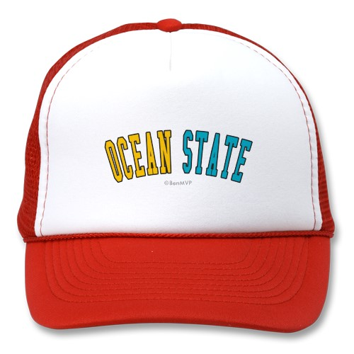
State Nickname
Our state’s nickname is the Ocean State. It got it’s name because we are surrounded by the ocean.

Slide 5
Statehood
This state became the 13th state in the United States in 1790.
The first Governor was Nicholas Cooke.

Slide 6
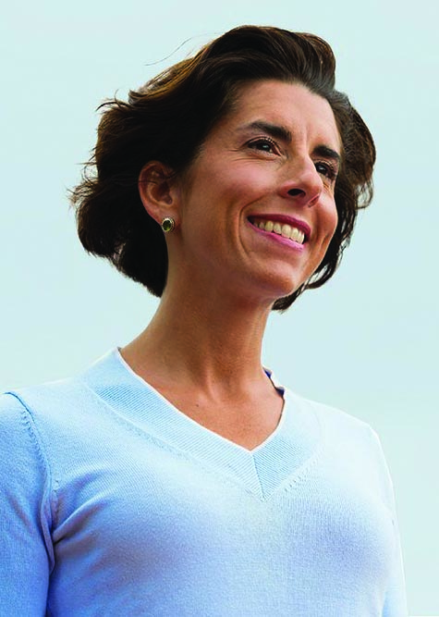
Government
Gina Raimondo is the
governor.

Slide 7
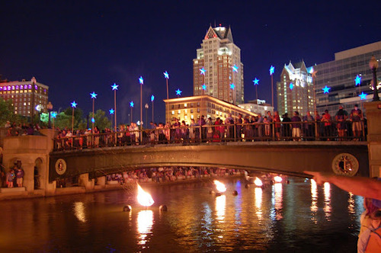
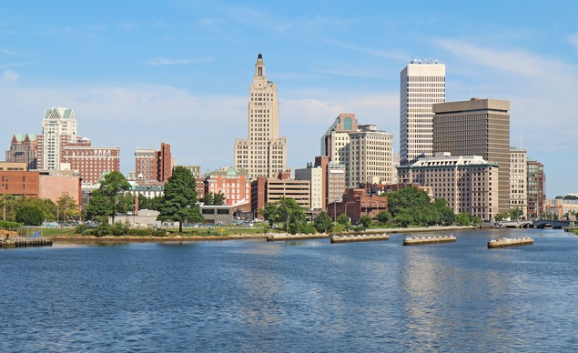
Weather
The average high temperature in July is: 83 degrees
The average high temperature in January is: 37 degrees
The average yearly precipitation is: 47.18 inches

Slide 8
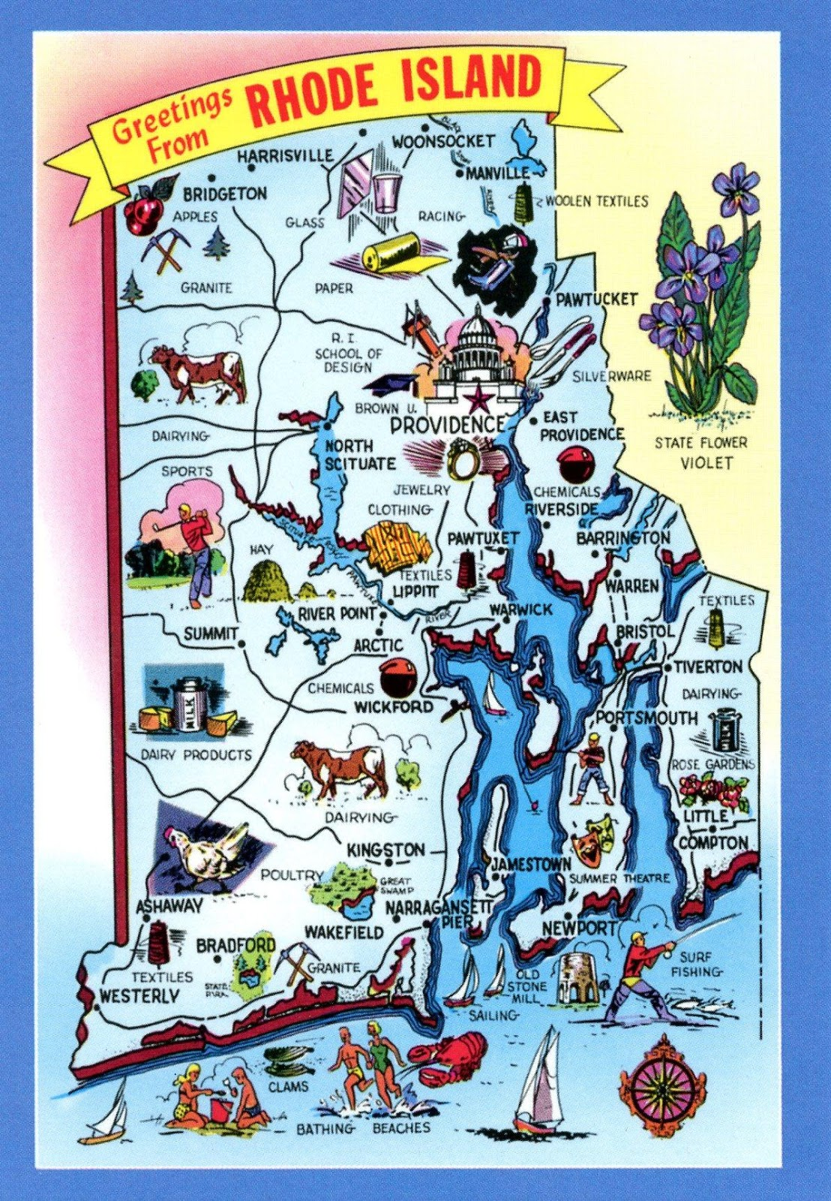
Maps

Slide 9
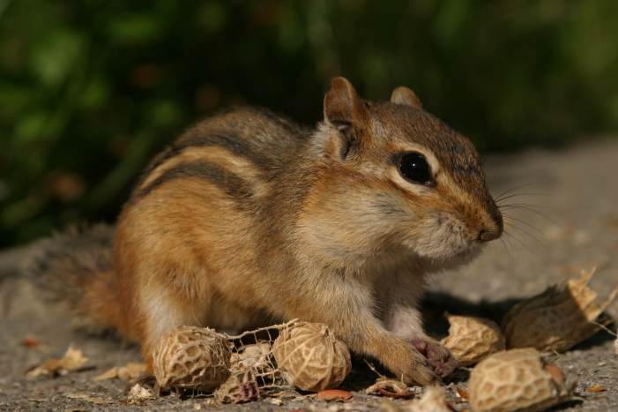
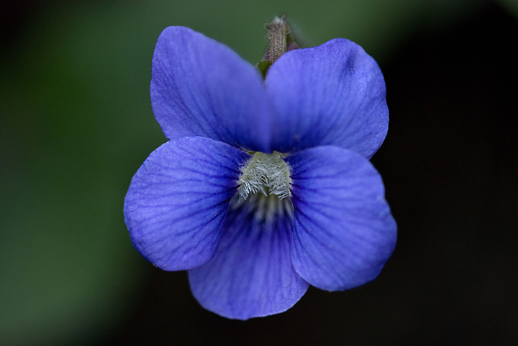
Natural Resources
Plant Life
Maple tree, violet, blue violet.
Animal Life
Chipmunks, rats, robins, blue jays, birds.

Slide 10
Places to Visit
Providence Place Mall
Roger Williams Park
Roger Williams Park Zoo
Note: You can use Microsoft Internet Explorer to find information about your site.

Slide 11
Famous People
Gina Raimondo
Roger Williams
Taylor Swift

