Slide 1
Our 50 States: Rhode Island
Camden
July 2015

Slide 2
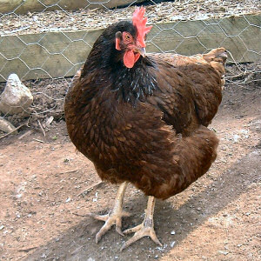
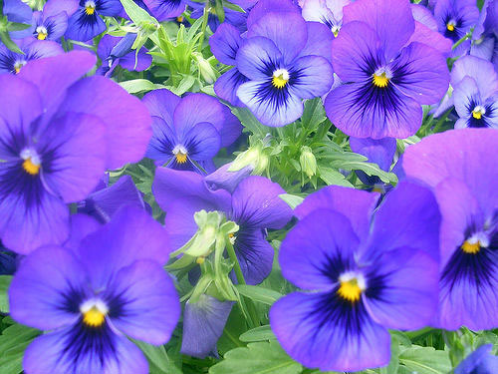
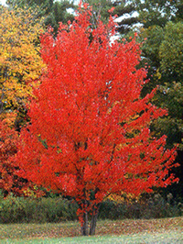
Symbols of Rhode Island
The state bird is: Rhode Island Red
The state flower is: Violet
The state tree is: Red Maple

Slide 3
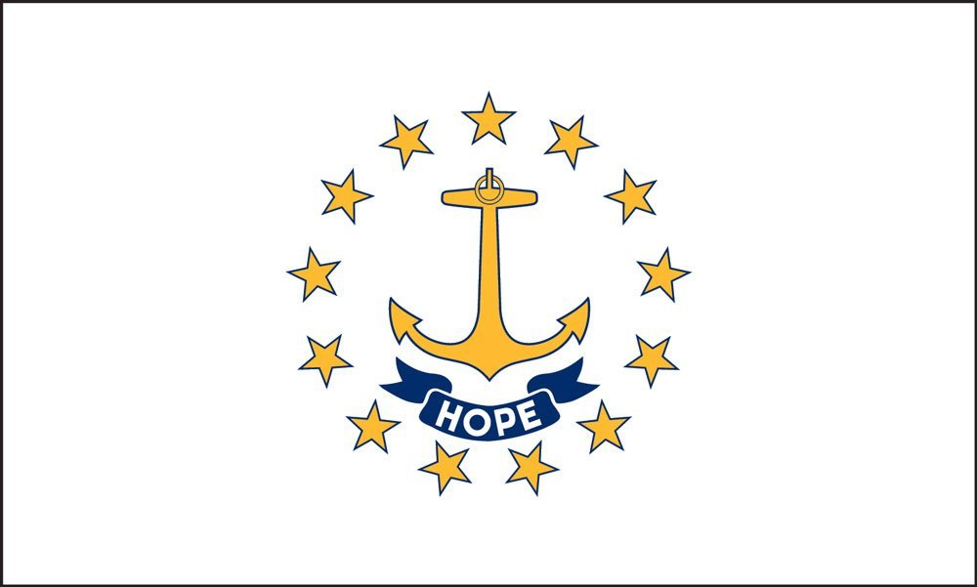
State Flag
The gold anchor in the middle of the flag stands for hope surrounded by thirteen stars for the original thirteen colonies.

Slide 4
State Nickname
Rhode Island’s nickname is the Ocean State because it is surrounded by ocean water.

Slide 5
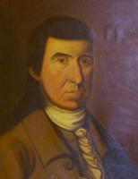
Statehood
This state became the 13th state in the United States in 1790.
The first Governor of the state was Nicholas Cooke.

Slide 6
Government
Gina Raimondo is the governor.

Slide 7
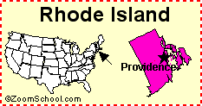
Maps

Slide 8
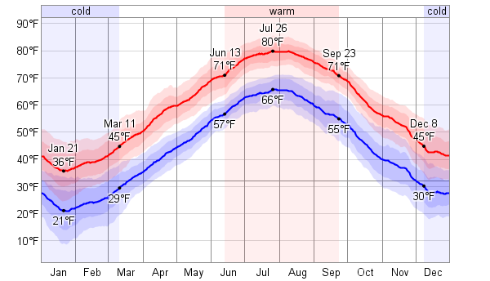
Weather
The average high temperature in July is: 80 degrees Fahrenheit
The average high temperature in January is: 36 degrees Fahrenheit

Slide 9
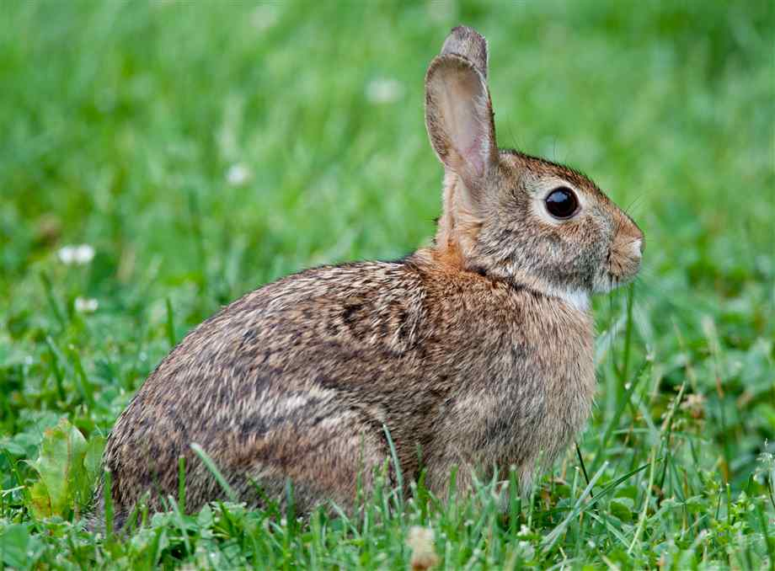
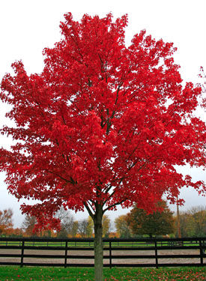
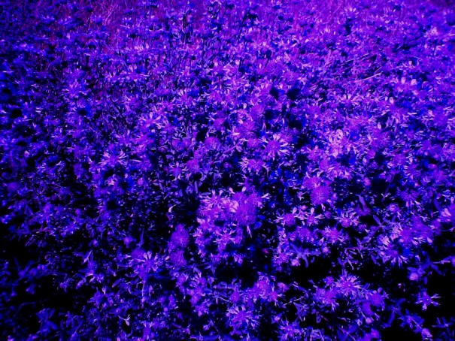
Natural Resources
Plant Life
Maple trees, violets and, evergreens
Animal Life
Coyotes, raccoons, skunks and, rabbits

Slide 10
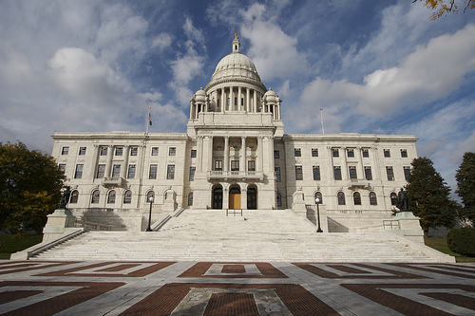
Places to Visit
If I were thinking about living in Rhode island, I would visit the Rhode island state house so I could get some background info on the state before I live there.

Slide 11
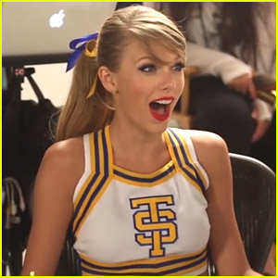
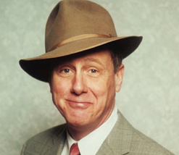
Famous People
Taylor Swift
Eddie Dowling
Harry Anderson

