Slide 1
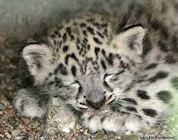
The Snow Leopard Quiz
By
Zoe

Slide 2
What color fur do snow leopards have?
grey and white
white and orange

Slide 3
Oops, try again.

Slide 4
Good Work!

Slide 5
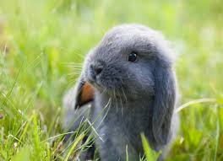
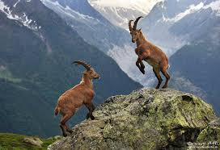
What do snow leopards eat?
rabbits and bugs
blue sheep, asiatic ibex, argali

Slide 6
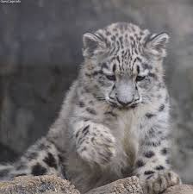
Good try! Try again.

Slide 7
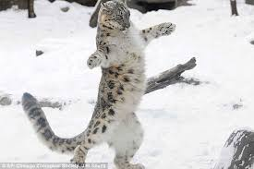
You got the answer correct! You made a snow leopard dance!

Slide 8
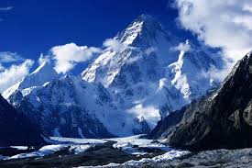
Where do snow leopards live?
cold high mountains
Antarctica

Slide 9
Please try again.

Slide 10
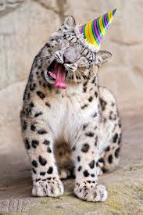
Congratulations!

Slide 11
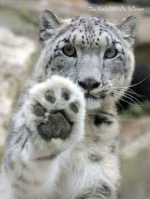
You’re a Snow Leopard expert!

