Slide 1
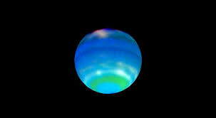
The Neptune Quiz
By
Sayler

Slide 2
How many rings circle Neptune?
2
6

Slide 3
Oops, try again.

Slide 4
Good Work!

Slide 5
Is the sun far from Neptune?
Yes
no

Slide 6
Good try! Try again.

Slide 7
Great Work!

Slide 8
What color is Neptune?
blue
red

Slide 9
Please try again.

Slide 10
Good Job!

Slide 11
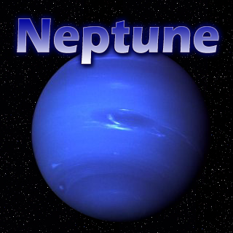
You’re a Neptune expert!

