Slide 1
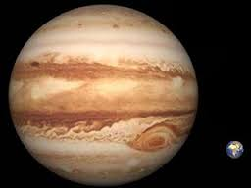
The Jupiter Quiz
By
Ruby

Slide 2
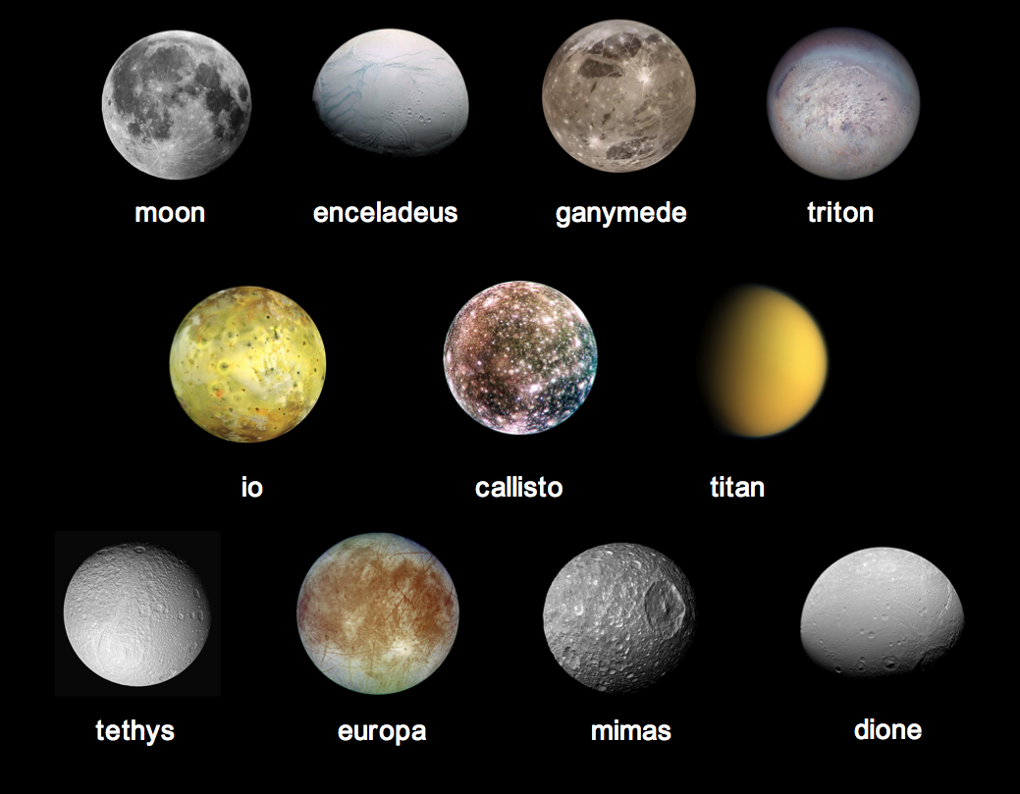
How many moons does Jupiter have?
60
50

Slide 3
Oops, try again.

Slide 4
Good Work!

Slide 5
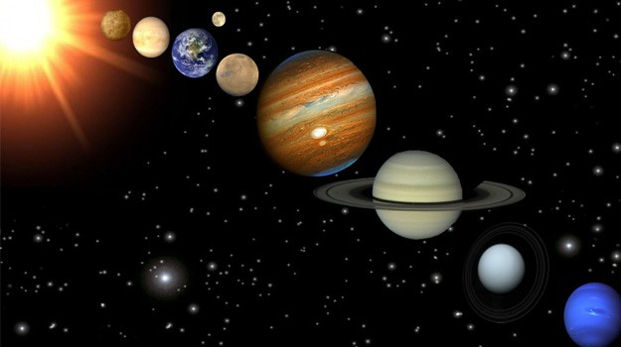
Is Jupiter close or far away from the earth?
Far away
close

Slide 6
Good try! Try again.

Slide 7
Great Work!

Slide 8
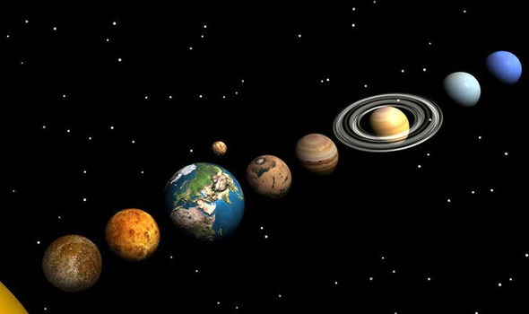
You’re a Jupiter expert!

