Slide 1
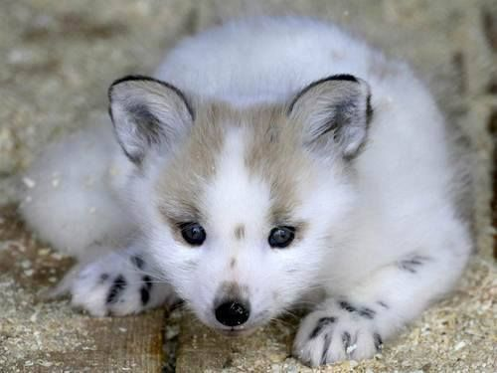
The Arctic Fox Quiz
By
Quincy

Slide 2
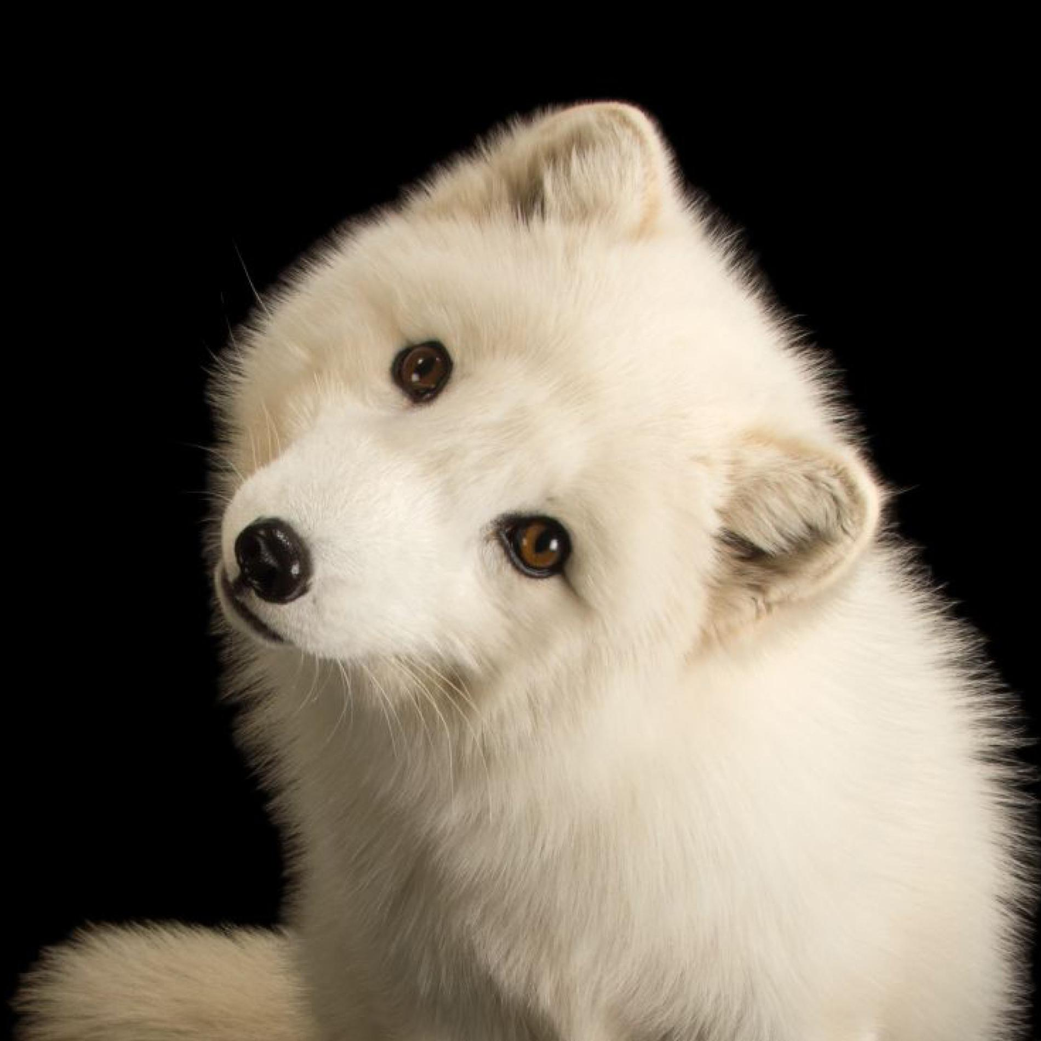
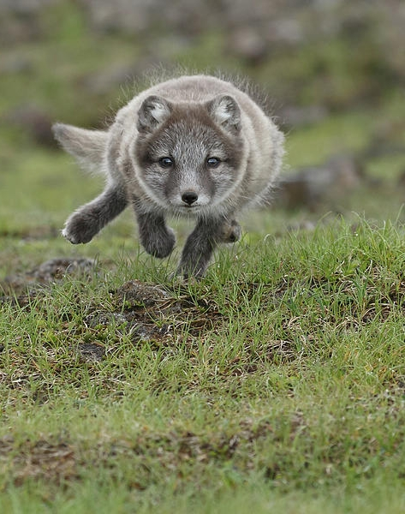
How heavy is a white fluffy fox?
6.5 to 17 lbs.
5.6 to 15 lbs.

Slide 3
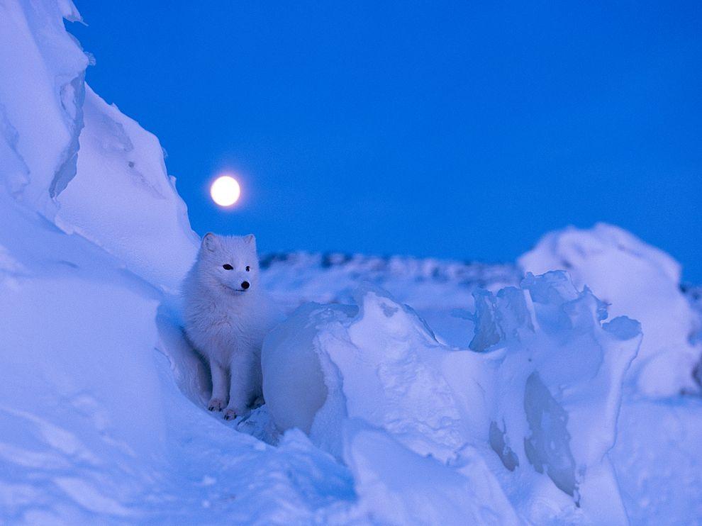
Oooooops, try again.

Slide 4
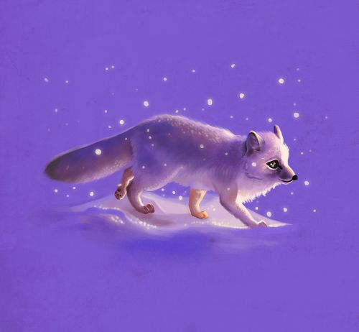
You the boss!

Slide 5
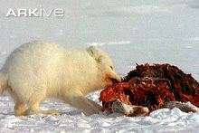
Do they eat birds, eggs, and fish?
yes
no

Slide 6
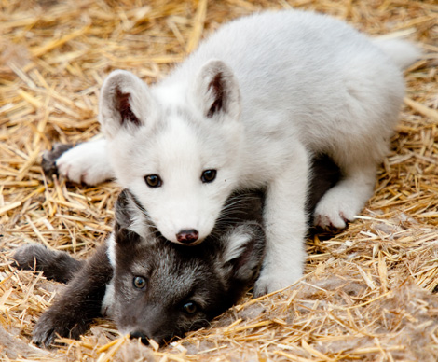
You not the boss.

Slide 7
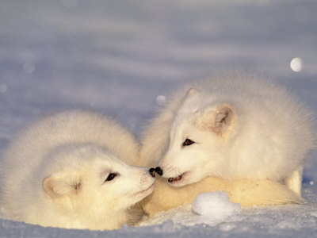
yaaaaaa!

Slide 8
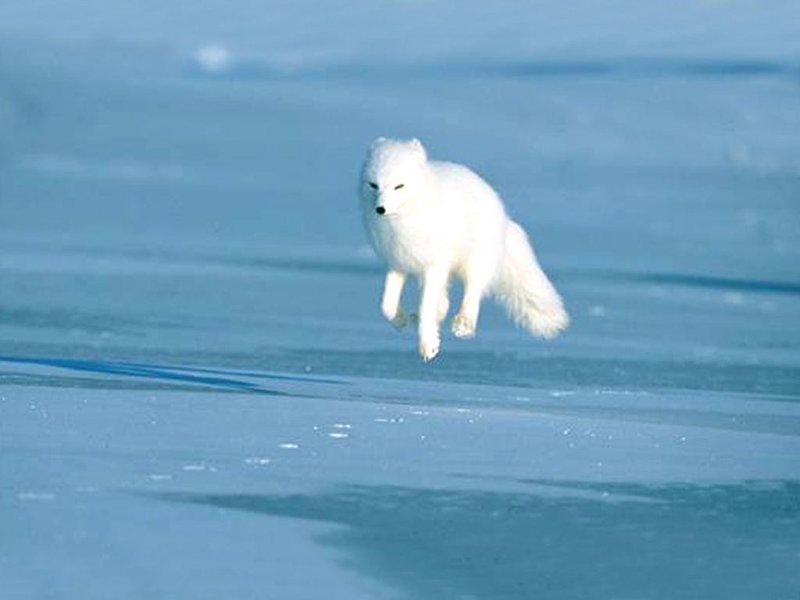
Do arctic foxes live in Africa?
yes
no

Slide 9
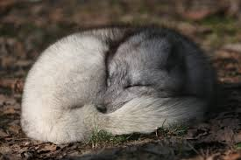
Try again.

Slide 10
Good Job!

Slide 11
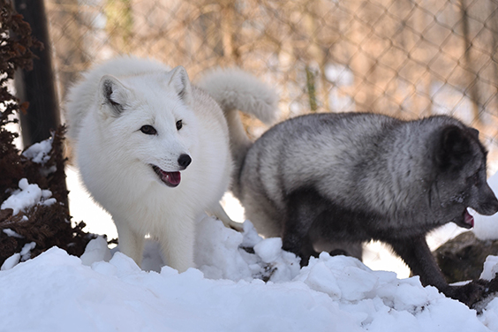
Do they live in the dog family?
yes
no

Slide 12
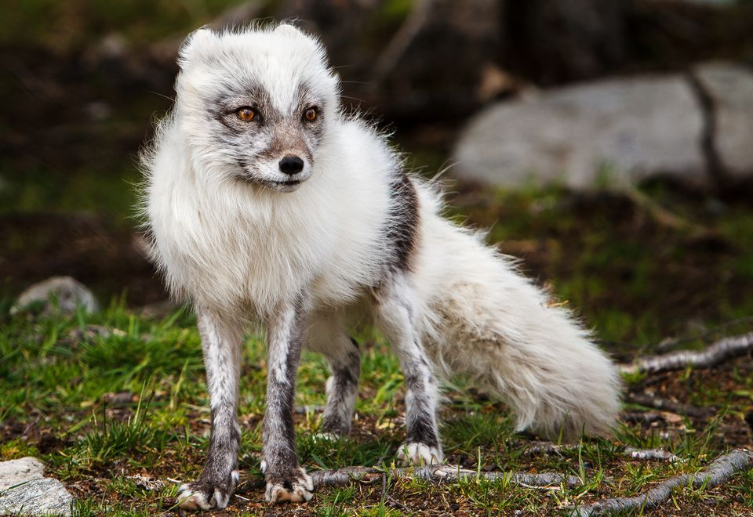
Try Again!

Slide 13
Grrrrreat job!

Slide 14
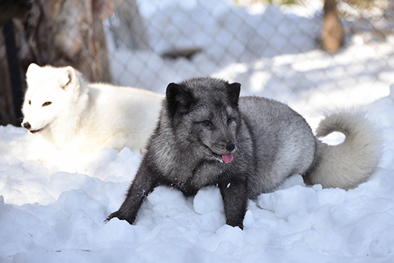
You are now an Arctic Fox Expert!

