Slide 1
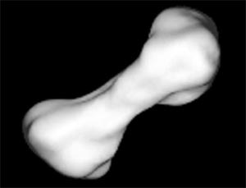
The Asteroid Quiz
By
Quincy

Slide 2
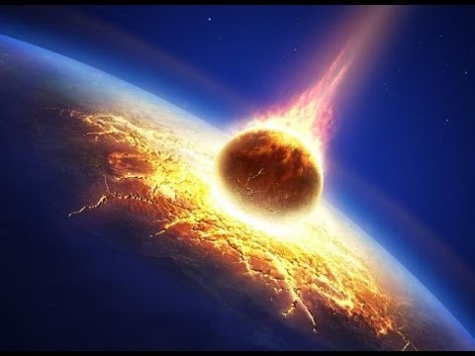
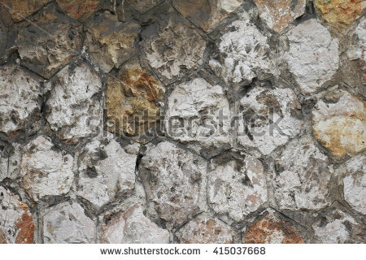
What are asteroids made of?
Small rocky objects
Small dirty objects

Slide 3
Whoops! Try again.

Slide 4
You did it!

Slide 5
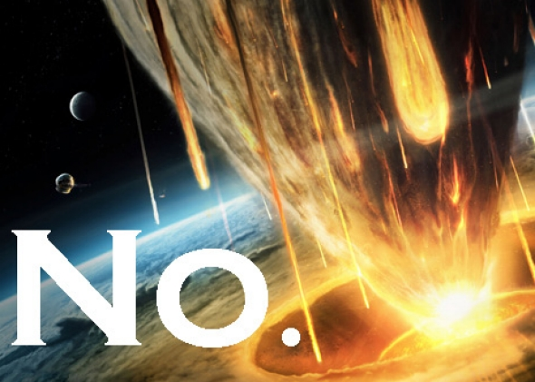
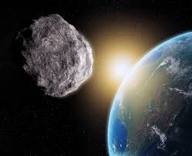
How many asteroids are known to be in our solar system?
6,000,000
10,000,000

Slide 6
So close! Try again.

Slide 7
Great Work!

Slide 8
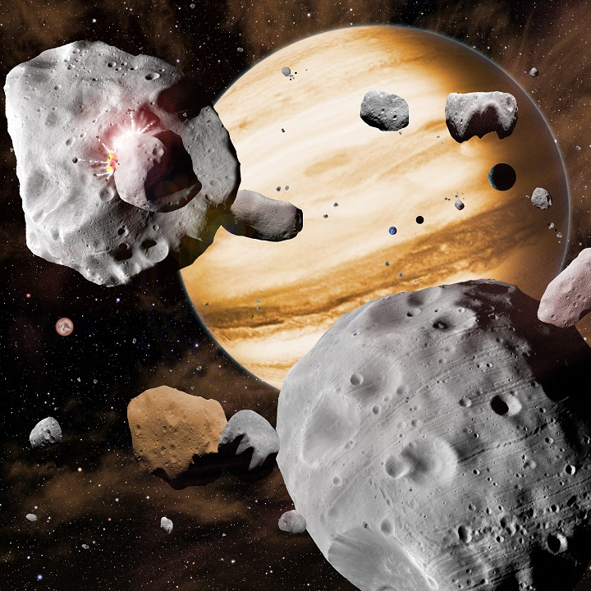
You’re an asteroid expert!

