Slide 1
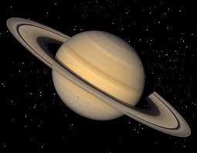
The Saturn Quiz
By
Nina

Slide 2
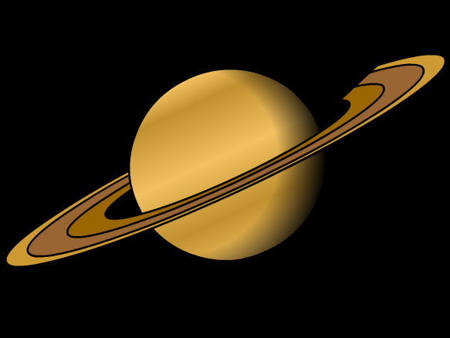
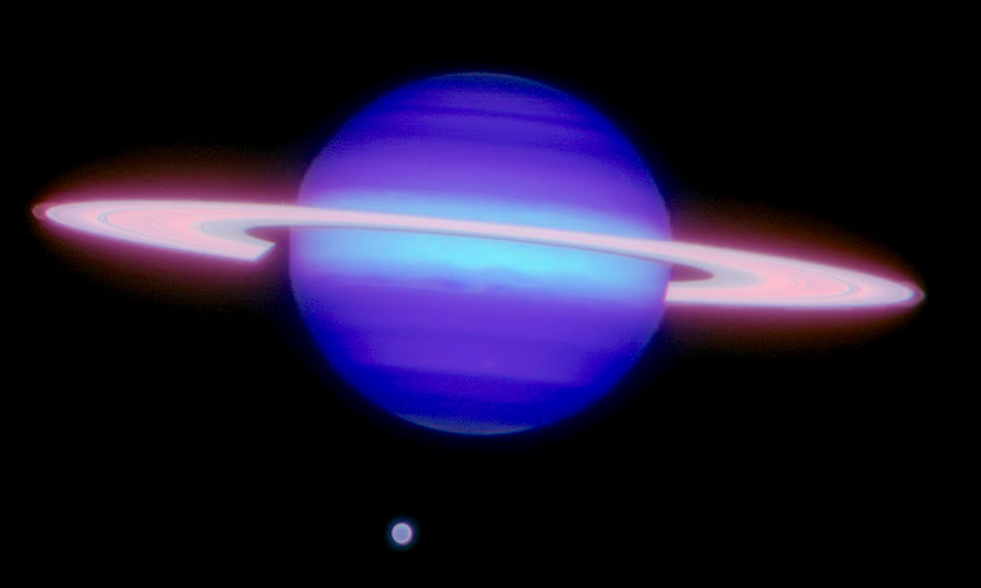
What color is Saturn?
A warm golden color
A purple

Slide 3
Oops, try again.

Slide 4
Good Work!

Slide 5
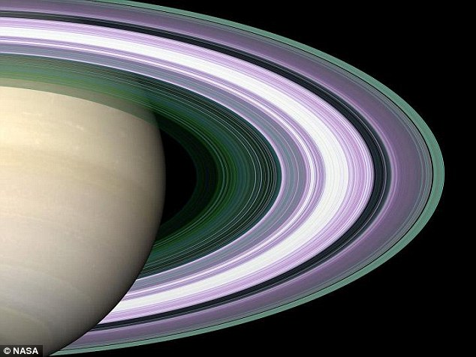
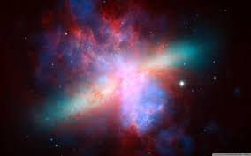
What are Saturn’s rings made of?
dust
Rock and ice

Slide 6
Good try! Try again.

Slide 7
Great Work!

Slide 8
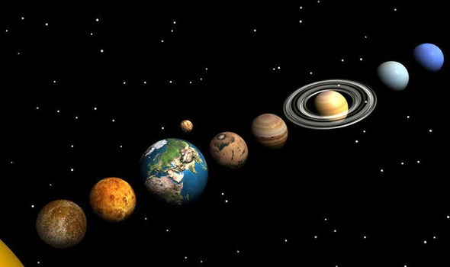
You’re a Saturn expert!

