Slide 1
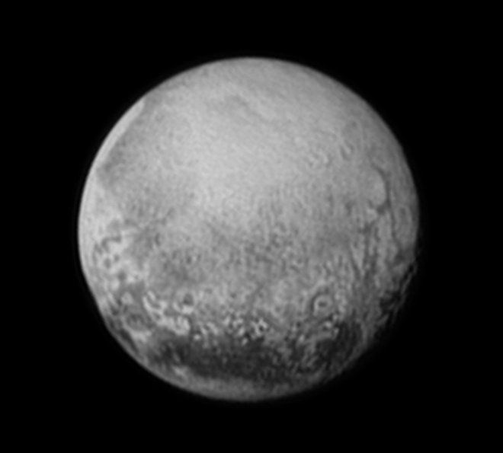
The Pluto Quiz
By
Meadow

Slide 2
Is the diameter of Pluto 1,430 miles?
Yes
No

Slide 3
Whoops! Try again.

Slide 4
You did it!

Slide 5
Is Pluto a dwarf planet?
Yes
No

Slide 6
So close! Try again.

Slide 7
Great Work!

Slide 8
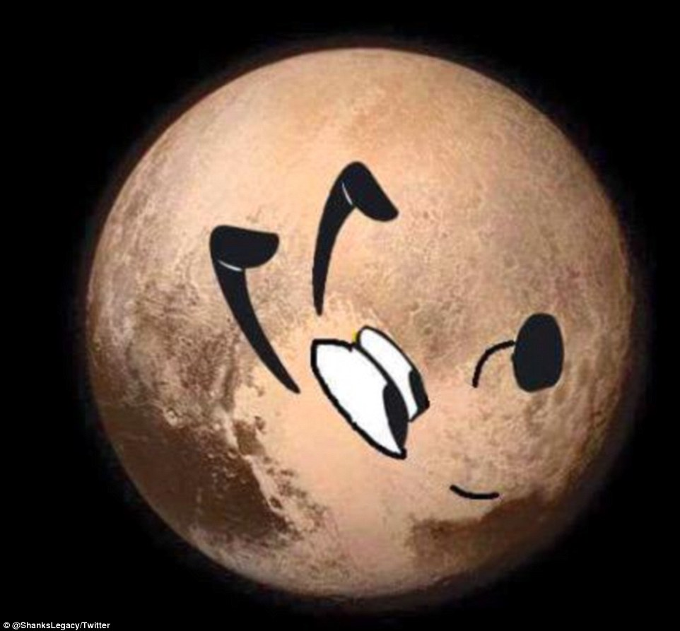
You’re a Pluto expert!

