Slide 1
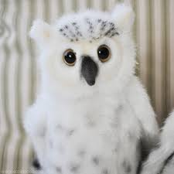
The Snowy Owl Quiz
By
Maggie

Slide 2
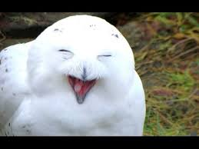
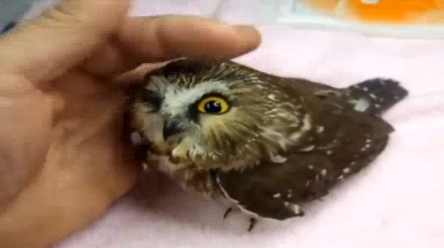
Are snowy owls just white?
yes
No

Slide 3
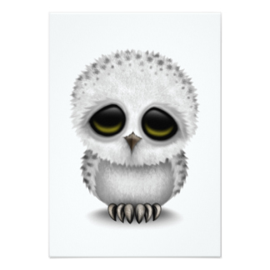
Whoops, try again.

Slide 4
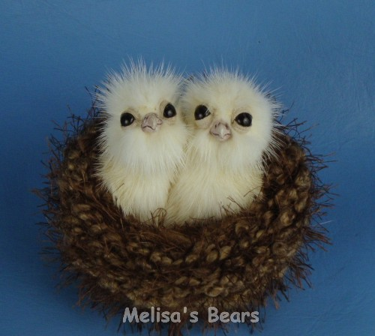
Good Work!

Slide 5
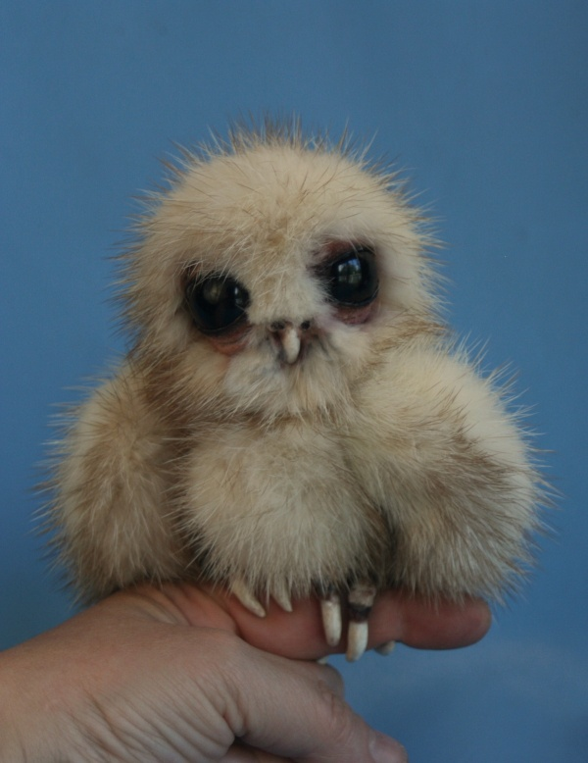
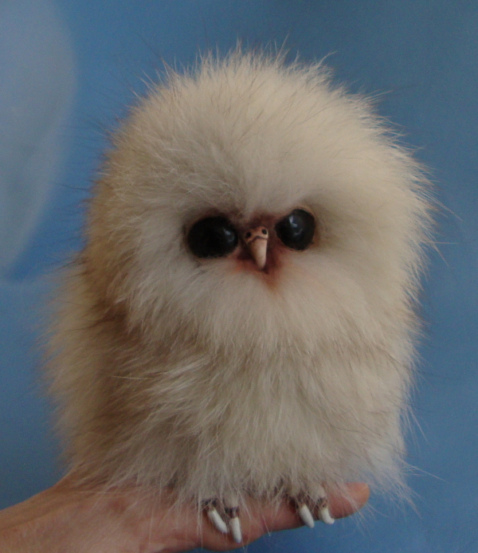
Do snowy owls live in tundras?
yes
no

Slide 6
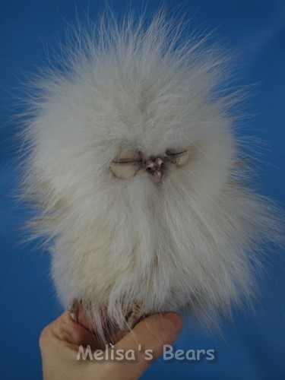
Good try! Try again.

Slide 7
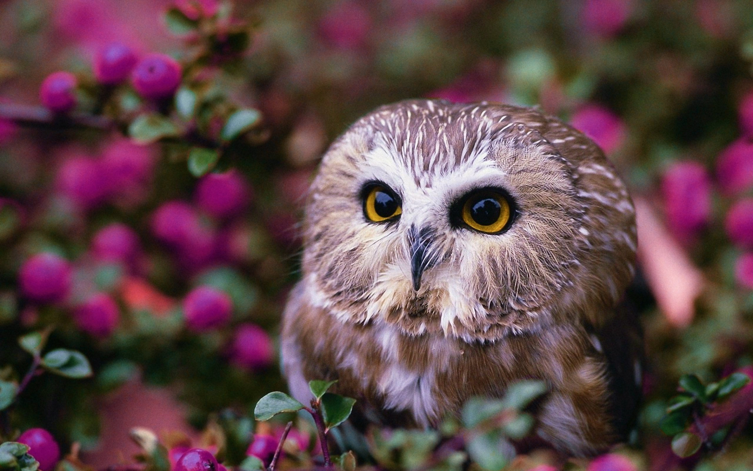
YOU DA BOSS!

Slide 8
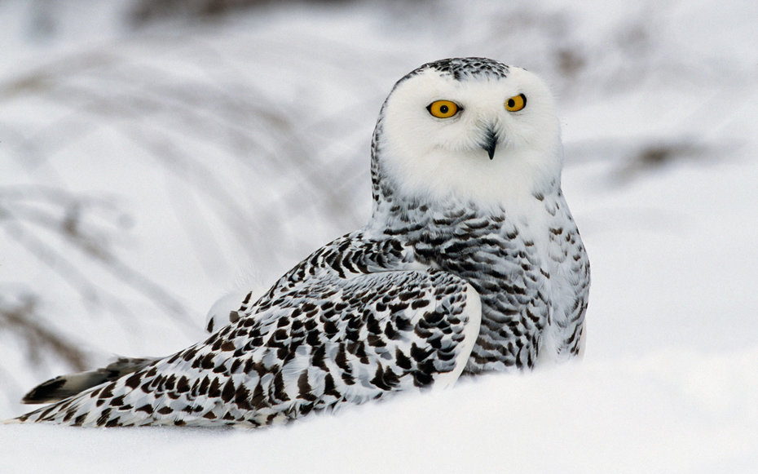
Do snowy owls only mate once?
only once
5 times

Slide 9
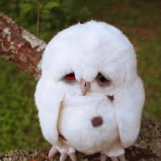
Please try again.

Slide 10
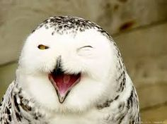
Good job, boss!

Slide 11
You’re a snowy owl boss.

