Slide 1
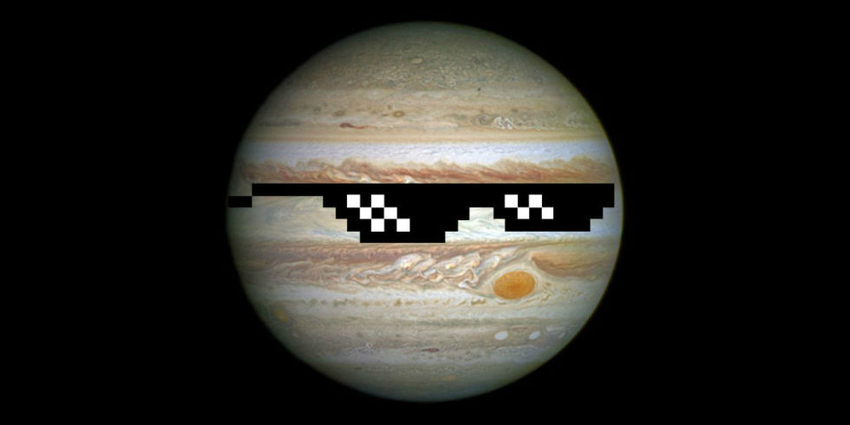
The Jupiter Quiz
By
Maggie

Slide 2
Is Jupiter the biggest planet?
YES
NO

Slide 3
Oops, try again.

Slide 4
Good Work!

Slide 5
Was Jupiter born 4.5 billion years ago or 5.4 billion years ago?
5.4 billion years
4.5 billion years

Slide 6
Good try! Try again.

Slide 7
Great Work!

Slide 8
Is Jupiter a gas giant?
Yes
No

Slide 9
Please try again.

Slide 10
Good Job!

Slide 11
You’re a Jupiter expert!

