Slide 1
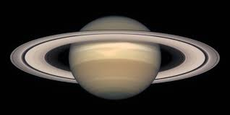
The Saturn Quiz
By
Madeline

Slide 2
What place is Saturn from the sun?
6
8

Slide 3
Oops, try again.

Slide 4
Good Work!

Slide 5
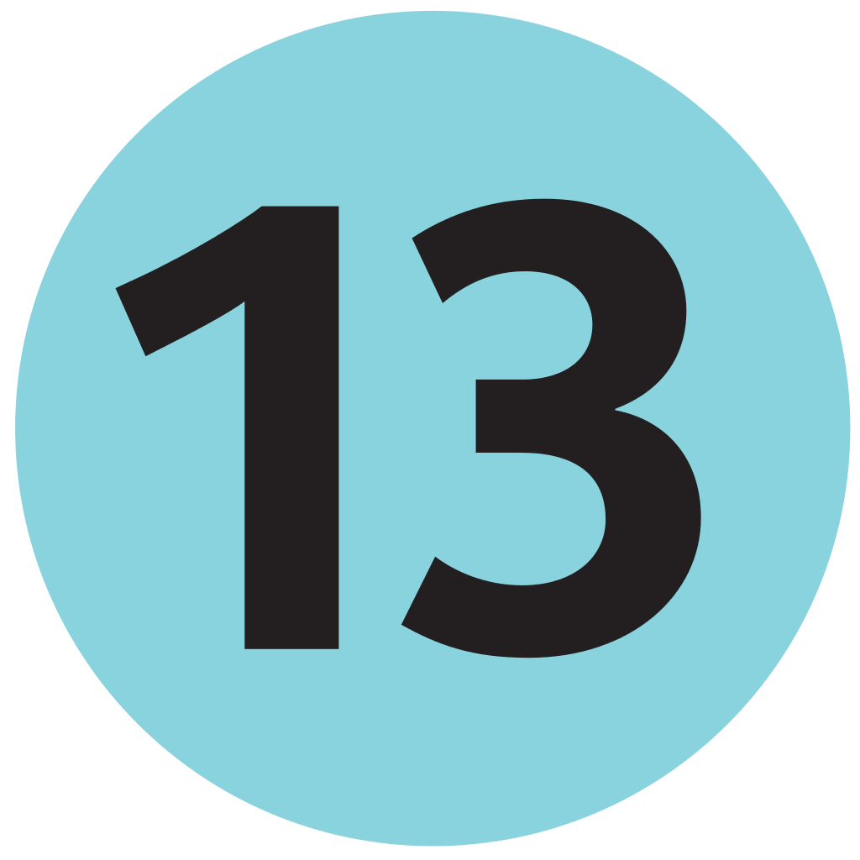
How many moons does Saturn have?
13
18

Slide 6
Good try! Try again.

Slide 7
Great Work!

Slide 8
You’re a Saturn expert!

