Slide 1
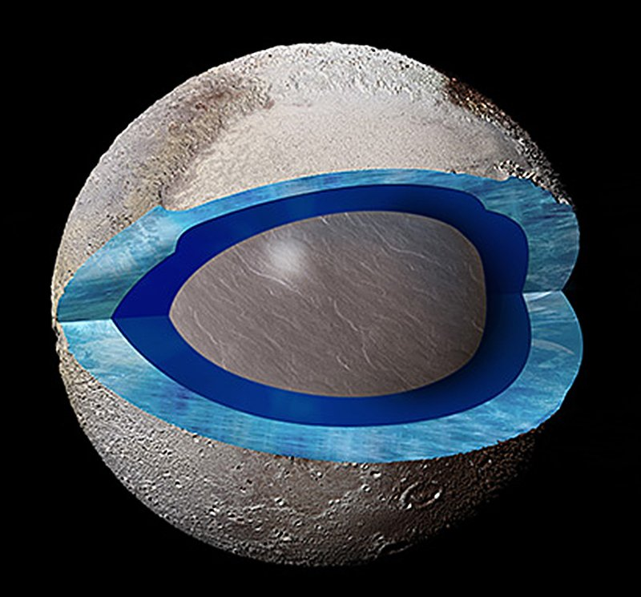
The Pluto Quiz
By
Link

Slide 2
How many miles is Pluto away from the sun?
1,430
800

Slide 3
Oops, try again.

Slide 4
Good Work!

Slide 5
What do scientists believe is on Pluto?
A volcano
An alien

Slide 6
Good try! Try again.

Slide 7
Great Work!

Slide 8
You’re a Pluto expert!

