Slide 1
The Narwhal Quiz
By
Lila

Slide 2
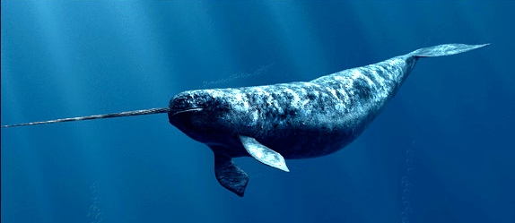
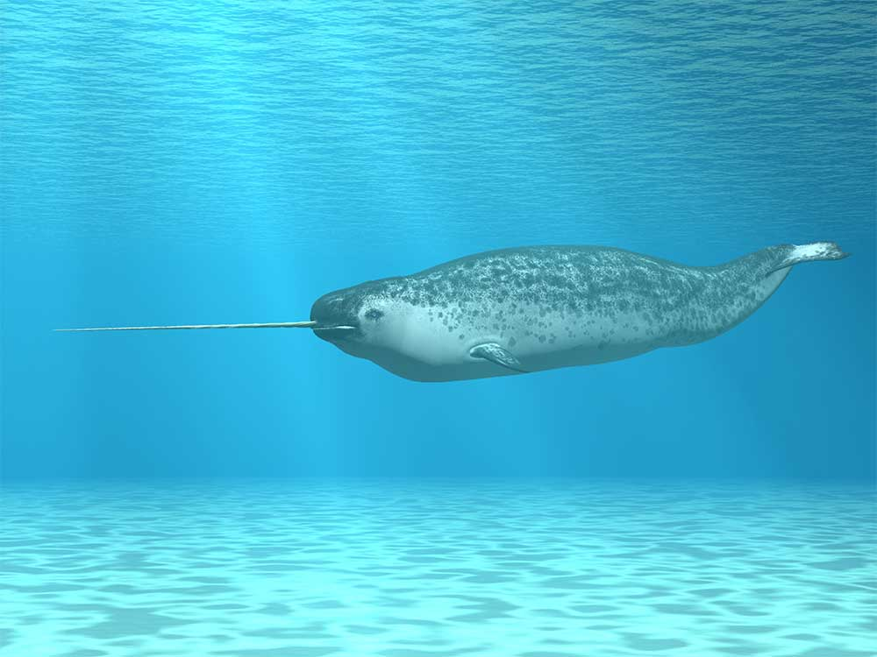
How much can a narwhal weigh?
4200 pounds
2000 pounds

Slide 3
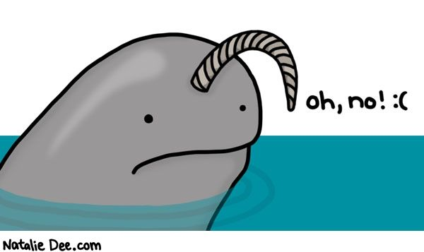
Whoops, try again.

Slide 4
Good Work!

Slide 5
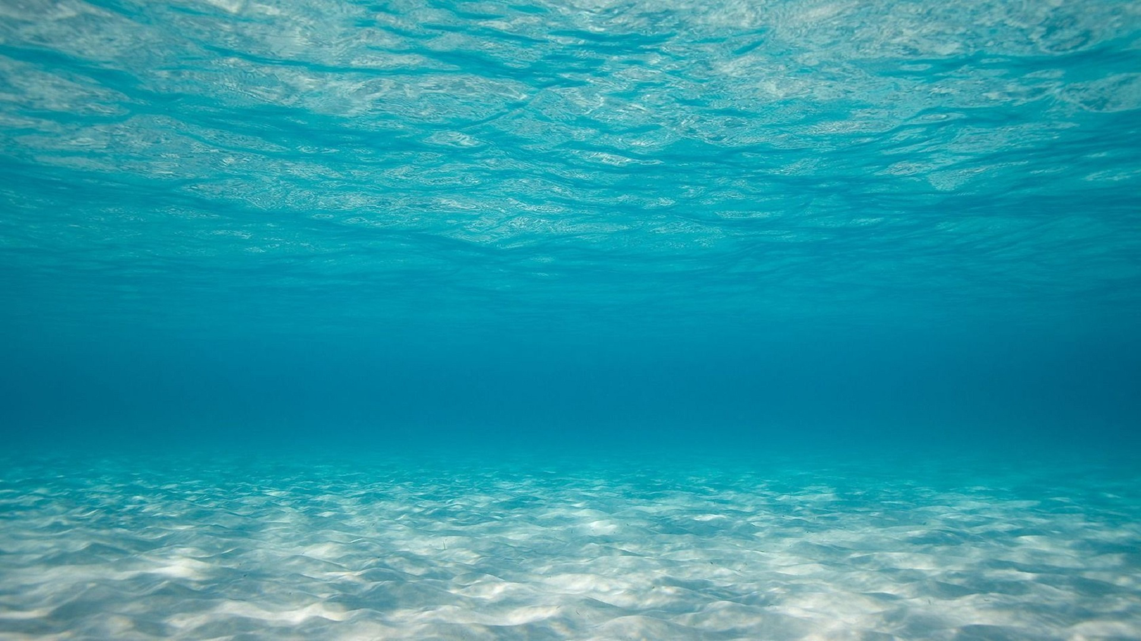
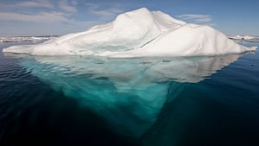
Do Narwhals hunt on land or in the sea?
Sea
land (iceberg)

Slide 6
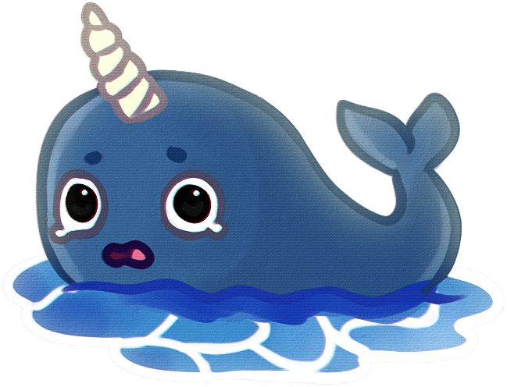
So close. Try again.

Slide 7
Great Work!

Slide 8
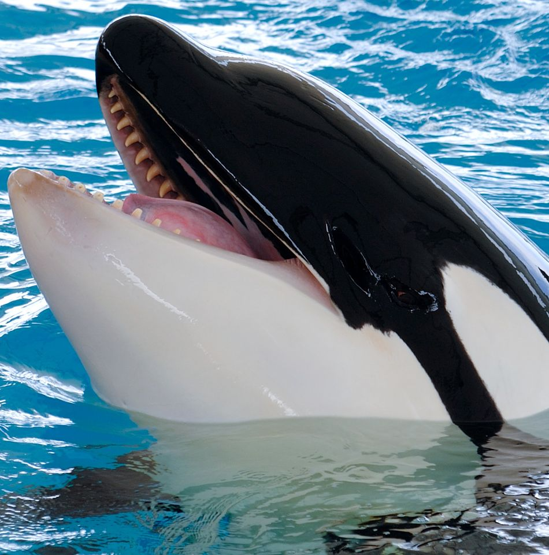
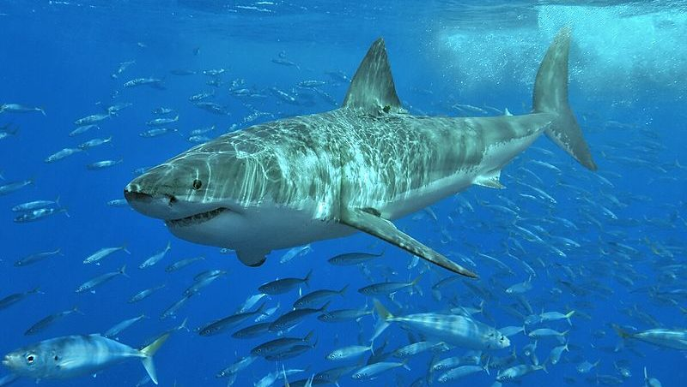
What’s a narwhals’ predator?
great white shark
killer whale

Slide 9
Please try again.

Slide 10
Good Job!

Slide 11
You’re a Narwhal expert!

