Slide 1
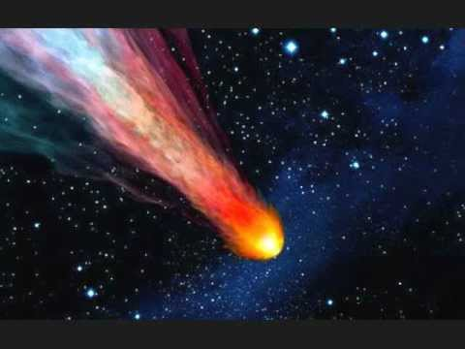
The Comet Quiz
By
Kristina

Slide 2
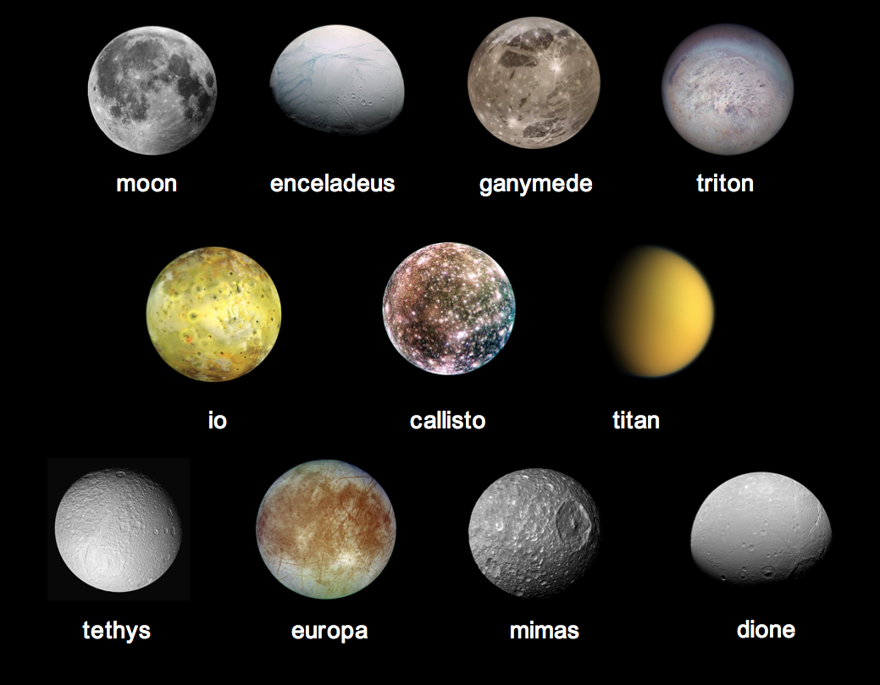
What do we call the dust and gas trail from the comet?
The comet’s tail
The comet’s cotton candy

Slide 3
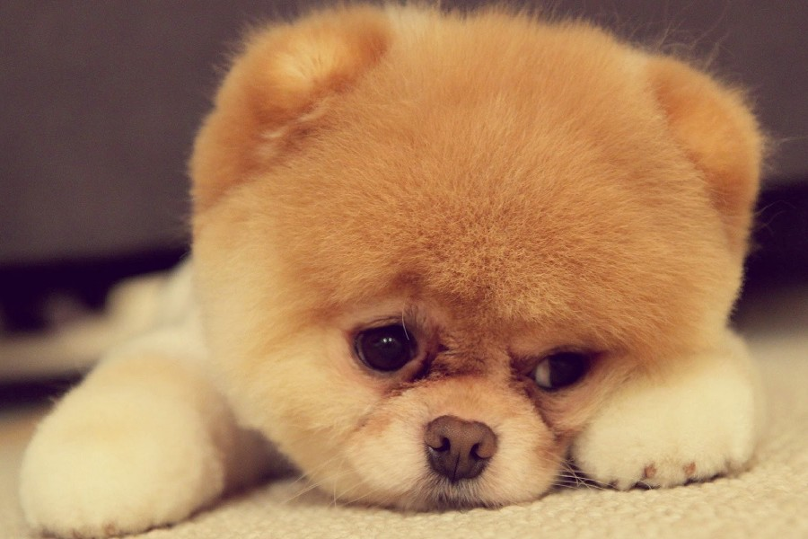
Oops, try again.

Slide 4
Good Work!

Slide 5
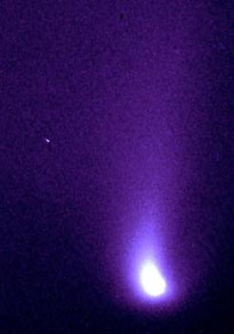
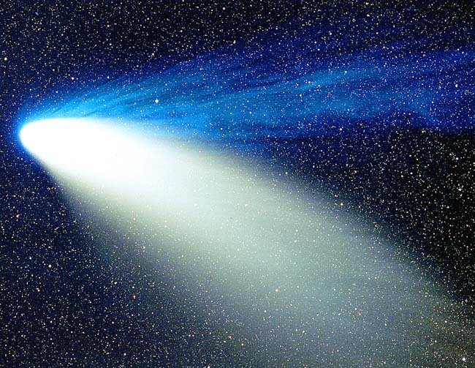
What is one of the best known comets?
Hale-Bopp
Cute comet

Slide 6
Good try! Try again.

Slide 7
Great Work!

Slide 8
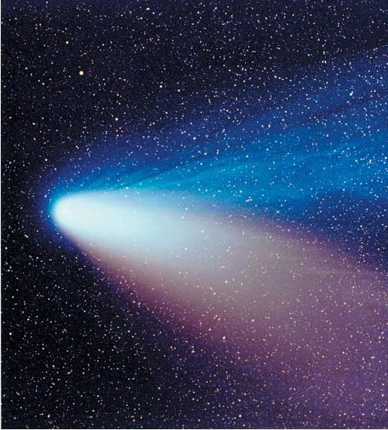
You’re a comet expert!

