Slide 1
The Blue Whales Quiz
By
Juliet

Slide 2
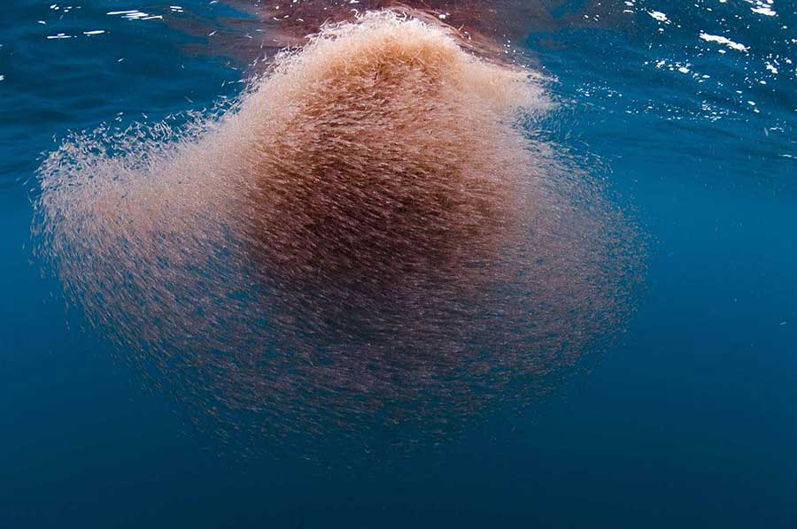
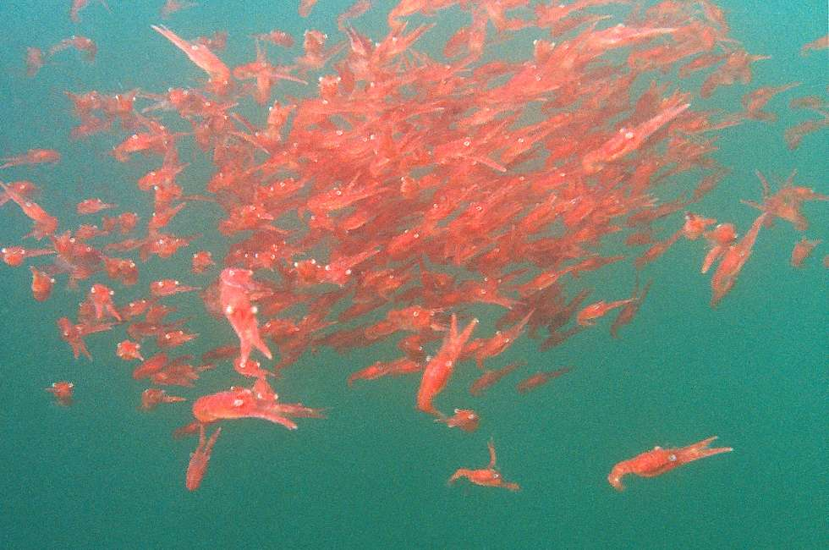
How many tons of krill does a Blue Whale need to eat each day?
4 tons
2 tons

Slide 3
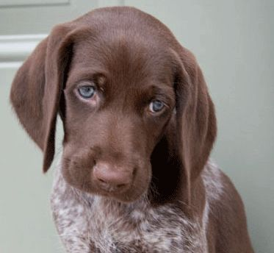
Oops, try again.

Slide 4
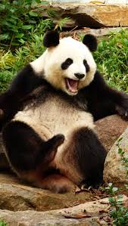
Good Work!

Slide 5
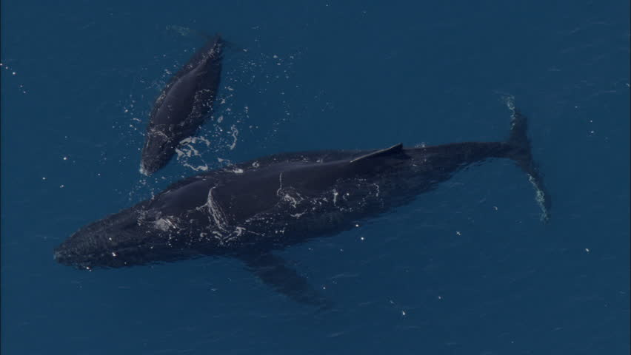
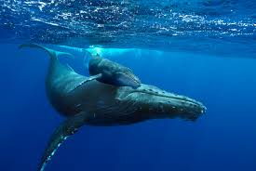
How long is a baby whale after a year in its mother?
25 feet
16 feet

Slide 6
Good try! Try again.

Slide 7
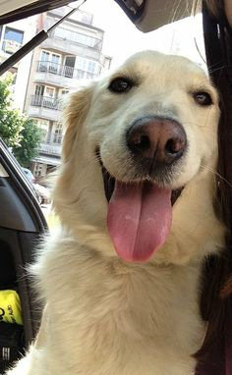
You did it! Good job!

Slide 8
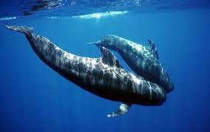
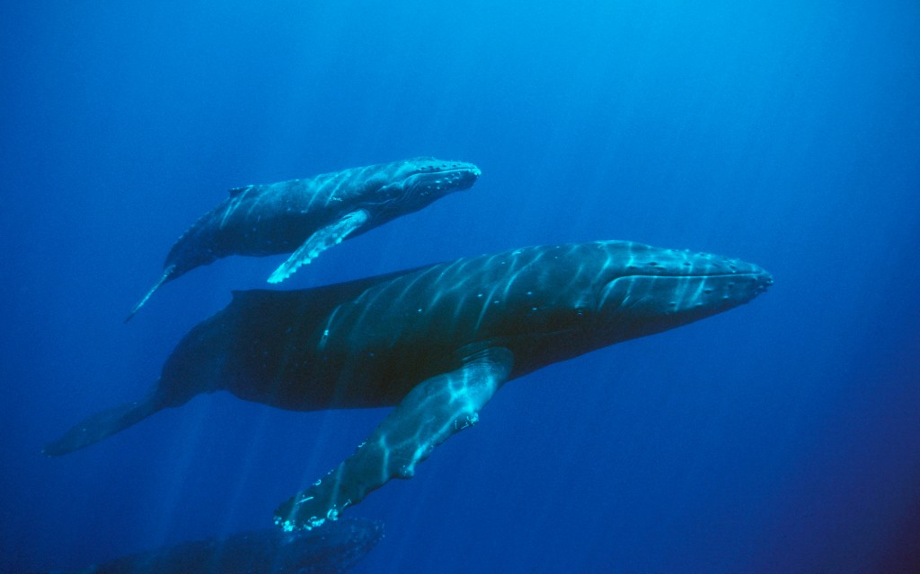
How many pounds does a baby whale gain with only its mother’s milk each day for a year?
126 pounds
200 pounds

Slide 9
Try again.

Slide 10
Good Job!

Slide 11
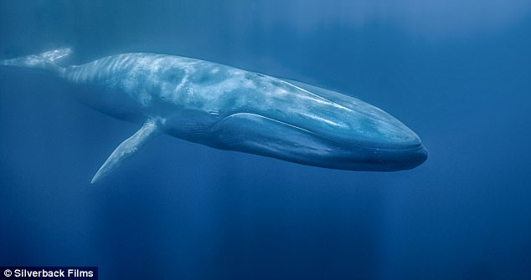
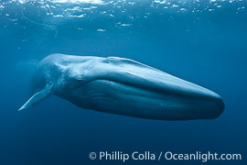
How loud is a Blue Whale’s call?
188 decibels
140 decibels

Slide 12
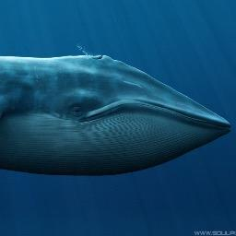
Sorry, try again.

Slide 13
Awesome job!

Slide 14
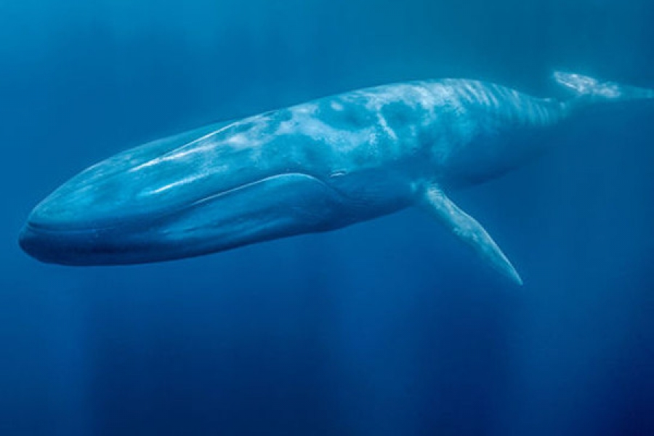
You’re a Blue Whale expert!

