Slide 1
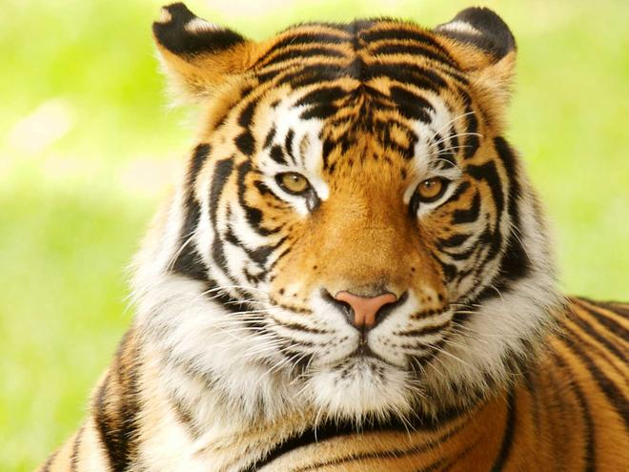
The Tiger Quiz
By
Isaac

Slide 2
Are tigers omnivores or carnivores?
Carnivores
Omnivores

Slide 3
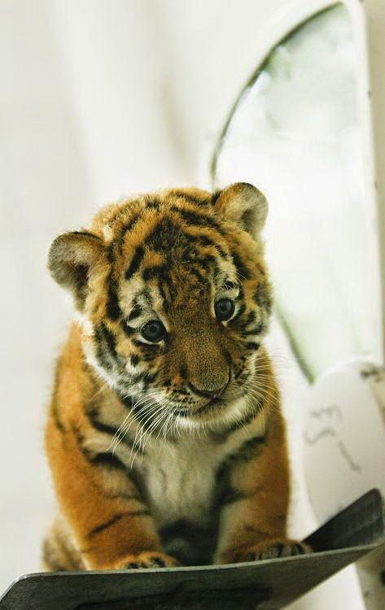
Oops, try again.

Slide 4
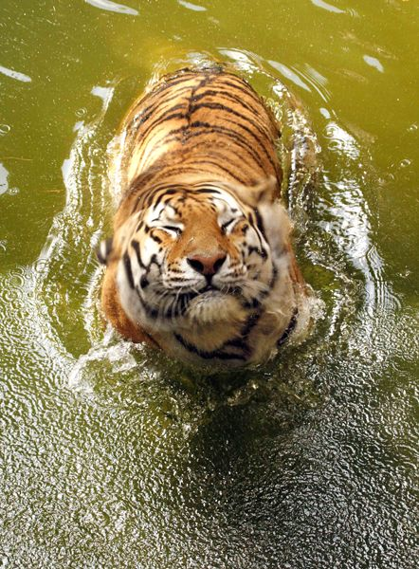
Good Work!

Slide 5
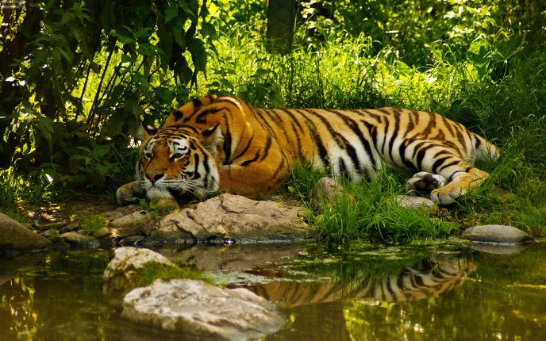
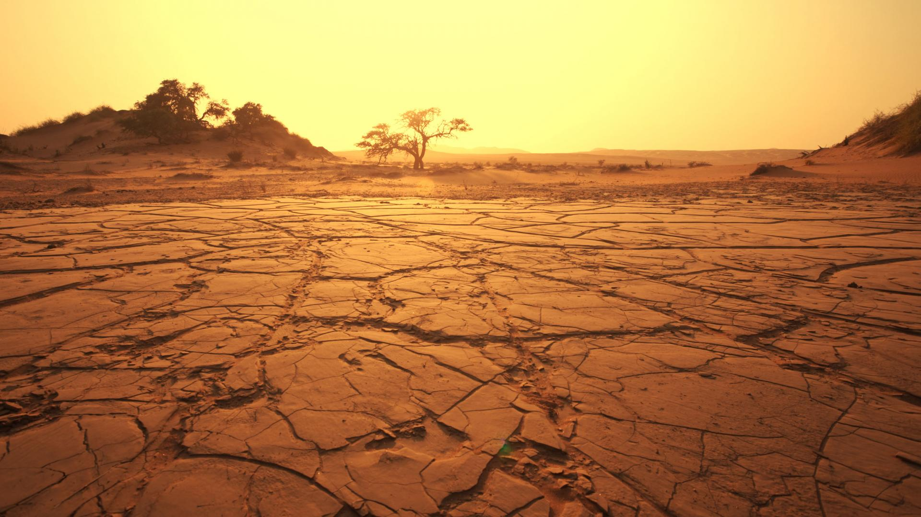
What kind of habitat do tigers live in?
Jungles, forests, mountains, grasslands
desert

Slide 6
Good try! Try again.

Slide 7
Great Work!

Slide 8
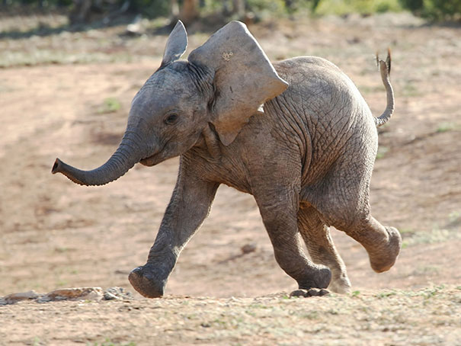
What do tigers look like?
Rhinos, deer, wild pigs and young elephants
trees, cupcakes, tables

Slide 9
Please try again.

Slide 10
Good Job!

Slide 11
You’re a tiger expert!

