Slide 1
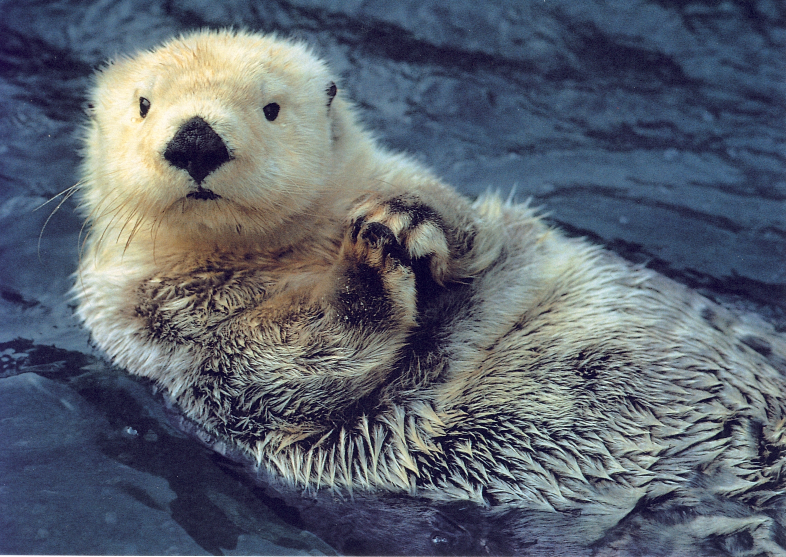
The Sea Otter Quiz
By
Harper

Slide 2
What color are sea otters’ feet?
green
black

Slide 3
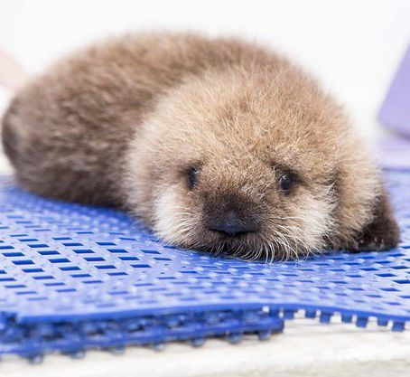
Whoops, try again.

Slide 4
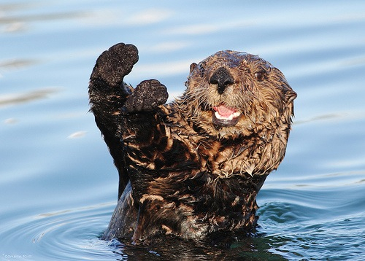
Good Work!

Slide 5
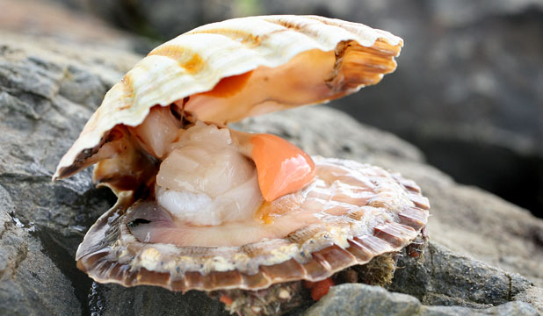
What do sea otters eat?
shellfish
grass

Slide 6
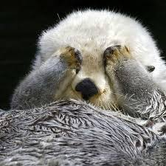
Good try! Try again.

Slide 7
Great Work!

Slide 8
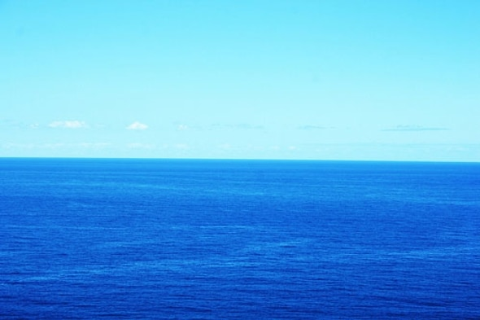
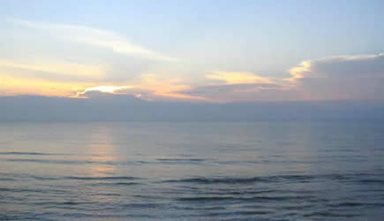
Where do sea otters live?
Pacific Ocean
Atlantic Ocean

Slide 9
Please try again.

Slide 10
Good Job!

Slide 11
You’re a sea otter expert!

