Slide 1
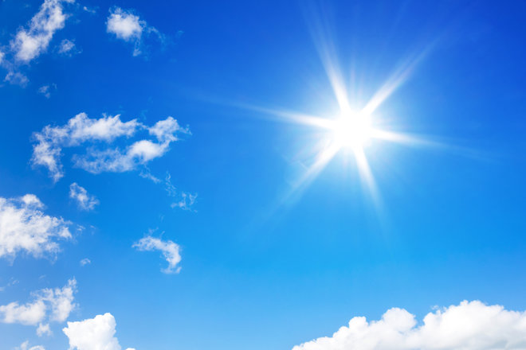
The Sun Quiz
By
Gabby

Slide 2
Is the Sun the center of our solar system?
Yes
No

Slide 3
Whoops! Try again.

Slide 4
You did it!

Slide 5
Is the Sun the closest star to Earth?
Yes
No

Slide 6
So close! Try again.

Slide 7
Great Work!

Slide 8
You’re a sun expert!

