Slide 1
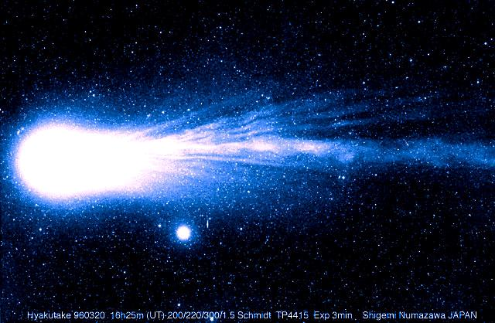
The Comet Quiz
By
Emma

Slide 2
What makes a comet’s trail dust or water?
Dust
water

Slide 3
Oops, try again.

Slide 4
Good Work!

Slide 5
Are comets and asteroids the same thing?
No
yes

Slide 6
Good try! Try again.

Slide 7
Great Work!

Slide 8
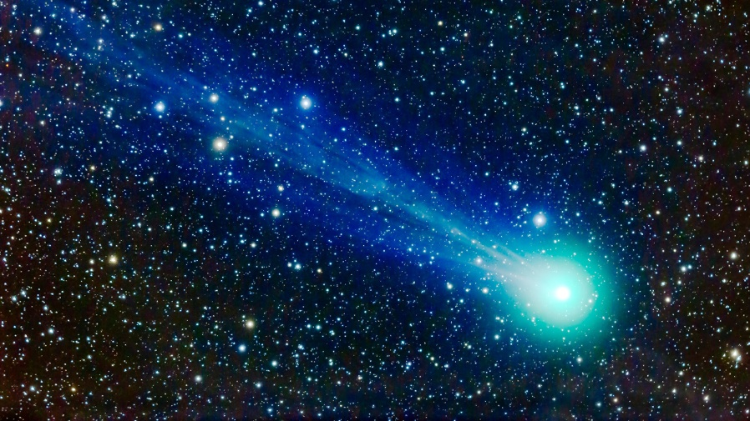
What are comets made out of?
Glitter, rock, and dust
Ice, dust, and rock

Slide 9
Please try again.

Slide 10
Good Job!

Slide 11
You’re a comet expert!

