Slide 1
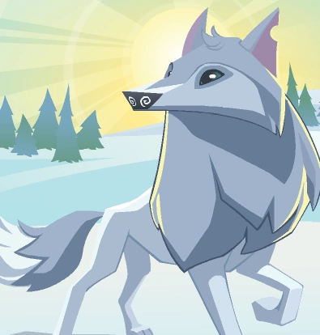
The Arctic Wolf Quiz
By
Destiny

Slide 2
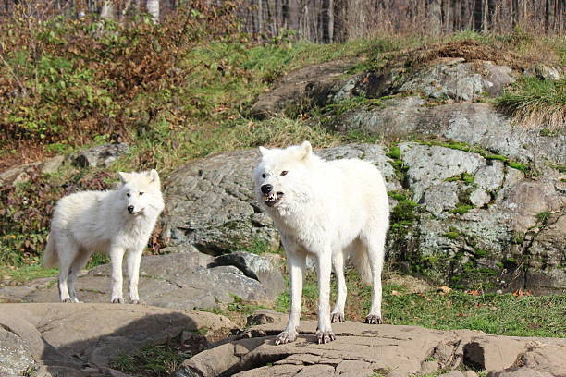
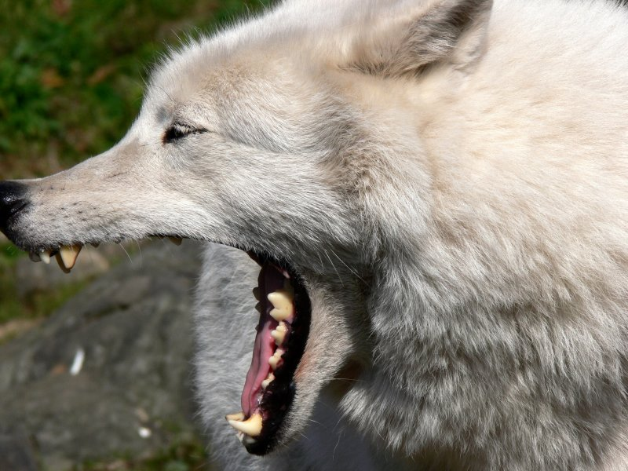
Do arctic wolves have 42 sharp teeth?
No, they have 28.
Yes, they do.

Slide 3
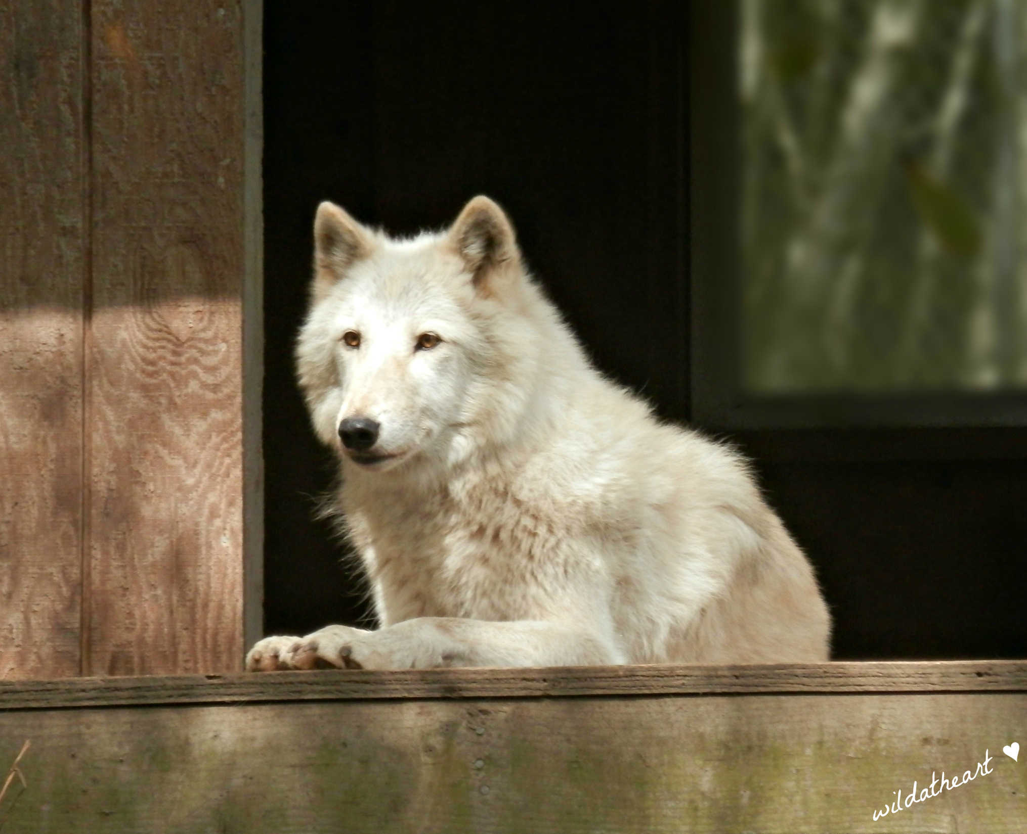
Oops, try again.

Slide 4
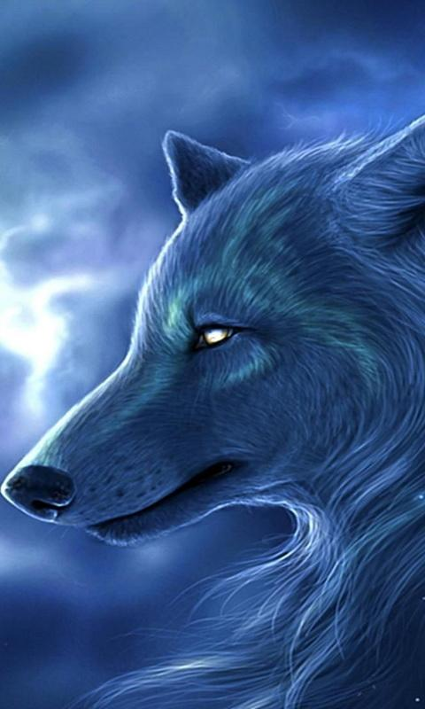
Good Work!

Slide 5
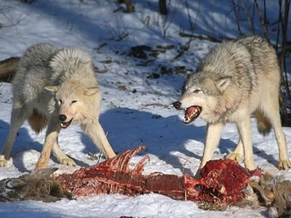
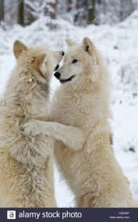
What do they eat?
hares and lemmings
They eat each other.

Slide 6
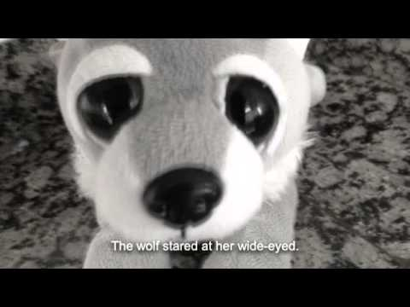
Good try! Try again.

Slide 7
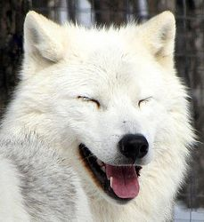
Great Work!

Slide 8
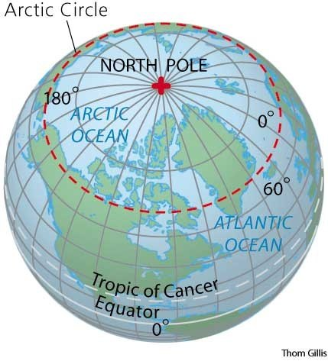
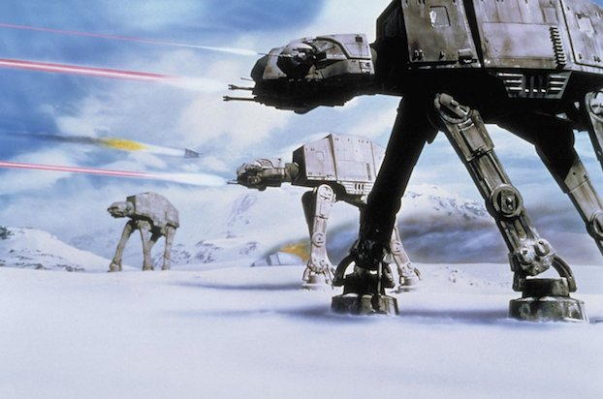
Where do they live?
The arctic circle
South Pole

Slide 9
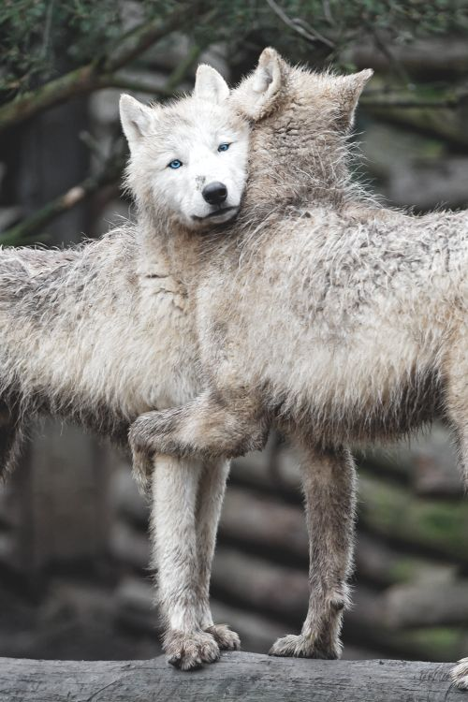
Please try again.

Slide 10
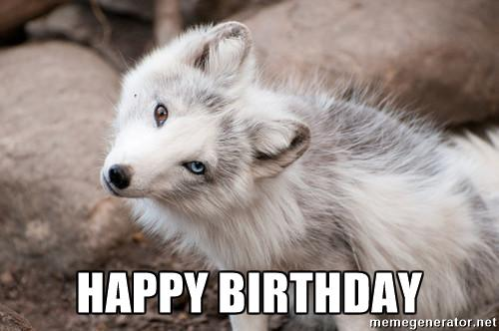
Good Job!

Slide 11
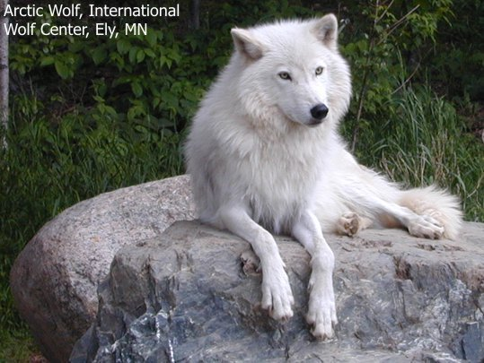
You’re an Artic Wolf expert!

