Slide 1
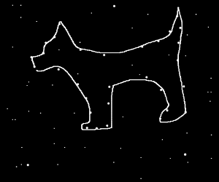
Canis Major: The Dog Constellation
By
Destiny

Slide 2
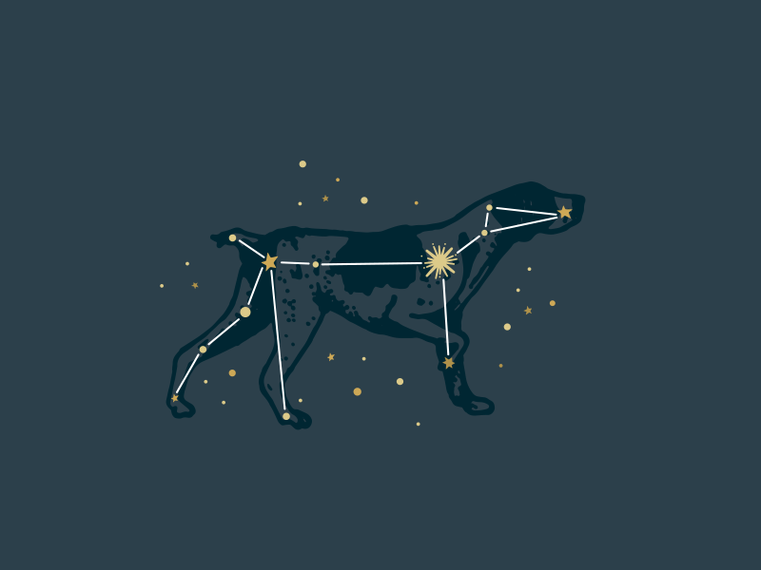
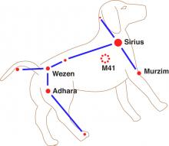
Is the brightest star (Sirius) in Canis Major a double star?
Yes
No

Slide 3
Oops, try again.

Slide 4
Good Work!

Slide 5
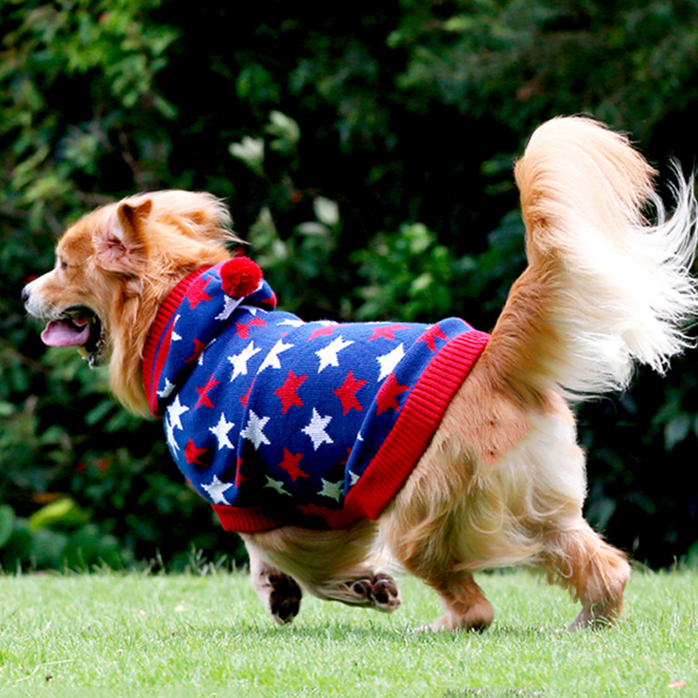
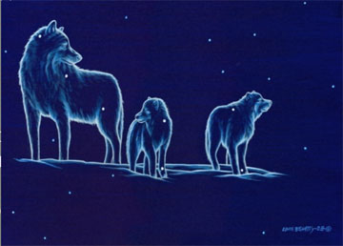
Is the brightest star (Sirius) in Canis Major 20 times brighter than our sun?
Yes
No

Slide 6
Good try! Try again.

Slide 7
Great Work!

Slide 8
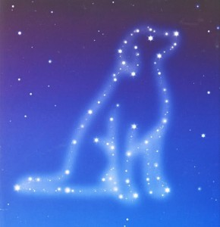
You’re a Dog Star expert.

