Slide 1
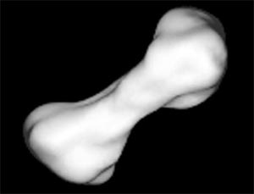
The Asteroid Kleopatra Quiz
By
Cordelia

Slide 2
How many moons does Asteroid Kleopatra have?
2 moons
3 moons

Slide 3
Whoops! Try again.

Slide 4
You did it!

Slide 5
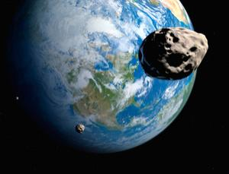
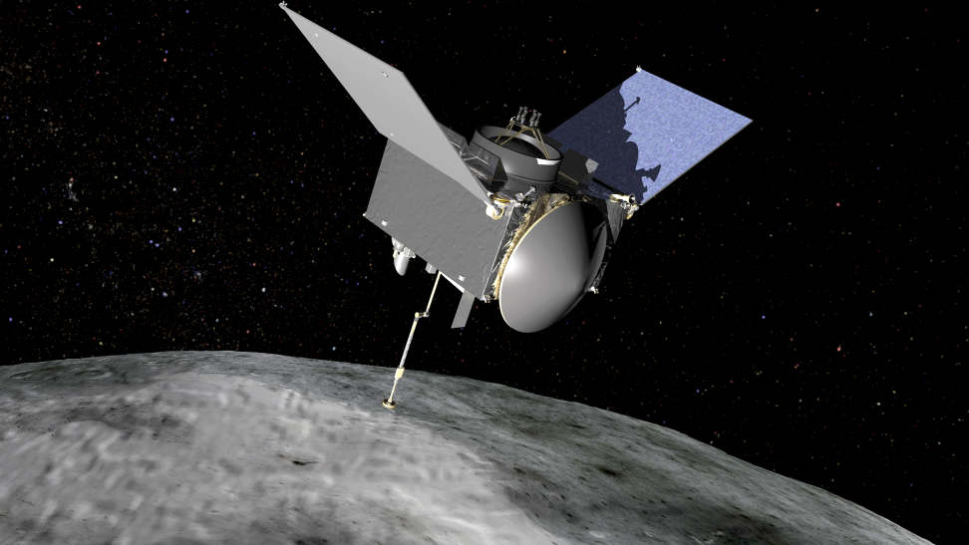
How long does it orbit for?
1,705 days
4 days

Slide 6
So close! Try again.

Slide 7
Great Work!

Slide 8
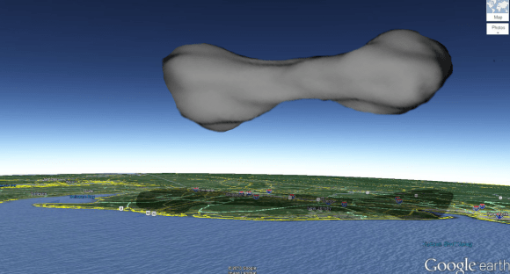
You’re an Asteroid Kleopatra expert!

