Slide 1
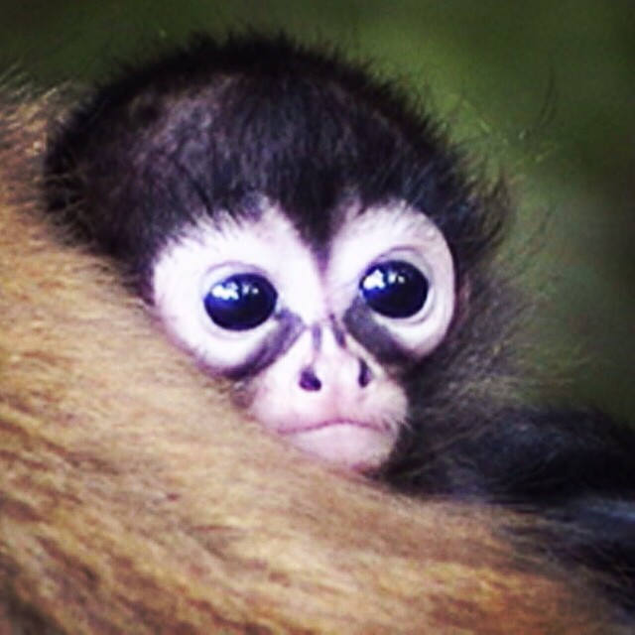
The Monkey Quiz
By
Clara

Slide 2
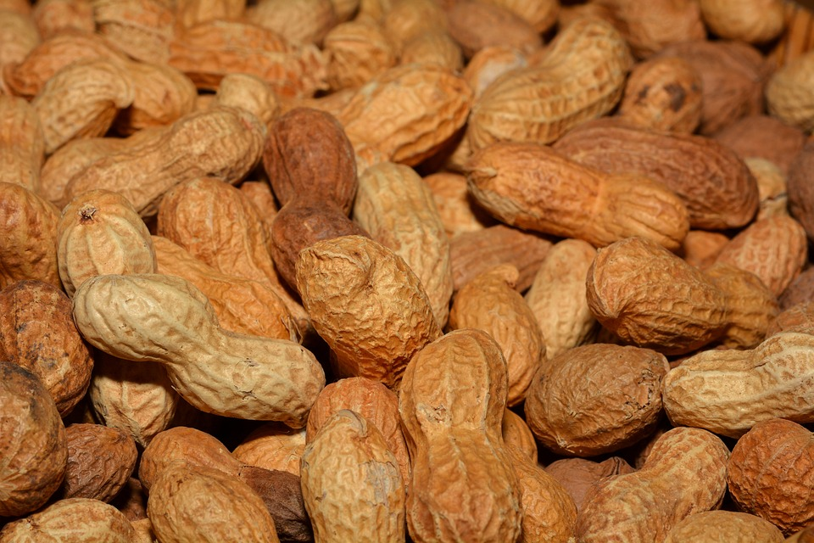
Do Monkeys eat bananas or peanuts?
Peanuts
Bananas

Slide 3
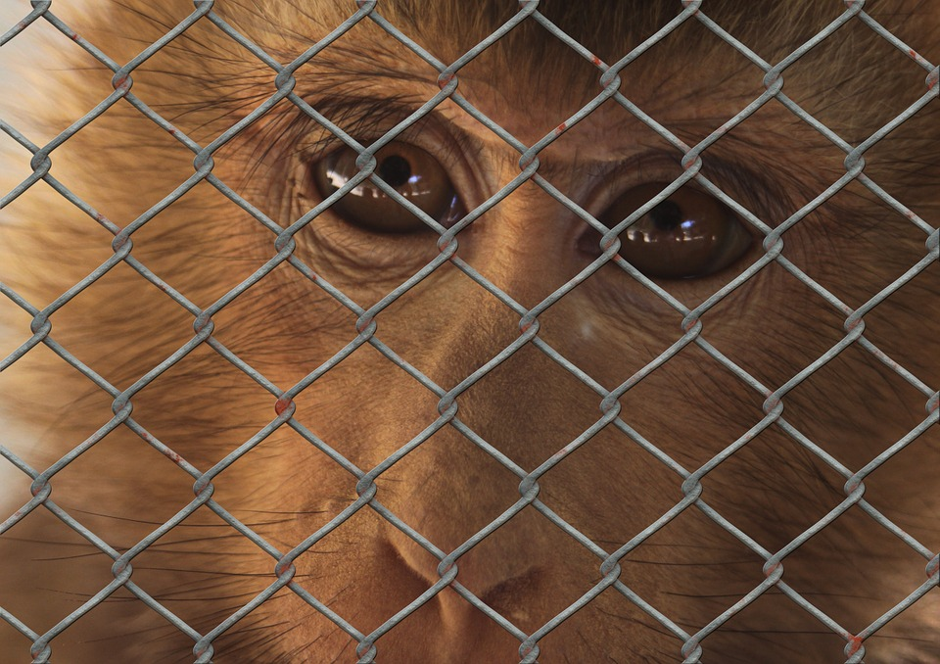
Oops, try again.

Slide 4
Good Job!

Slide 5
Are there two major groups of monkeys or seven major groups of monkeys?
Two
Seven

Slide 6
Good try! Try again.

Slide 7
Good Job!

Slide 8
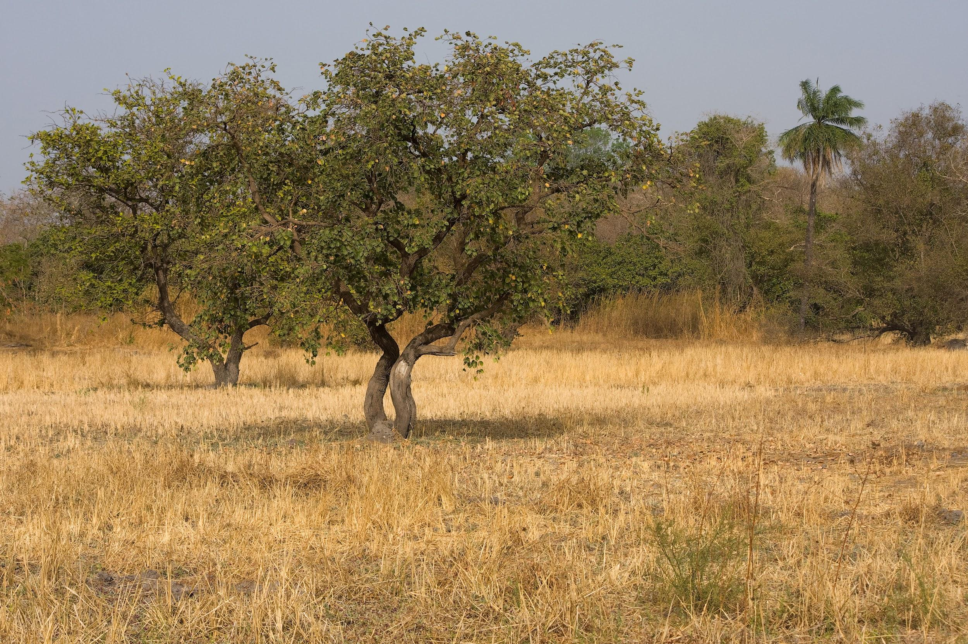
Do Monkeys live in Savannas and Tropical Forests or Deserts?
Savannas/Tropical Forests
Deserts

Slide 9
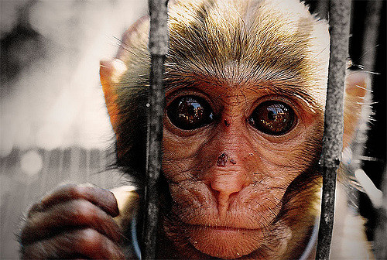
Please try again.

Slide 10
Good Job!

Slide 11
Thank You For Playing!

