Slide 1
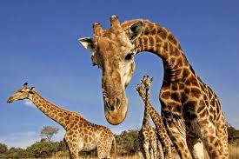
The Giraffe Quiz
By
Brett

Slide 2
What do giraffes eat?
leaves
meat

Slide 3
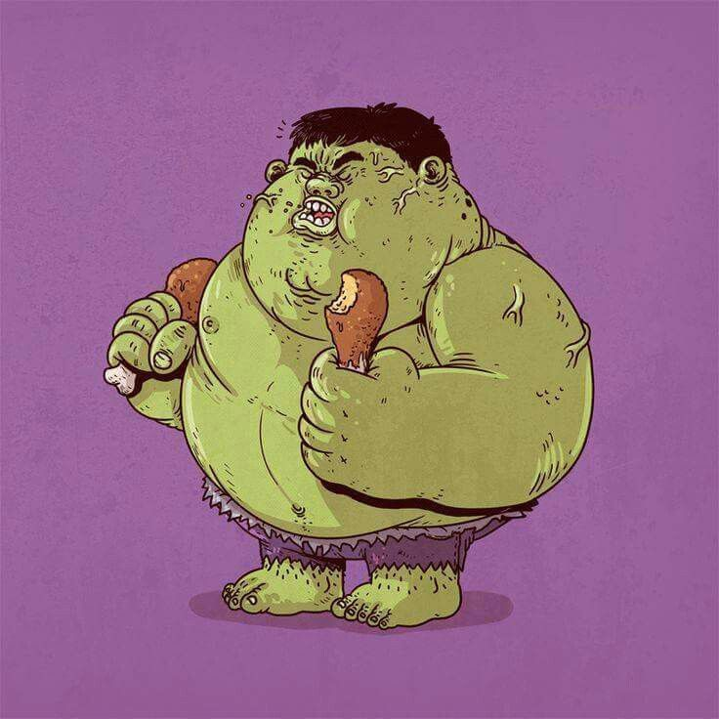
Oops, try again.

Slide 4
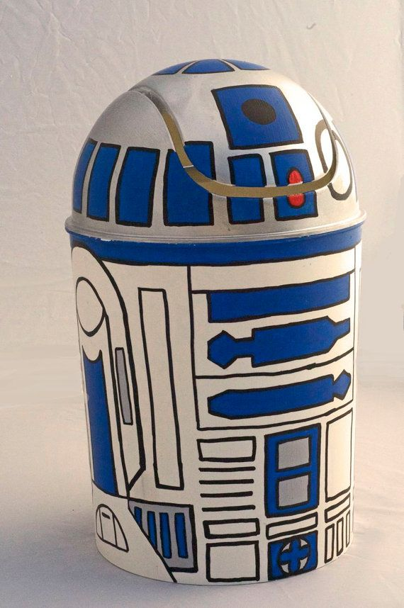
Good Work!

Slide 5
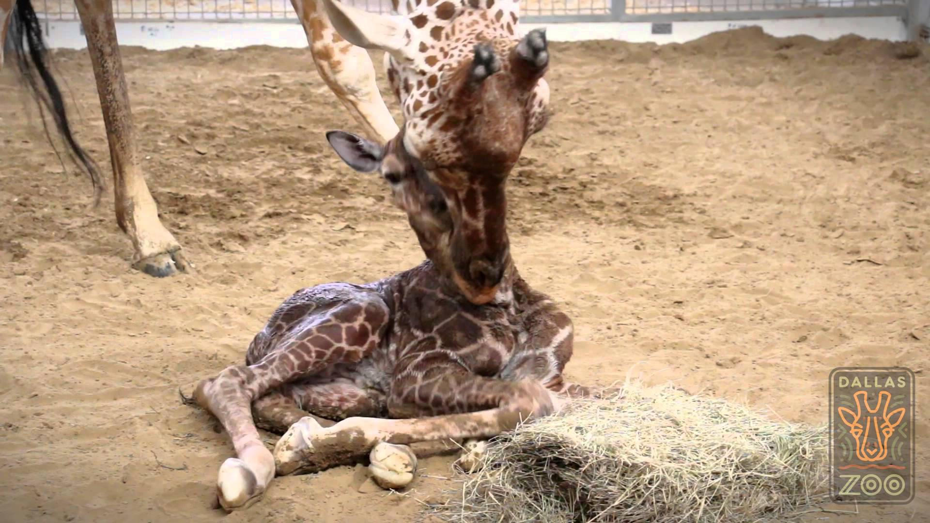
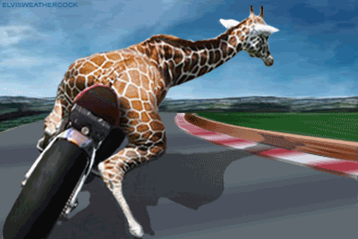
Are giraffes tall or small?
small
tall

Slide 6
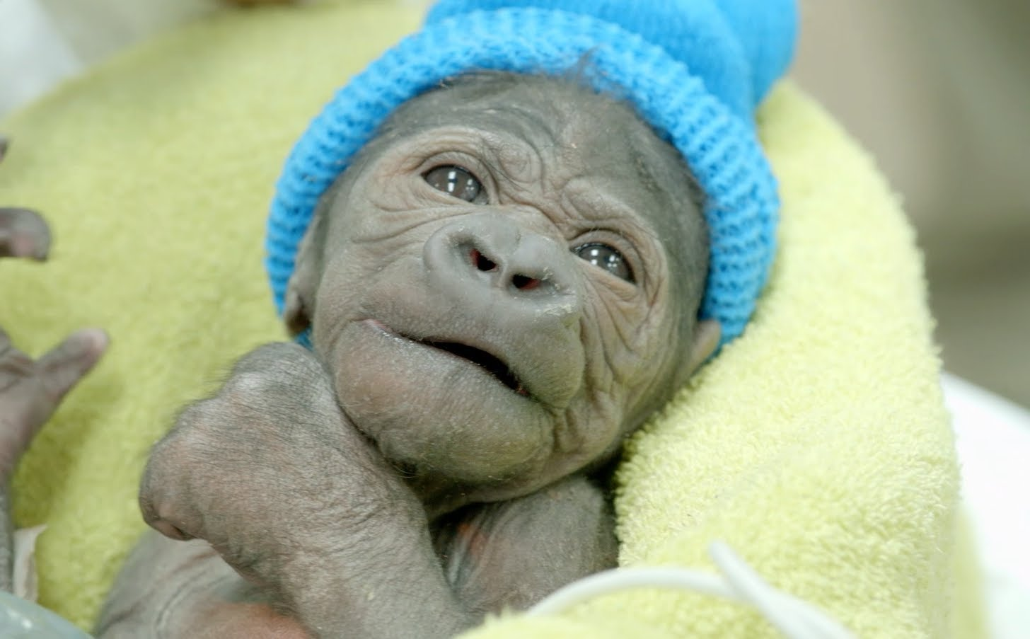
Try again.

Slide 7
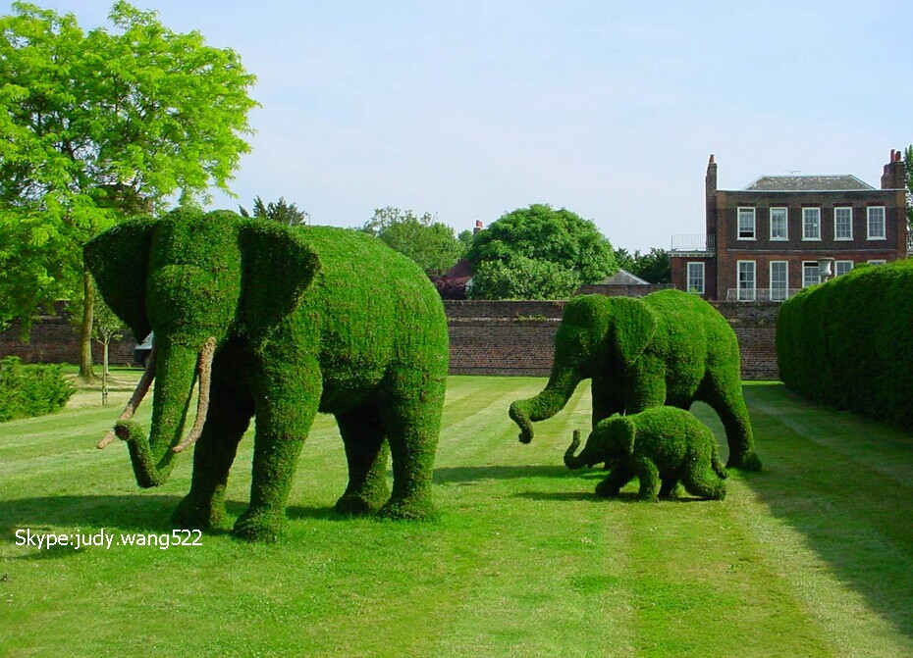
Great!

Slide 8
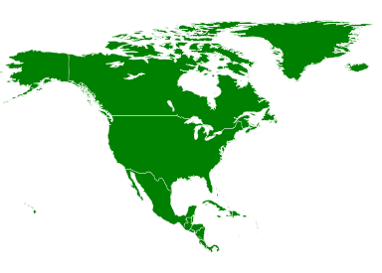
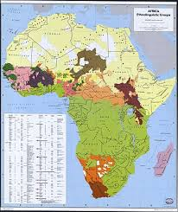
Where do giraffes live?
North America
Africa

Slide 9
Please try again.

Slide 10
Good Job!

Slide 11
You’re a giraffe expert!

