Slide 1
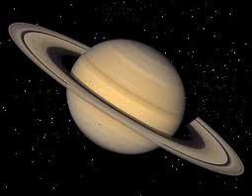
The Saturn Quiz
By
Brett

Slide 2
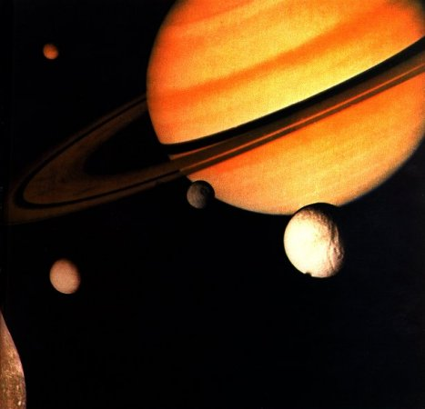
How many moons does Saturn have?
Less than 20 moons
Over 60 moons

Slide 3
Oops, try again.

Slide 4
Good Work!

Slide 5
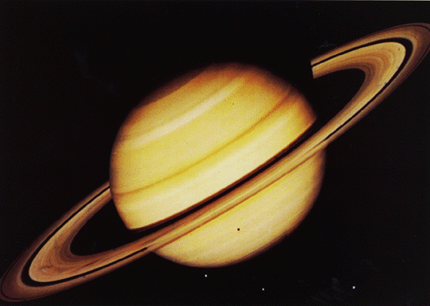
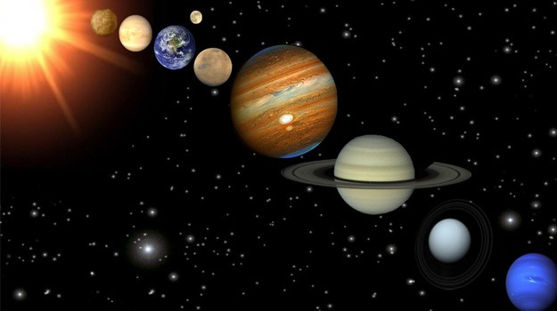
What has made Saturn “Jewel of the solar system”?
How far away it is from the sun
Its rings and golden color

Slide 6
Good try! Try again.

Slide 7
Great Work!

Slide 8
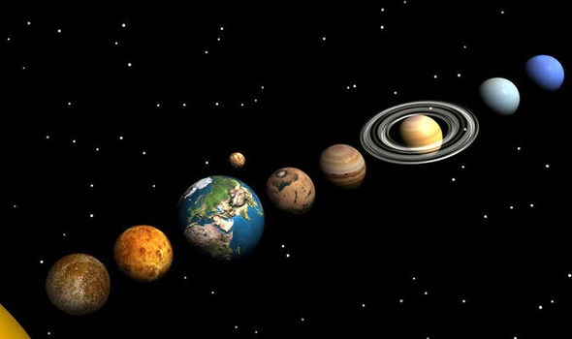
You’re a Saturn expert!

