Slide 1
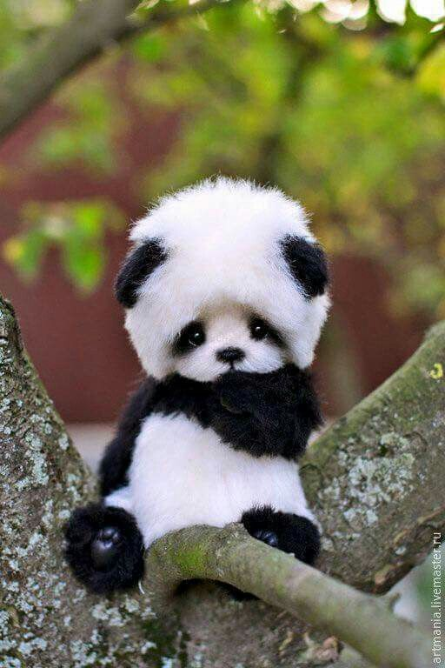
The Giant Panda Quiz
By
Autumn

Slide 2
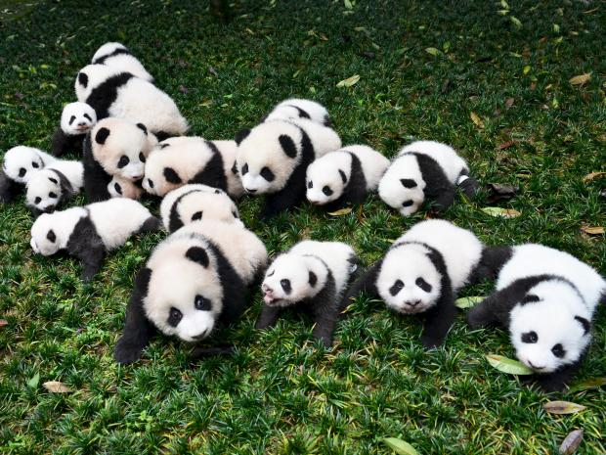
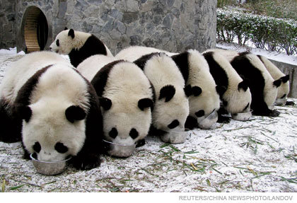
How many pandas live in the wild?
1,864
1,856

Slide 3
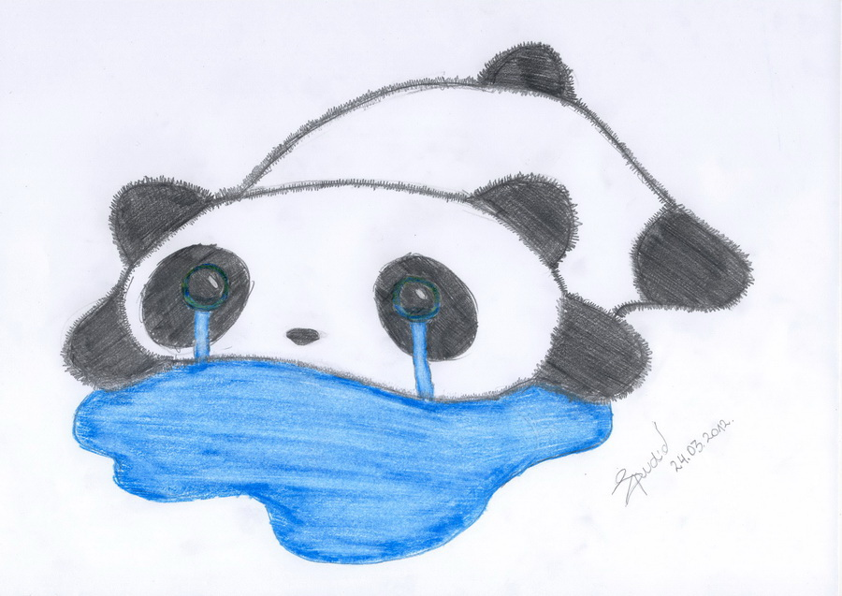
Oops, try again.

Slide 4
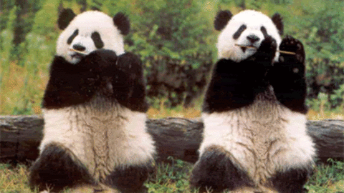
Panda says great work!

Slide 5
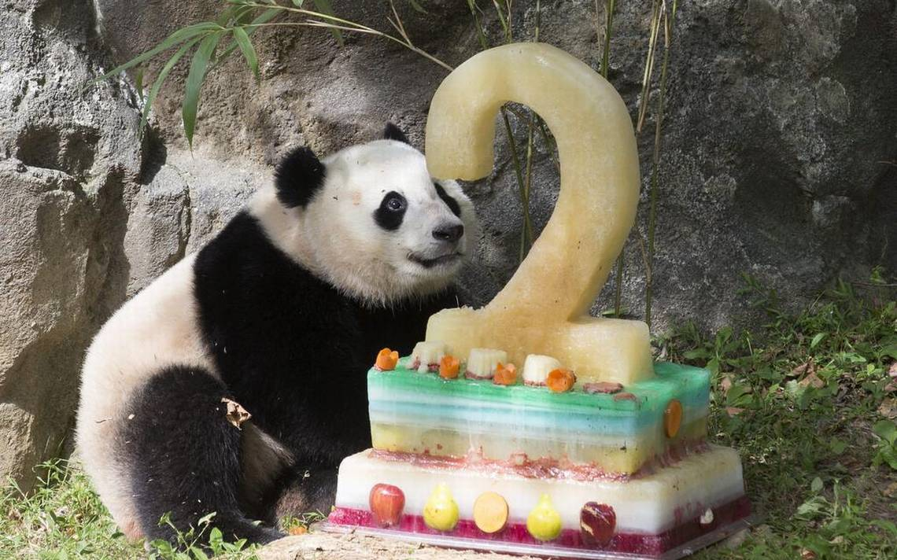
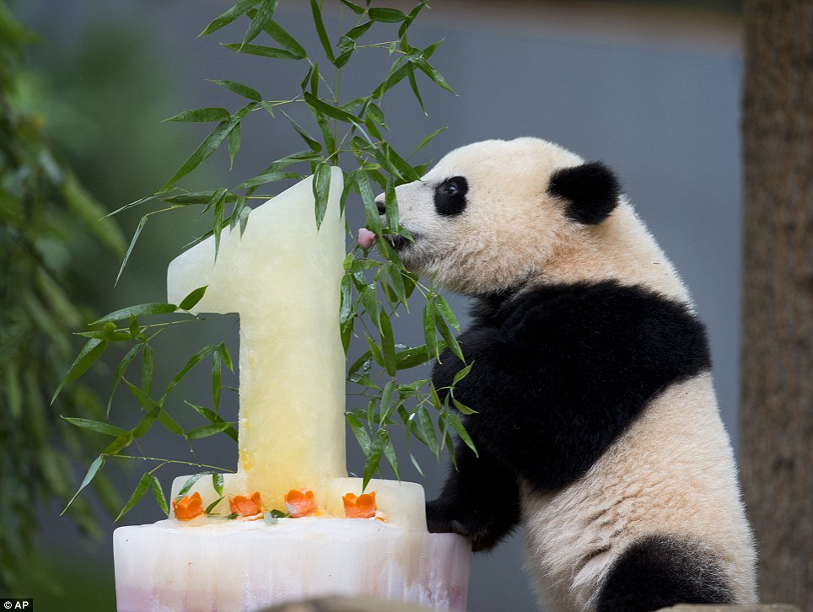
How long is a giant panda’s life span?
20 years
12 years

Slide 6
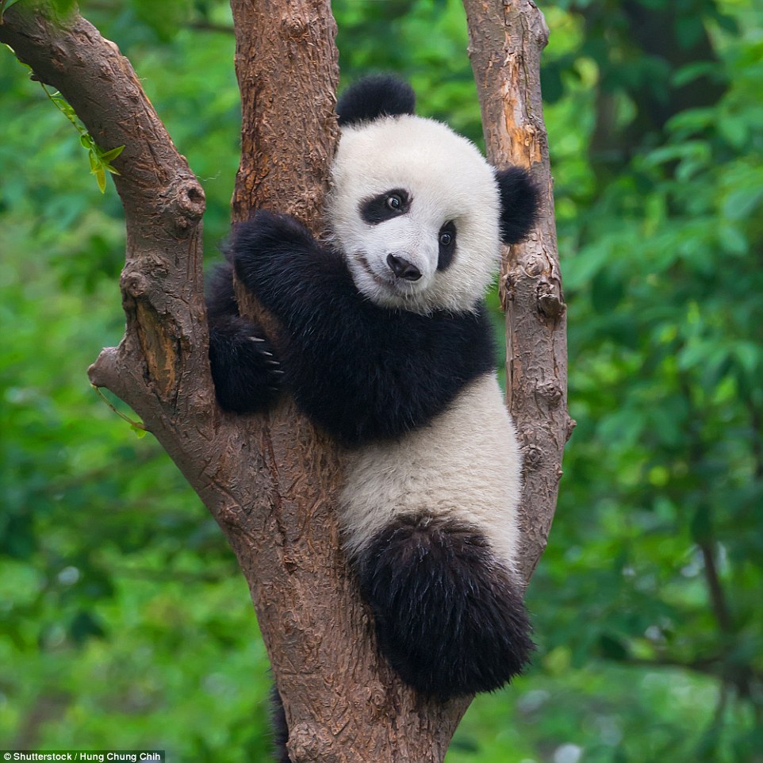
Good try! Try again.

Slide 7
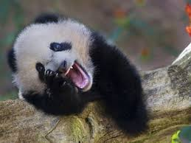
You made a panda happy!

Slide 8
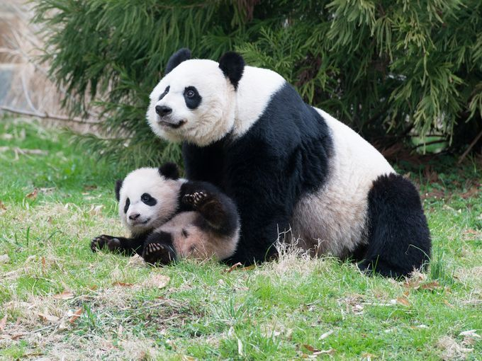
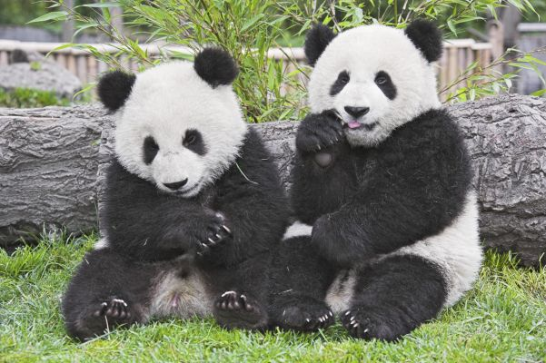
How long does a baby panda stay with its mom?
24 months
18 months

Slide 9
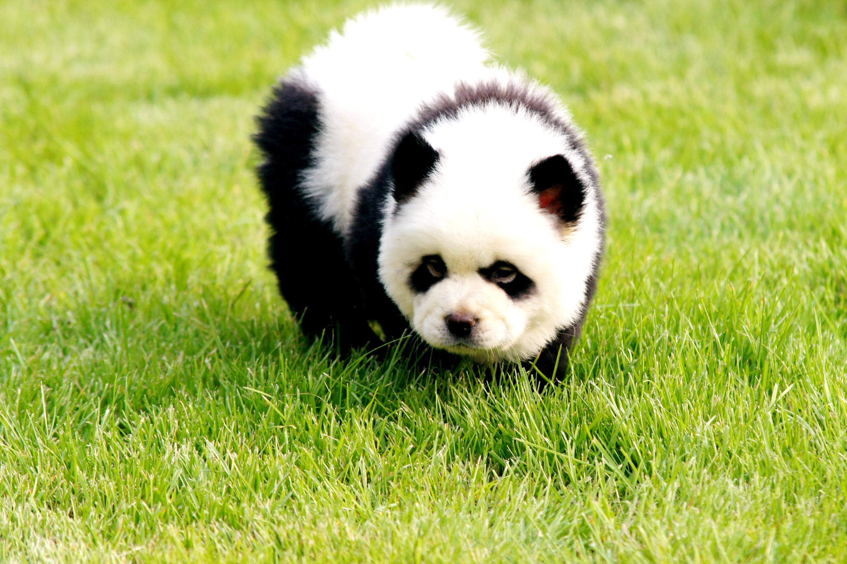
Panda is sad. Please try again.

Slide 10
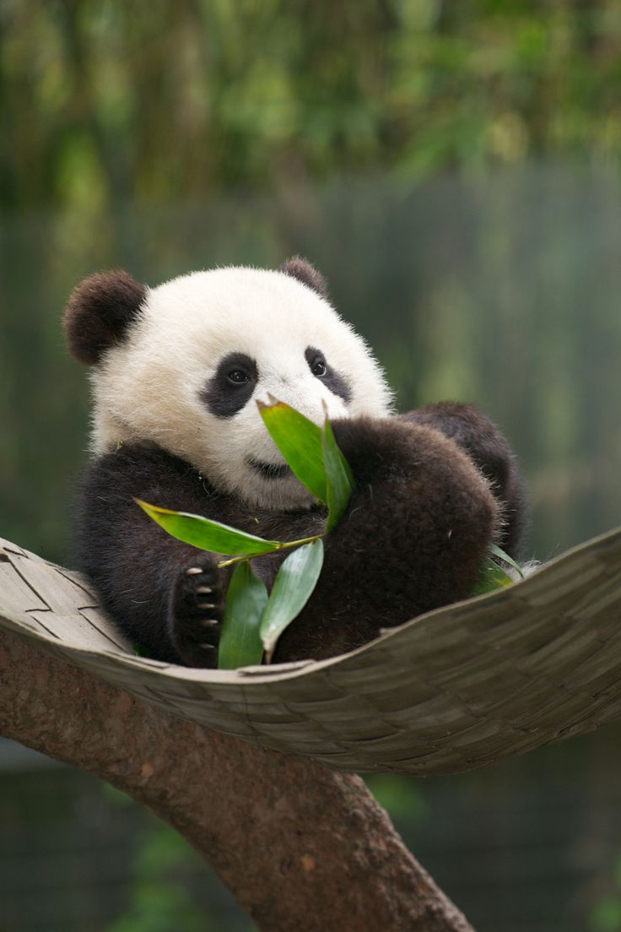
Panda loves you!

Slide 11
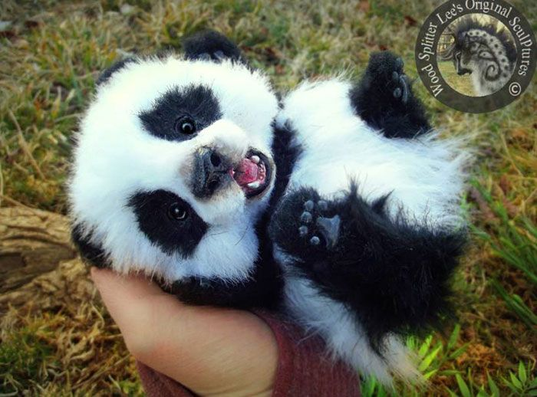
You’re a giant panda expert!

