Slide 1
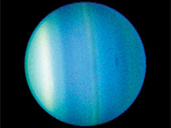
The Uranus Quiz
By
Autumn

Slide 2
How long does it take for Uranus to go around the sun one time?
84 Earth years
42 years

Slide 3
Oops, try again.

Slide 4
Good Work!

Slide 5
Why does Uranus look like it is rolling on it side?
Because space can’t hold it up.
Uranus got crashed into with a big rock.

Slide 6
Good try! Try again.

Slide 7
Great Work!

Slide 8
How many years of daytime and nighttime?
42 years of nighttime and 42 years of daytime
32 years on nighttime and 39 years of daytime

Slide 9
Please try again.

Slide 10
Good Job!

Slide 11
You’re a Uranus expert!

