Slide 1
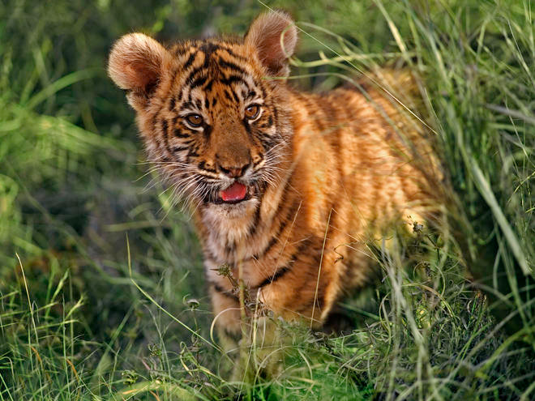
The Tiger Quiz
By
Anastasia

Slide 2
Do tigers have black stripes?
Yes
No

Slide 3
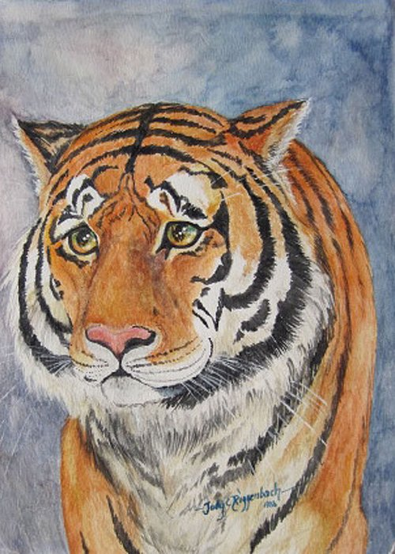
Whoops, try again.

Slide 4
Good Work!

Slide 5
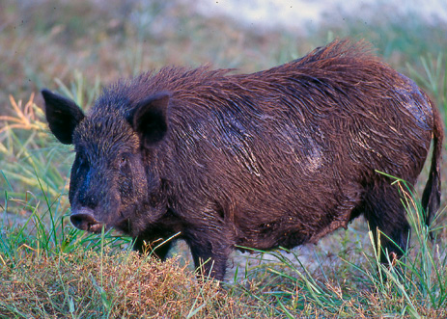
What do tigers eat?
Wild Pigs
Hot dogs and cake

Slide 6
Good try! Try again.

Slide 7
Great Work!

Slide 8
Where do tigers live?
Grasslands
In the city

Slide 9
Please try again.

Slide 10
Good Job!

Slide 11
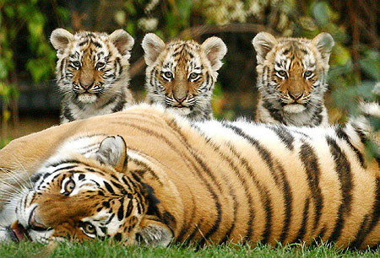
What family do the tigers belong to?
The cat family
Tigers are fish.

Slide 12
Try Again!

Slide 13
Grrrrreat job!

Slide 14
Thanks for playing!

