Slide 1
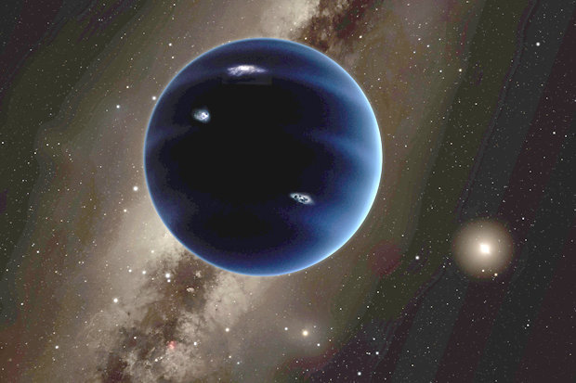
The Planet 9 Quiz
By
Alex

Slide 2
Is Planet 9 10 times Earth’s mass?
Yes
No

Slide 3
Oops, try again.

Slide 4
Good Work!

Slide 5
Has Planet 9 tilted the other planets over the lifetime of the solar system?
Yes
No

Slide 6
Good try! Try again.

Slide 7
Great Work!

Slide 8
You’re a Planet 9 expert.

