Slide 1
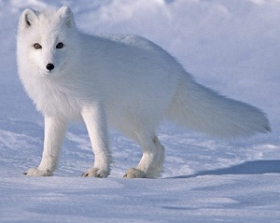
The Arctic Fox Quiz
By
Abi

Slide 2
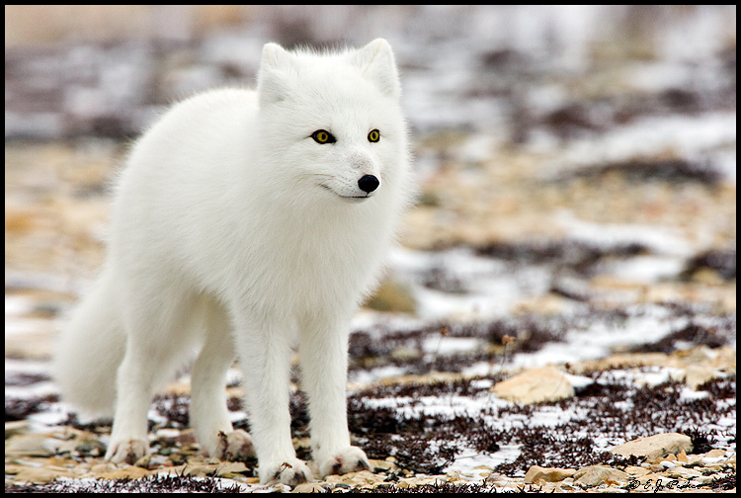
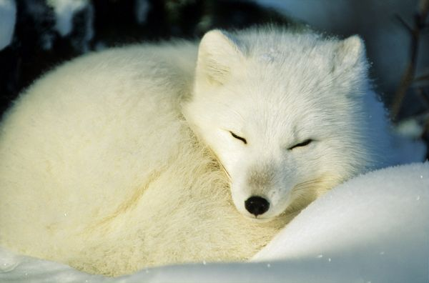
Do Arctic Foxes hibernate?
No
Yes

Slide 3
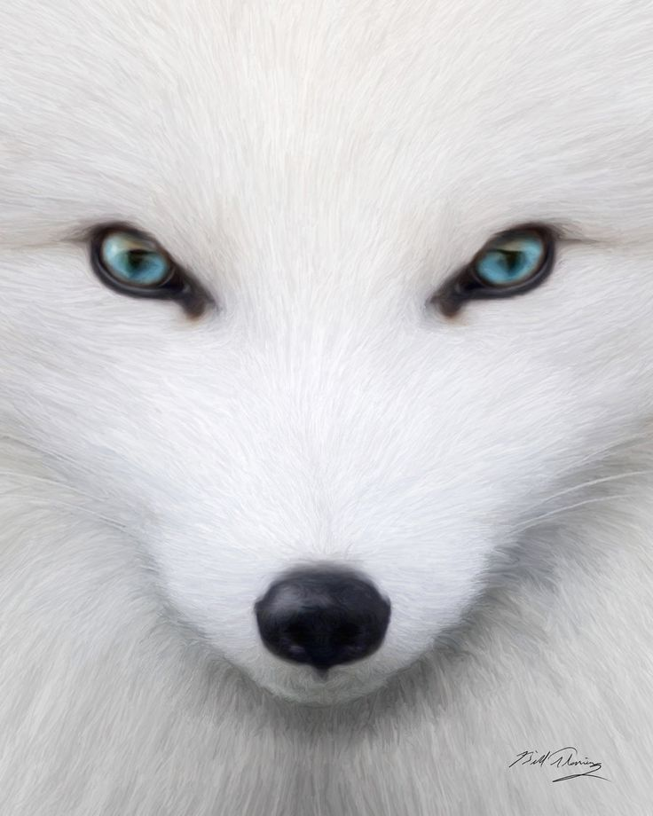
Arctic Fox is MAD.

Slide 4
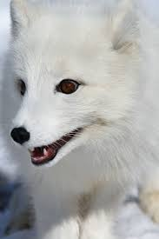
Arctic Fox is HAPPY.

Slide 5
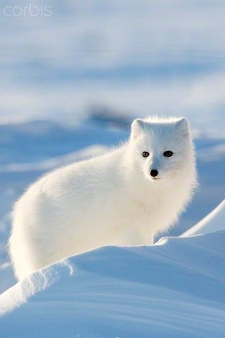
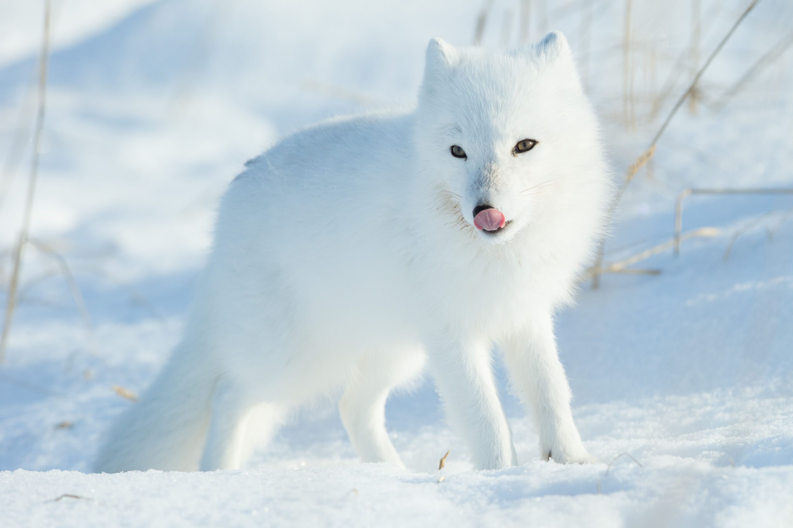
Are they omnivores?
Yes
No

Slide 6
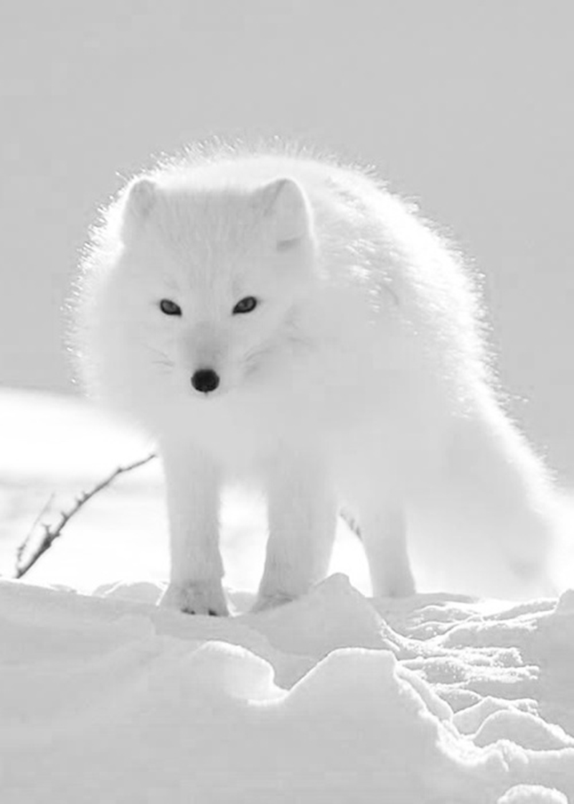
Arctic Fox says, “NO.”

Slide 7
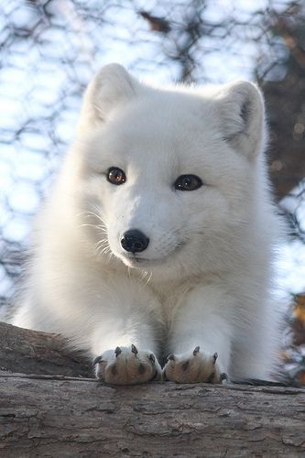
Arctic Fox says YES.

Slide 8
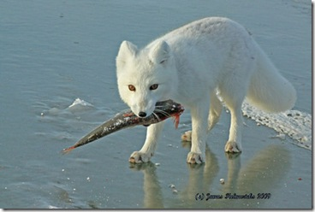
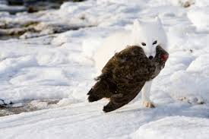
Does the father search for food?
No
Yes

Slide 9
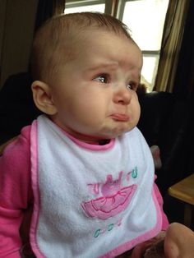
Please try again.

Slide 10
Good Job!

Slide 11
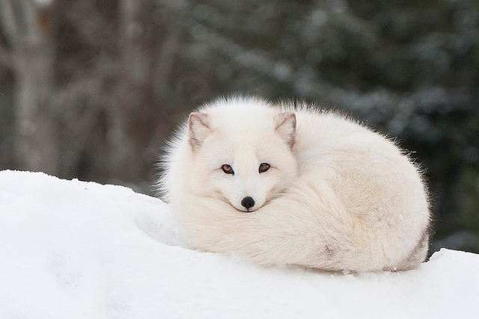
You’re an Arctic Fox Expert!

