Slide 1
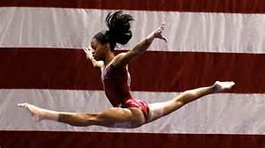
Gabby Douglas
By Zoe

Slide 2
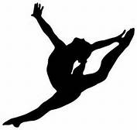
Why is this person famous?
She is famous because she is a great gymnast.

Slide 3
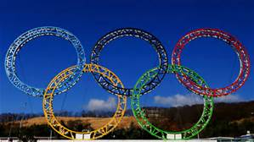
Early Life
She was born on December 31, 1995.
She was born in Virginia Beach, Virginia.
Family-Parents :Natalie Hawkins and Timothy Douglas
Siblings- Arielle, Joyelle, and John
Interests: Gymnastics
Important Facts: She made it to the Olympics.

Slide 4
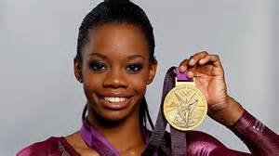
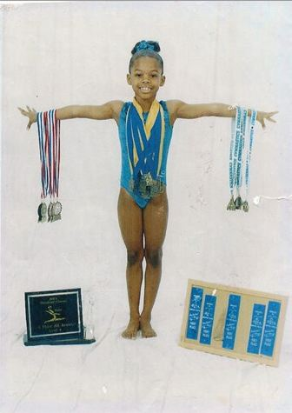
Adult Life
She won four gold medals.
She was the first African American to win the all around.
She helped team USA finish first at the world Gymnastic competition.

