Slide 1
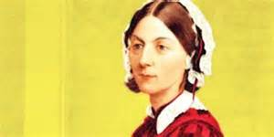
Florence Nightingale
By: Ruby

Slide 2
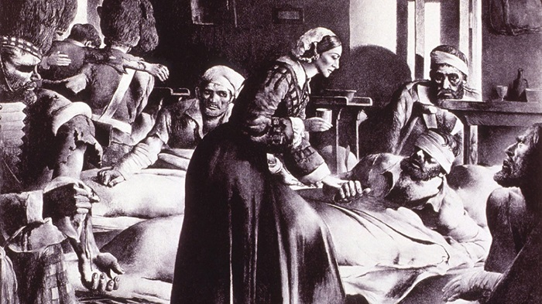
What is she famous for?
Florence was a nurse.

Slide 3
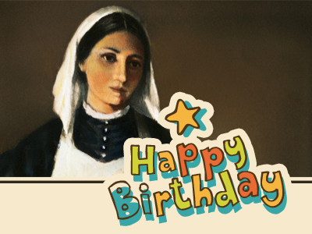
Early Life
She was born in 1920.
She visited the poor.
She was born in Italy.

Slide 4
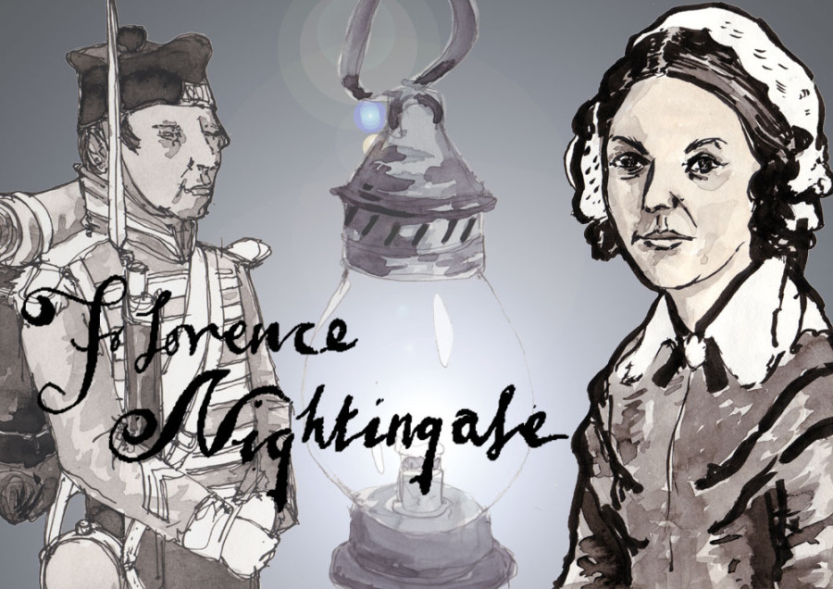
Character Traits
Hard working
Caring

Slide 5
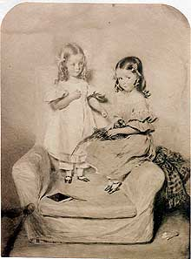
Fun Facts
She was the oldest sibling.
She helped soldiers during the war.
She had a sister named Parthe.

