Slide 1
Leonardo Da Vinci
By: Maggie

Slide 2
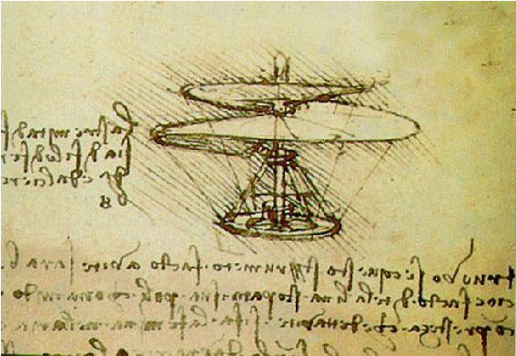
What he is famous for?
Leo is famous for his art.
He is also famous for his cool inventions.

Slide 3
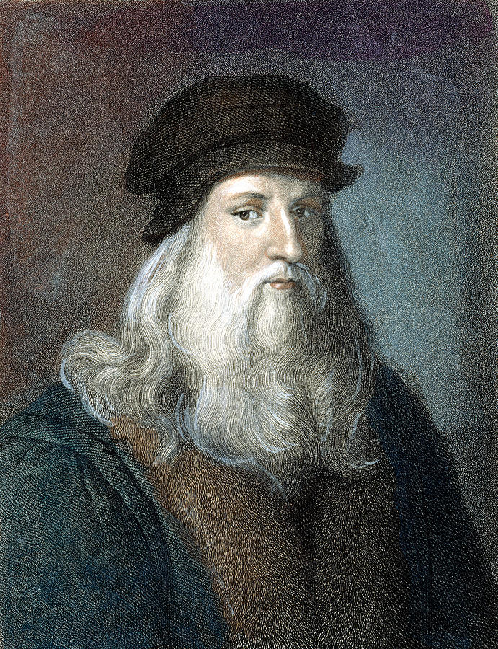
Early life
Leo drew pictures of plants, flowers, insects, and animals.
He lived in Europe.

Slide 4
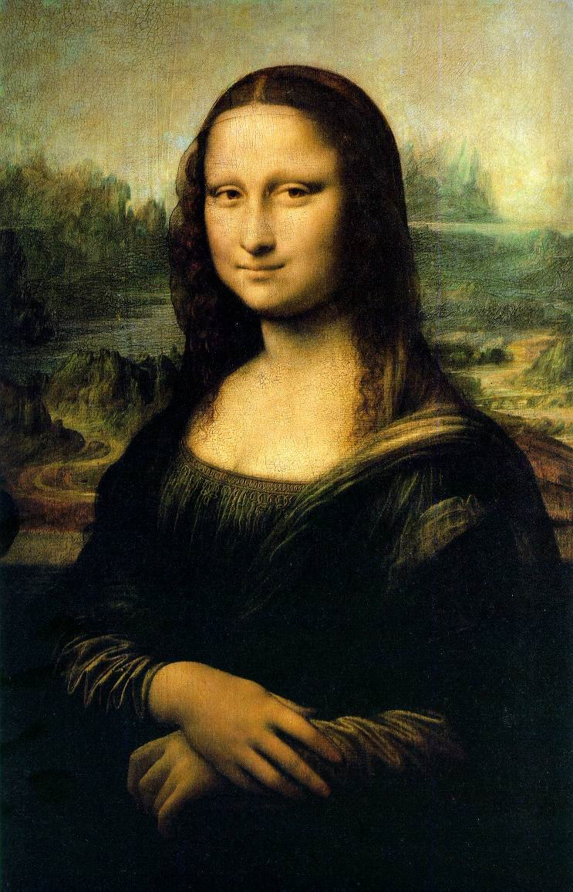
Fun facts
He made a famous picture of “The Virgin Of The Rocks”.
He made a super famous painting called the Mona Lisa.
He was more interested in his inventions and experiments .

