Slide 1
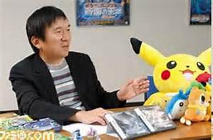
Satoshi Tajiri
By Lincoln

Slide 2
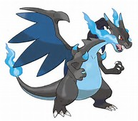
What is he famous for?
He created Pokemon.

Slide 3
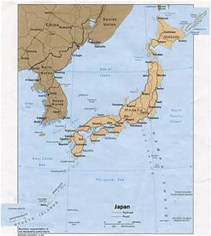
Early Life
He was born in Japan on August 28, 1965.
He loved insects.
His nickname was Dr. Bug.

Slide 4
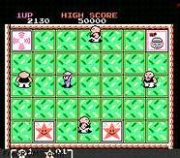
Fun Facts
He skipped school to play video games.
He wrote a magazine called Game Freak.
In 1987 he made his first game called Mendal Palace.

