Slide 1
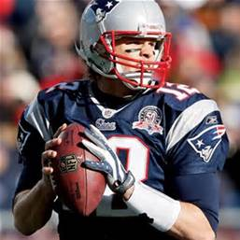
Tom Brady
By Izabell

Slide 2
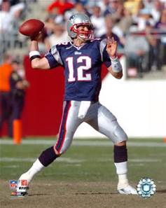
What is he famous for?
Tom Brady is famous for being really good at football.
He works hard and is confident.

Slide 3
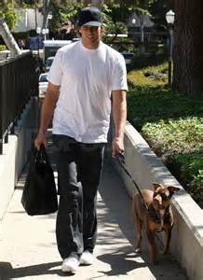
Early Life
Tom Brady grow up in San Mateo, California.
One of his early memories was attending a football game.

Slide 4
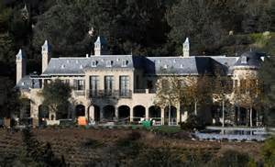
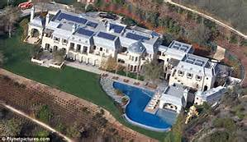
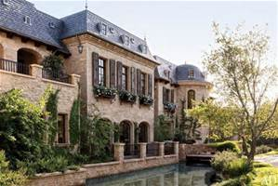
Where in the world is he?
He lives in:
Los Angeles
Boston
New York

Slide 5
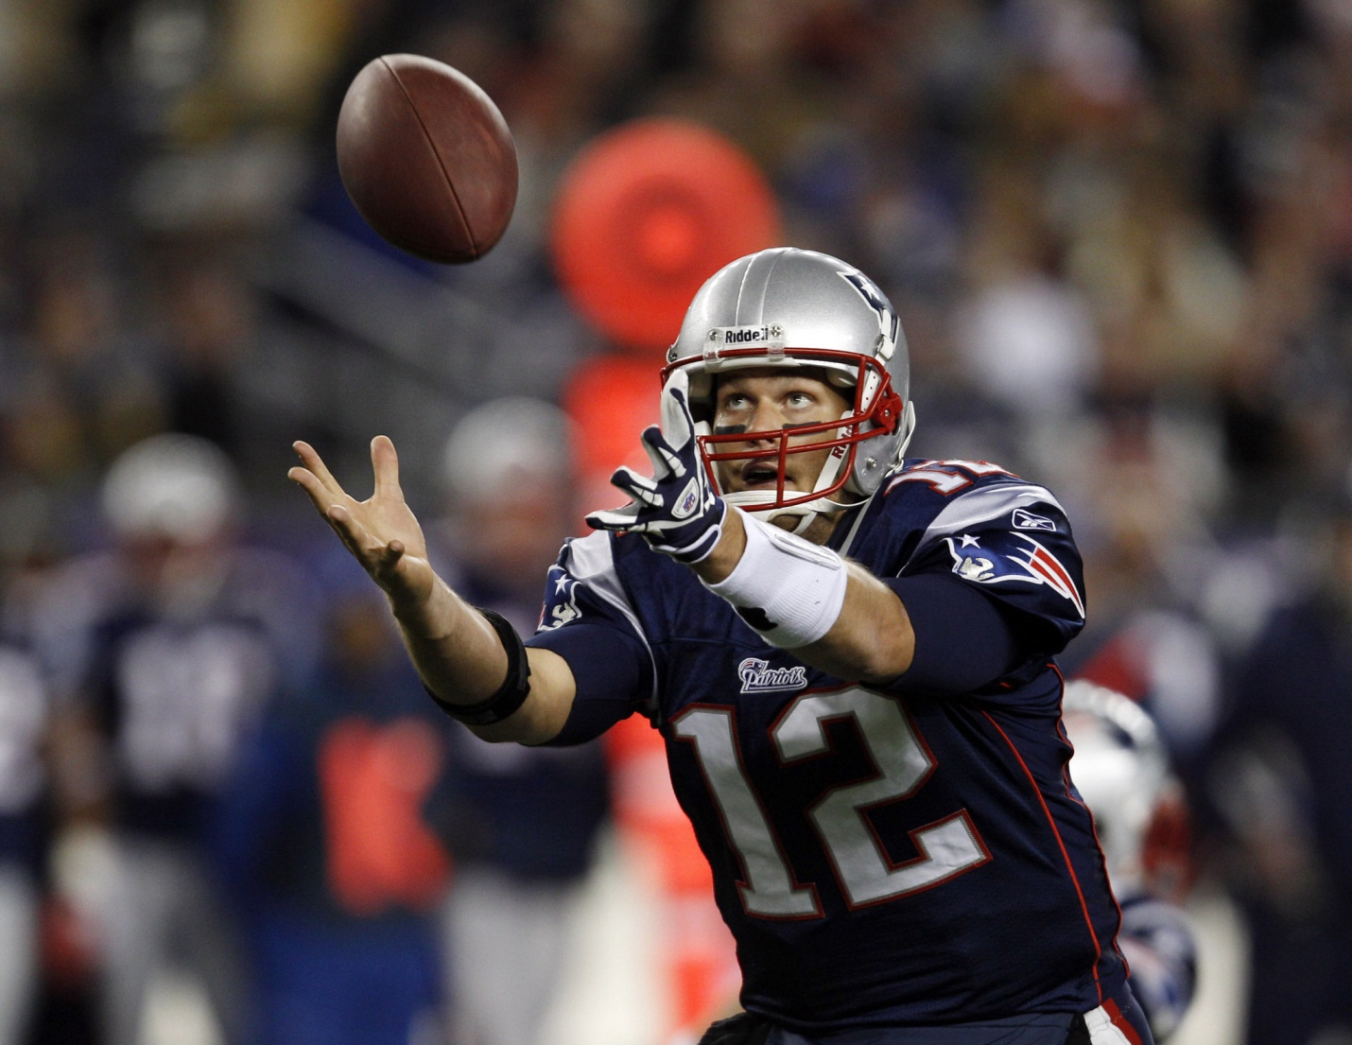
Character traits
perseverance

Slide 6
Fun Facts
Tom was a baseball player.
The football team never won a game when he first started.
He always had to get up at 6:00 in the morning.

