Slide 1
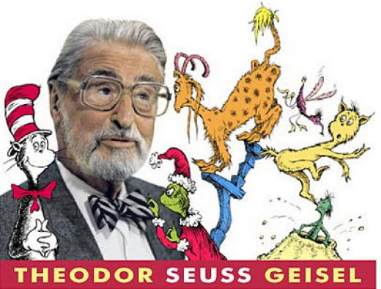
Dr. Seuss
By: Gwen

Slide 2
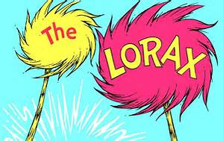
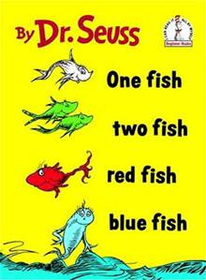
What is he famous for?
He wrote books.

Slide 3
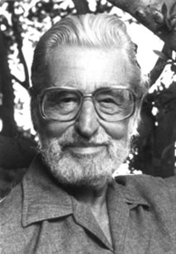
Early Life
He was born on March 2, 1904.
He was born in Springfield, Massachusetts.
His name is Theodor Seuss Geisel.

Slide 4
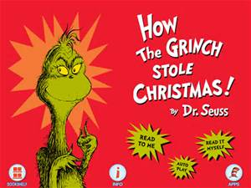
Fun Facts
He was a good artist.
He married Helen.
He wrote “How the Grinch Stole Christmas.”

