Slide 1
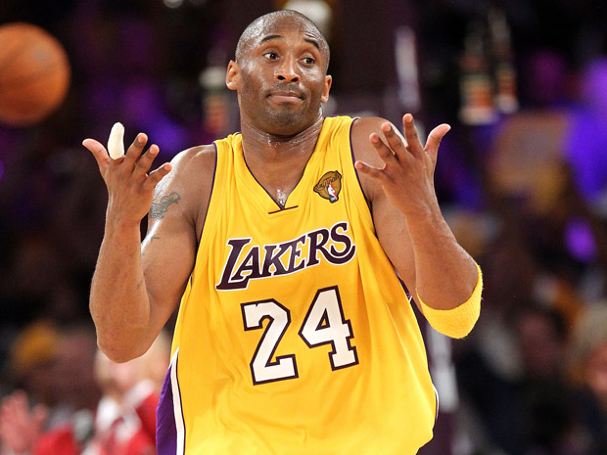
Kobe Bryant
By: Camden

Slide 2
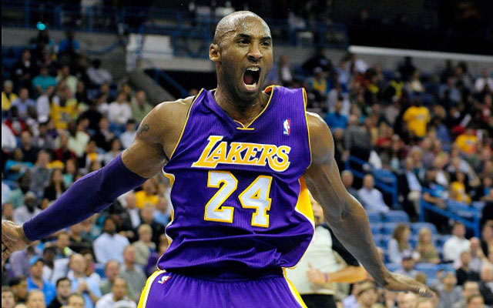
Why was this person famous?
Kobe Bryant is famous because he was an amazing basketball player and could make almost every shot he made. He was also was very good at blocking and passing the ball.

Slide 3
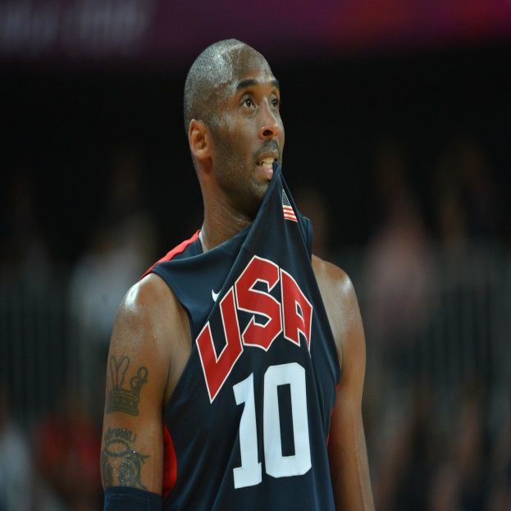
Birth and Family
He was born on August 23^{rd,} 1978.
Kobe was born in Philadelphia, Pennsylvania.
His parents are Joe and Pam Bryant.
He has two sisters named Shaya and Sharia.

Slide 4
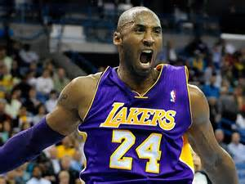
Early Life
Kobe went to Lower Merion High School.
He decided to skip college and go straight to the NBA.
He liked playing basketball against his father because it was a challenge.
One summer Kobe made 100,000 shots.

Slide 5
Adult Life
The Lakers lost the championships to the Celtics in 2008.
Kobe played basketball in the Olympics in Beijing, China.
He broke his index finger but kept playing.

