Slide 1
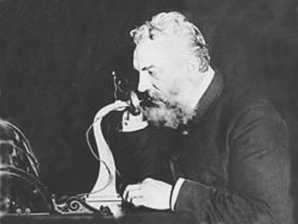
Alexander Graham Bell
By: Abel

Slide 2
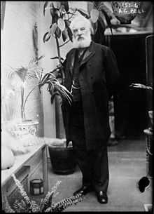
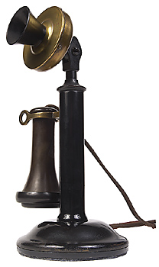
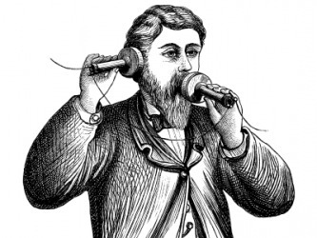
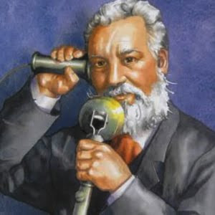
What is he famous for?
He invented the telephone.

Slide 3
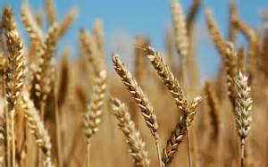
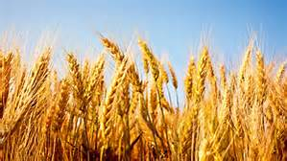
Early Life
He was born on March 3, 1847.
He created a machine that cleaned wheat.

Slide 4
Fun Facts
He invented a lot of things.
He made a machine that cleaned wheat.
His mother had problems hearing.
Alexander taught deaf children to speak.
Alexander’s baby passed away.
He created a machine to help people breathe.

