Slide 1
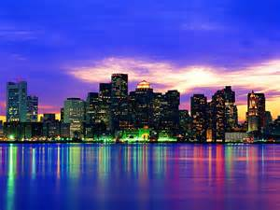
My Massachusetts ABC Book
By
Zoe

Slide 2
A is for Animals
Puppy
Bunnies

Slide 3
B is for Border States
Rhode Island
Vermont

Slide 4
C is for Capitol
Boston

Slide 5
D is for Distance

Slide 6
E is for Entertainment
Beach
Water Wizz

Slide 7
F is for Flag and Flower

Slide 8
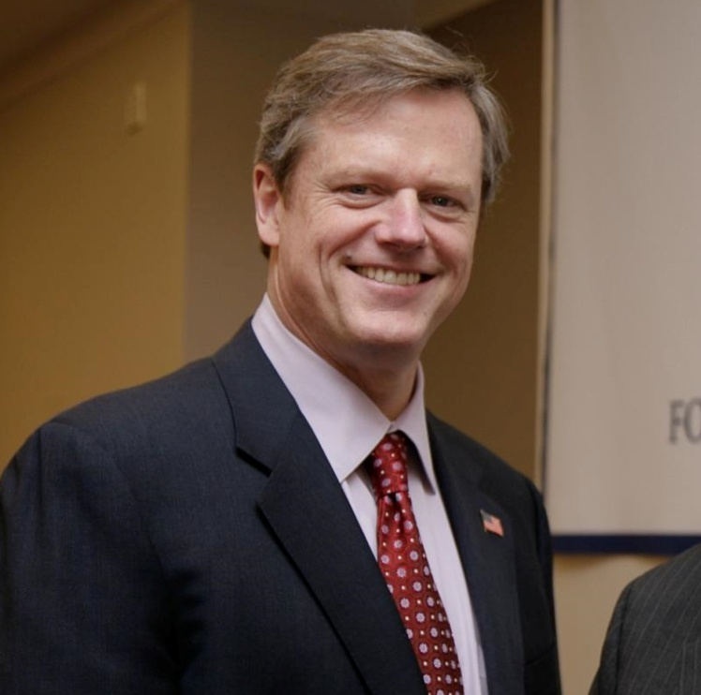
G is for Governor
Charlie Baker

Slide 9
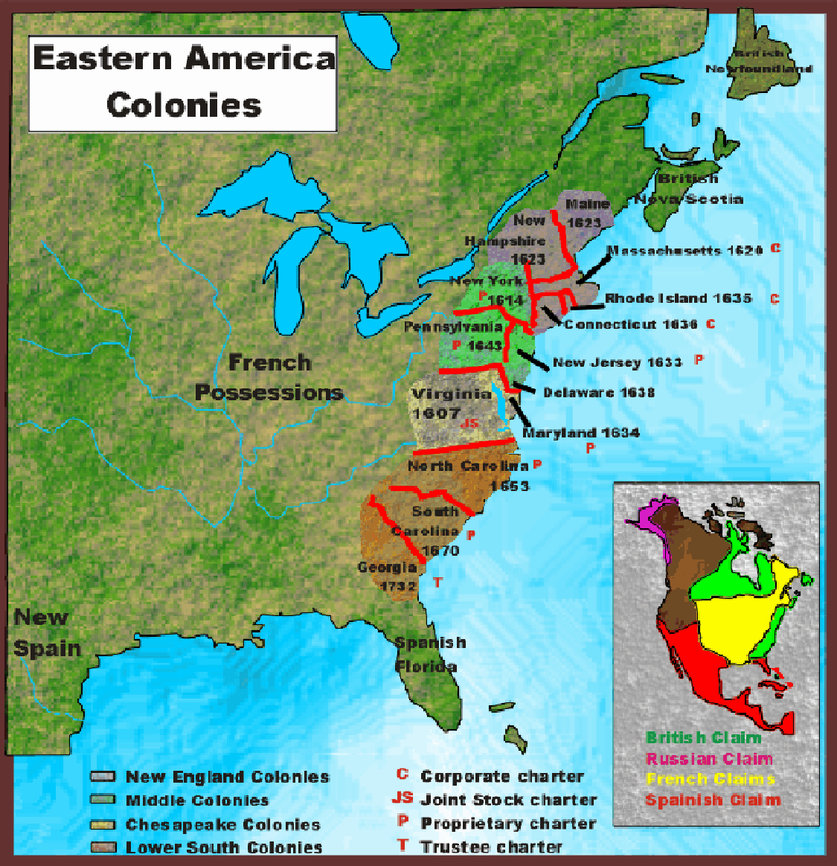
H is for History
Massachusetts was one of the original 13 colonies.

Slide 10
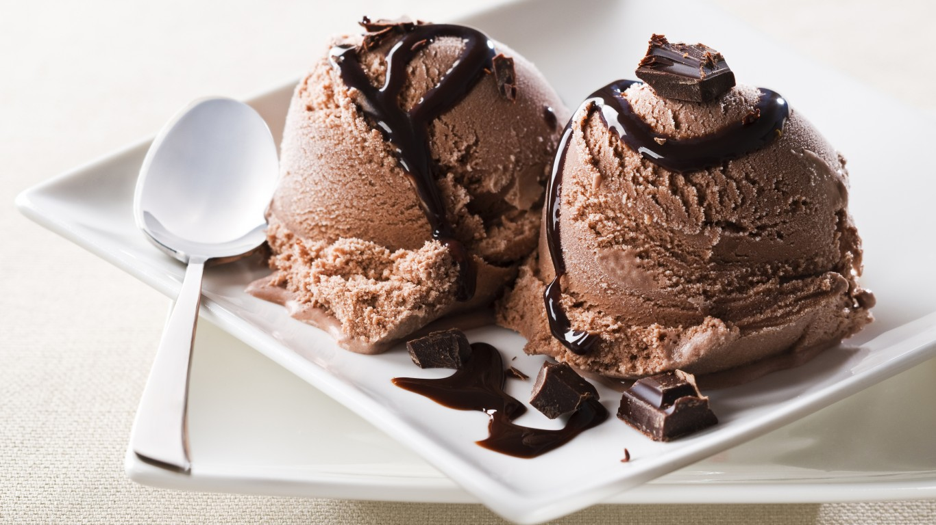
I is for Industries
Manufacturing ice cream

Slide 11
J is for Jobs
nurse

Slide 12
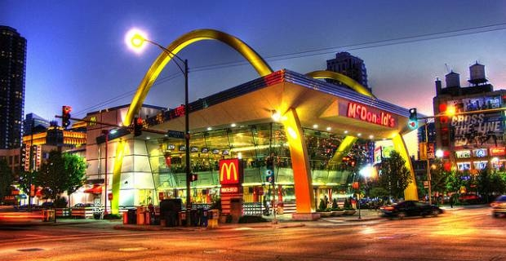
K is for Kinds of Food
McDonald’s

Slide 13
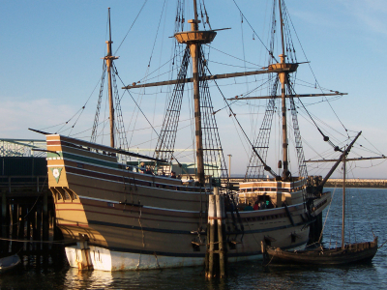
L is for Landmarks
Plimoth Plantation

Slide 14
M is for Motto
By the sword we seek peace, but peace only under liberty

Slide 15
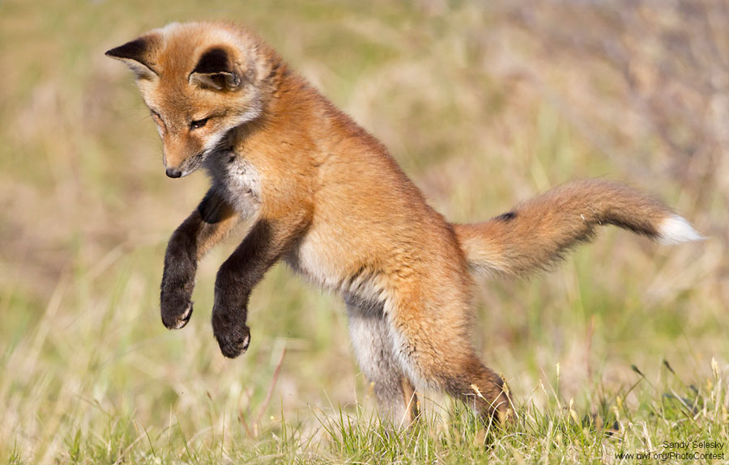
N is for Natural Resources
Wildlife

Slide 16
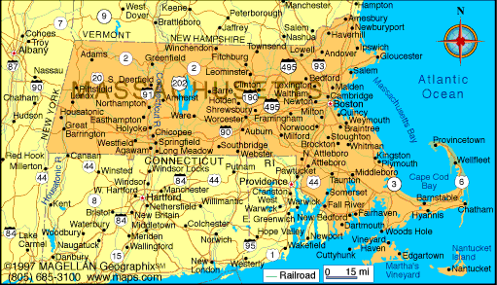
O is for Origin of State
Massachusetts became a state on February 6, 1788.

Slide 17
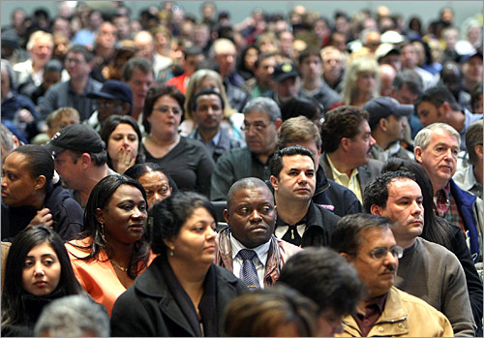
P is for Population
6.745 million

Slide 18
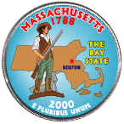
Q is for Quarter

Slide 19
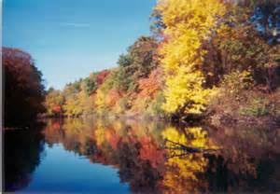
R is for Rivers and Lakes
Taunton River

Slide 20
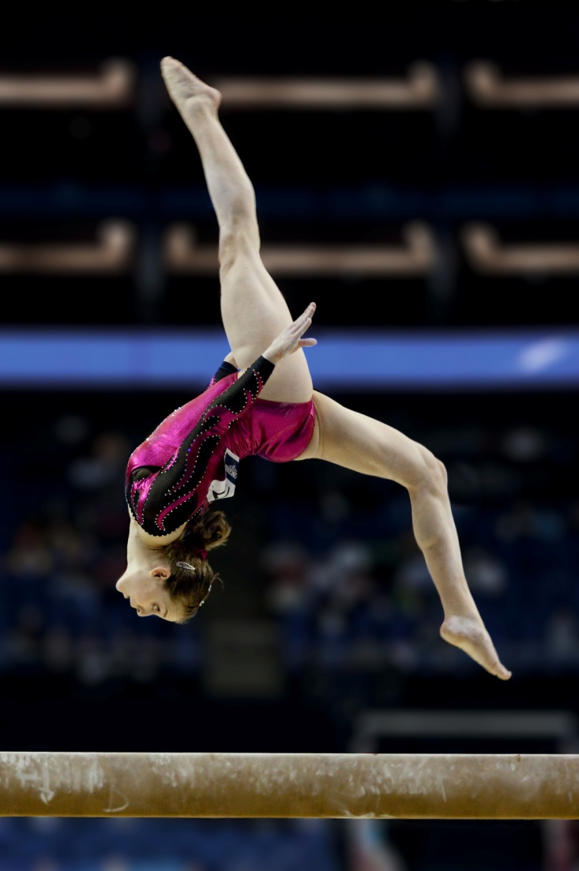
S is for Sports
Gymnastics

Slide 21
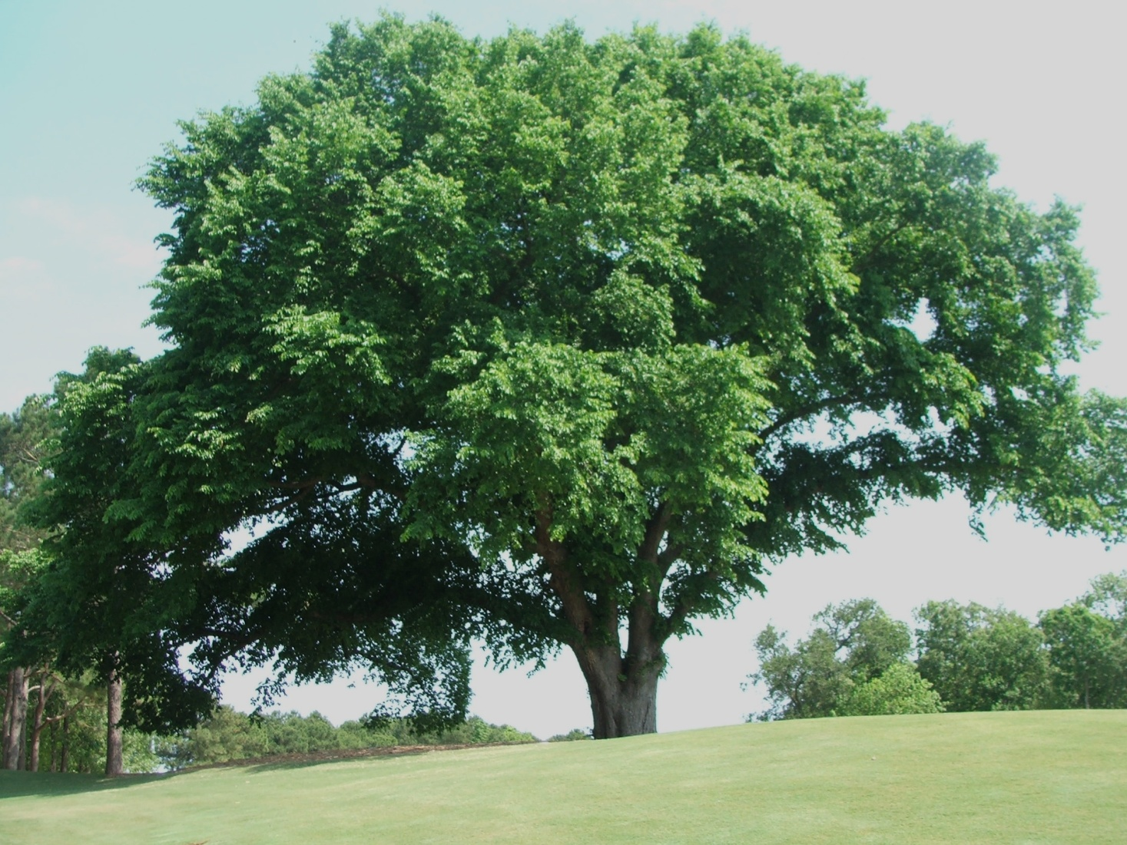
T is for Tree
Ulmus americana

Slide 22
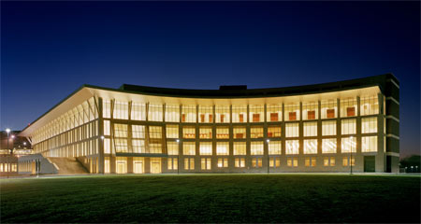
U is for University
University of Massachusetts Boston

Slide 23
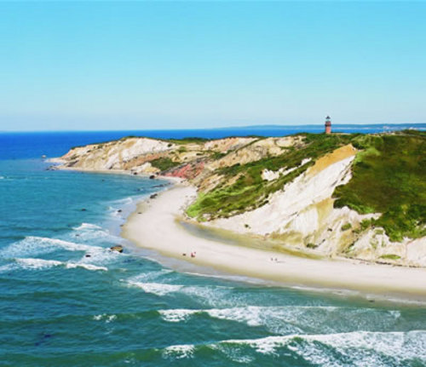
V is for Vacation Spots
Martha’s Vineyard

Slide 24
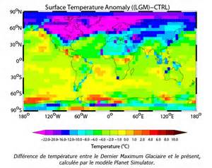
W is for Weather and Climate
Average temperature in summer is 82
Average temperature in winter is 36

Slide 25
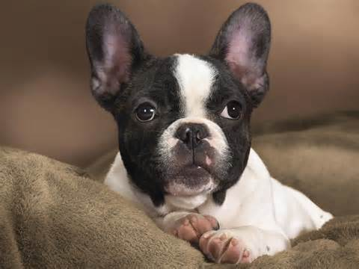
X is for eXciting facts
The Boston terrier is the official dog of Massachusetts.

Slide 26
Y is for Year of Statehood
February 6, 1788

Slide 27
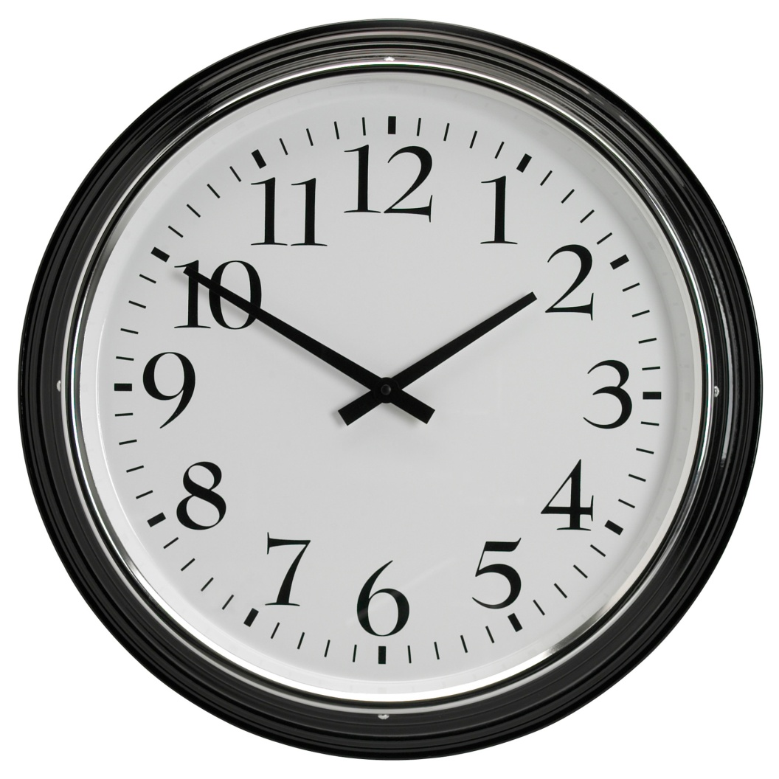
Z is for Time Zone
Eastern time zone

