Slide 1
My Rhode Island ABC Book
By
Sergio

Slide 2
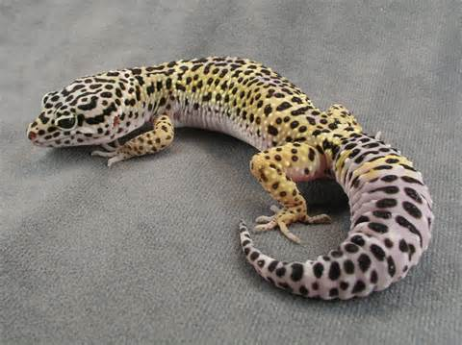
A is for Animals
Fish
Lizards
Foxes
Bunnies
Bugs

Slide 3
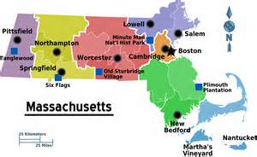
B is for Border States
Massachusetts
Connecticut

Slide 4
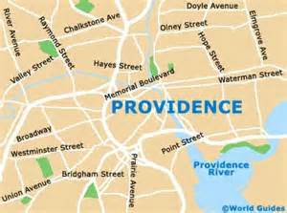
C is for Capitol
Providence

Slide 5
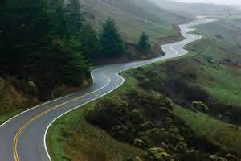
D is for Distance
1,545 square miles

Slide 6
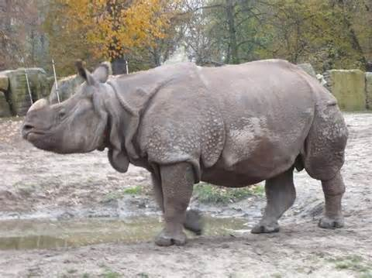
E is for Entertainment
Zoo
Home

Slide 7
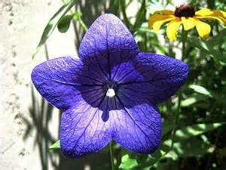
F is for Flag and Flower
Violet

Slide 8
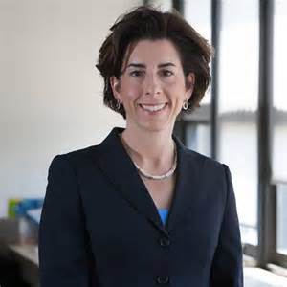
G is for Governor
Gina Raimondo

Slide 9
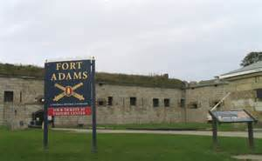
H is for History
Roger Williams
Fort Adams
Four Corners

Slide 10
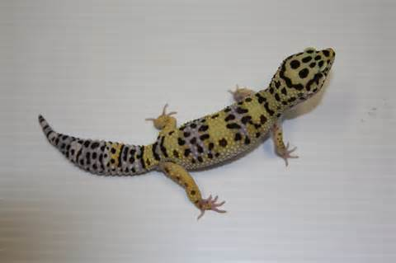
I is for Industries
Pet Stores
Fisherman

Slide 11
J is for Jobs
Cashiers
Chefs

Slide 12
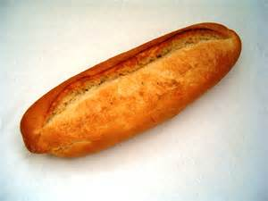
K is for Kinds of Food
Bread
Coffee milk
Chips

Slide 13
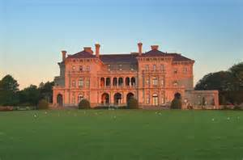
L is for Landmarks
Old State House
The Breakers

Slide 14
M is for Motto
Hope

Slide 15
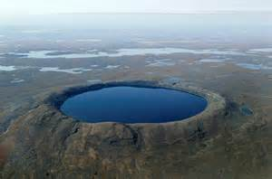
N is for Natural Resources
water

Slide 16
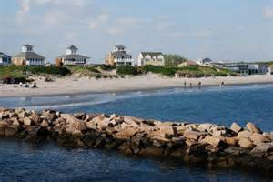
O is for Origin of State
1790

Slide 17
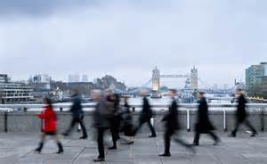
P is for Population
1,052,567 people

Slide 18
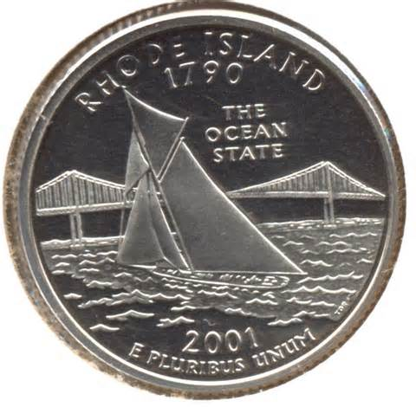
Q is for Quarter

Slide 19
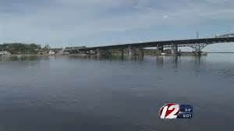
R is for Rivers and Lakes
Sakonnet River

Slide 20
S is for Sports
New England Patriots

Slide 21
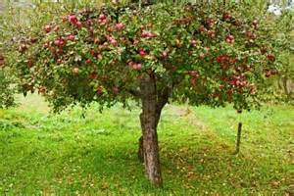
T is for Tree
Apple tree
Pine tree

Slide 22
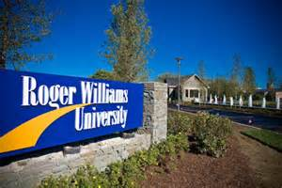
U is for University
Roger Williams University

Slide 23
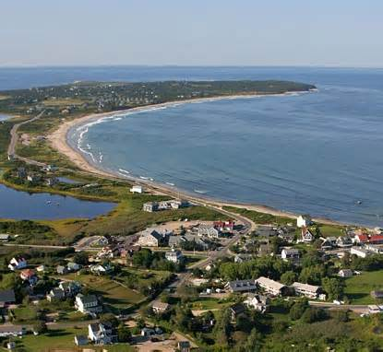
V is for Vacation Spots
Block Island

Slide 24
W is for Weather and Climate
Short Summer
Long Winter

Slide 25
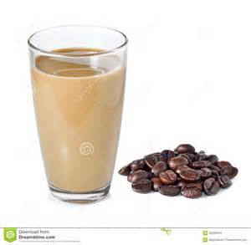
X is for eXciting facts
The parks are fun.
Coffee milk is the state drink.

Slide 26
Y is for Year of Statehood
1790

Slide 27
Z is for Time Zone
Eastern Time

