Slide 1
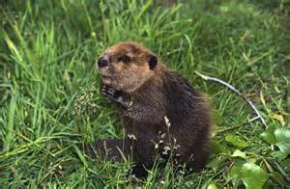
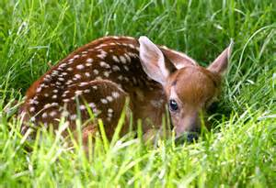
My Rhode Island ABC Book
By
Samantha

Slide 2
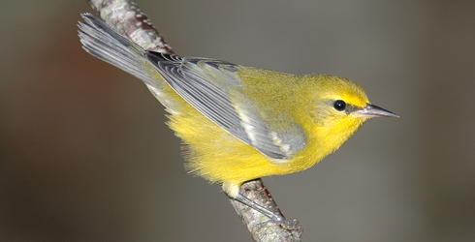
A is for Animals
Birds
Cats

Slide 3
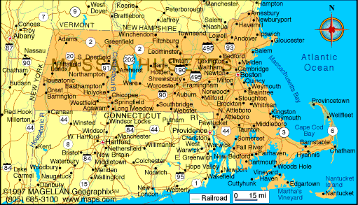
B is for Border States
Massachusetts
Connecticut

Slide 4
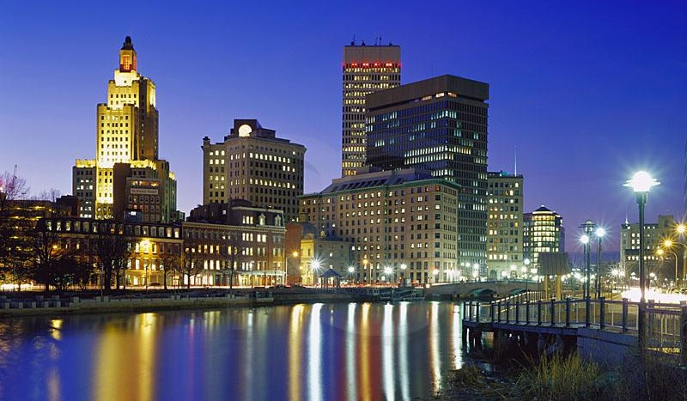
C is for Capitol
Providence

Slide 5
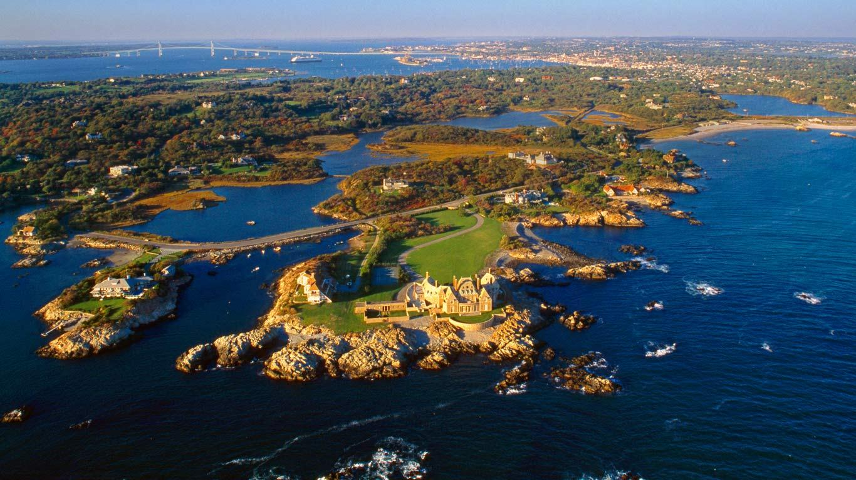
D is for Distance
1,545sq.mi

Slide 6
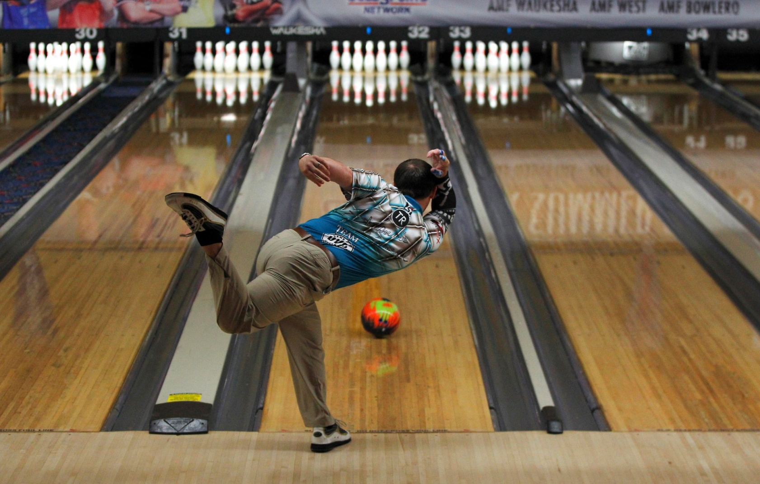
E is for Entertainment
Bowling alley

Slide 7
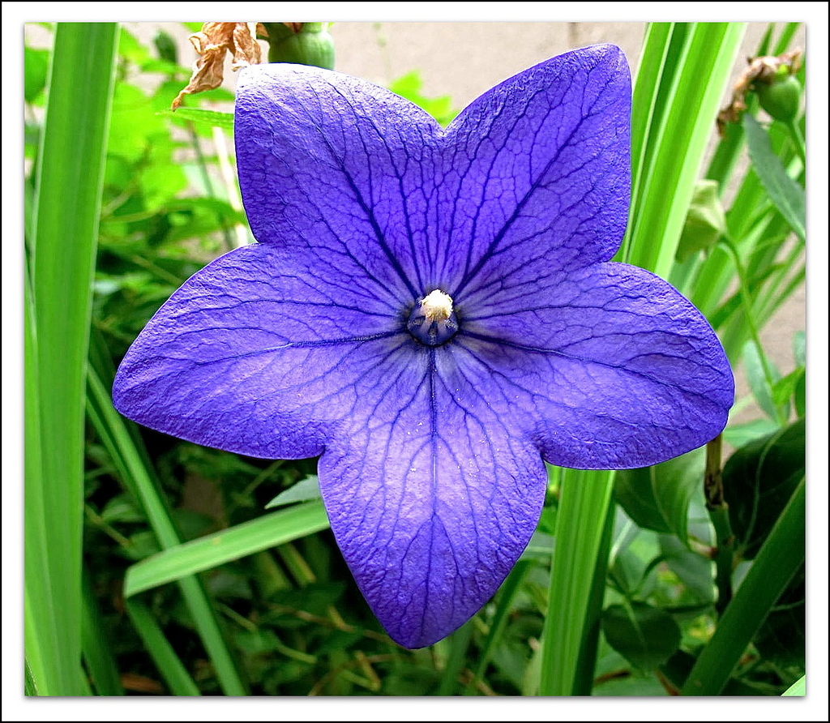
F is for Flower
Violet

Slide 8
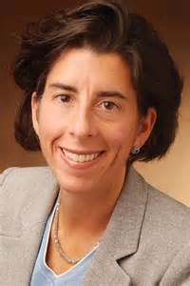
G is for Governor
Gina Raimondo

Slide 9
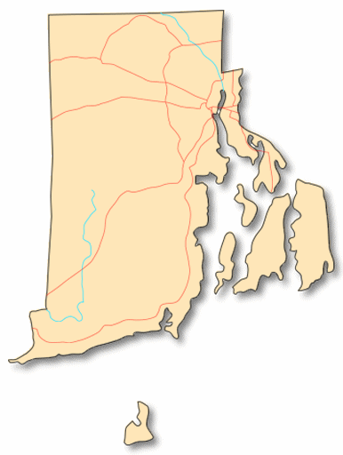
H is for History
Rhode Island is the smallest state

Slide 10
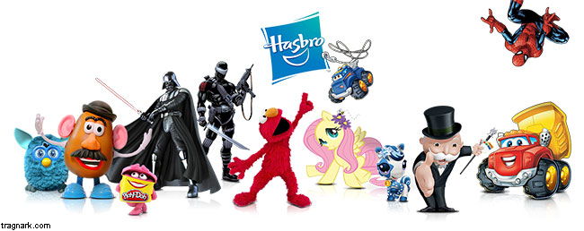
I is for Industries
Hasbro

Slide 11
J is for Jobs
Verizon

Slide 12
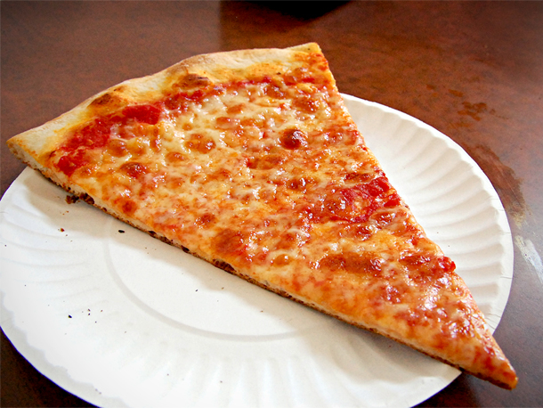
K is for Kinds of Food
Pizza

Slide 13
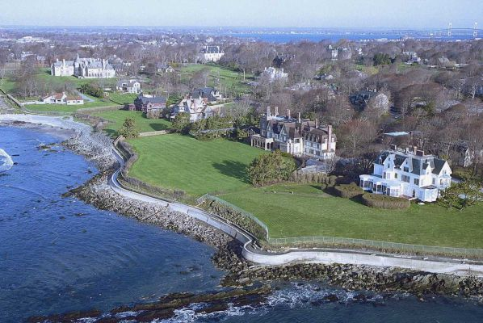
L is for Landmarks
Roger Williams Park Zoo
Newport Cliff Walk

Slide 14
M is for Motto
Hope

Slide 15
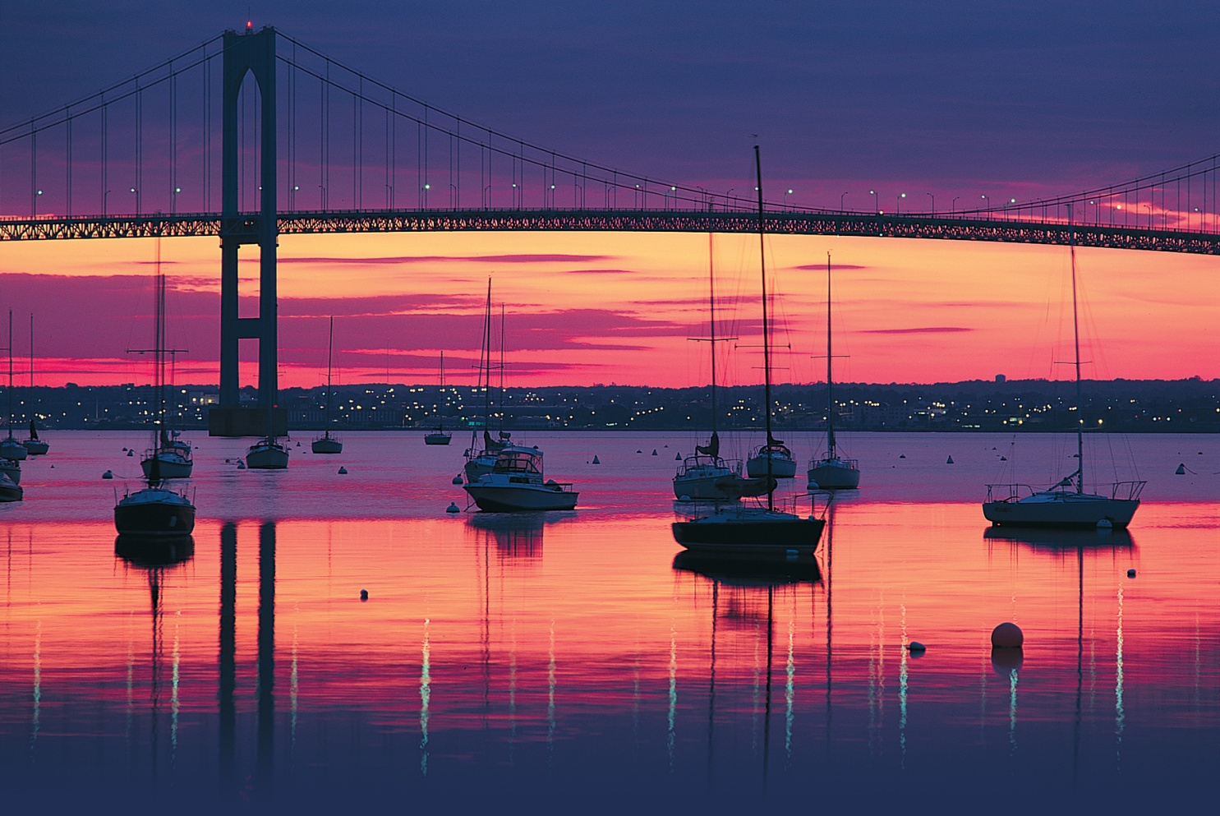
N is for Natural Resources
Water

Slide 16
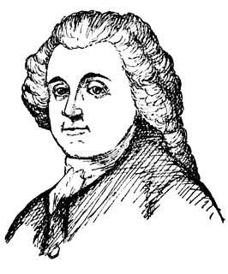
O is for Origin of State
Roger Williams was governor in 1654.

Slide 17
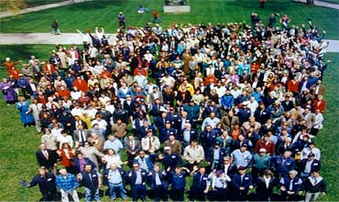
P is for Population
1.055 million

Slide 18
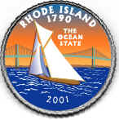
Q is for Quarter

Slide 19
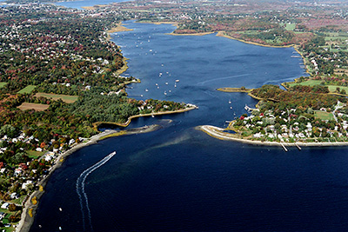
R is for Rivers and Lakes
Mt. Hope Bay

Slide 20
S is for Sports
Soccer

Slide 21
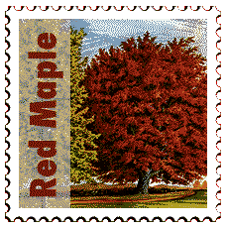
T is for tree
Red Maple

Slide 22
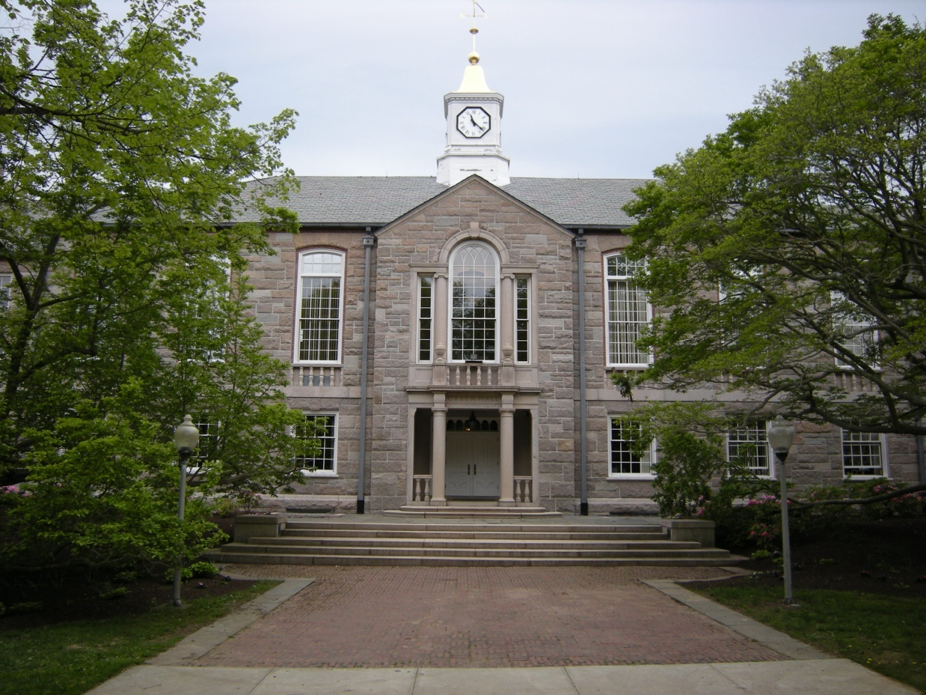
U is for University
University of Rhode Island

Slide 23
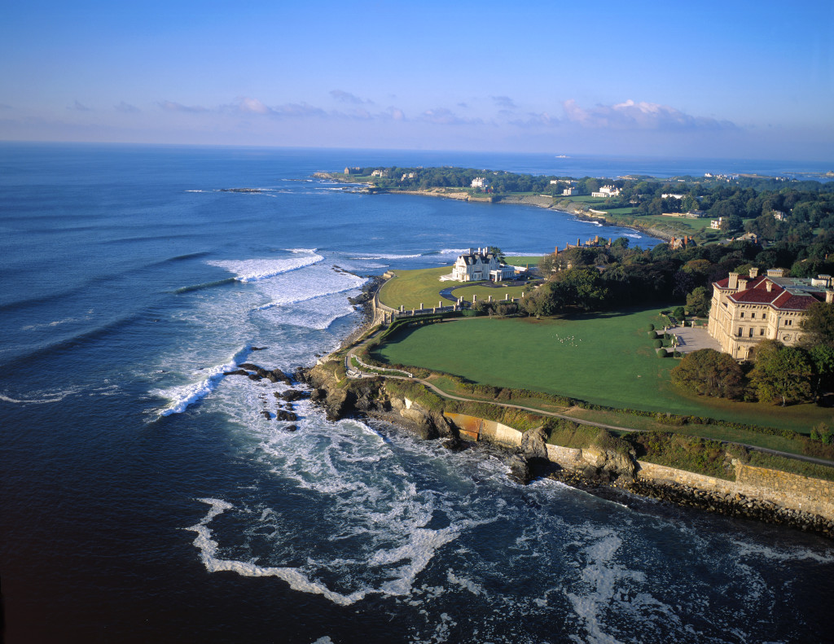
V is for Vacation Spots
Newport

Slide 24
W is for Weather and Climate
Average temperature in January is 37 degrees
Average temperature in July is 83 degrees

Slide 25
X is for Exciting facts
Rhode Island is the smallest state.

Slide 26
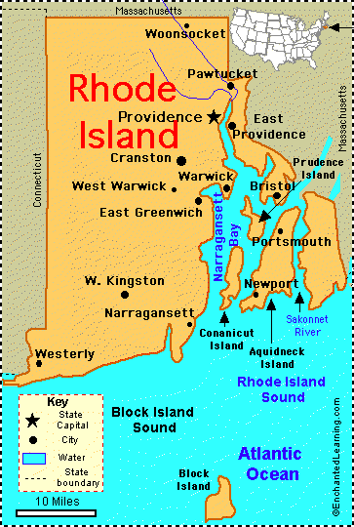
Y is for Year of Statehood
May 29, 1790

Slide 27
Z is for Time Zone
Eastern time zone

