Slide 1
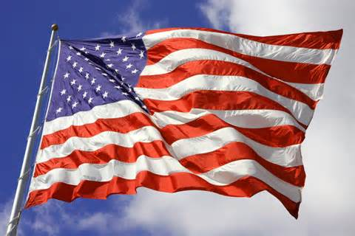
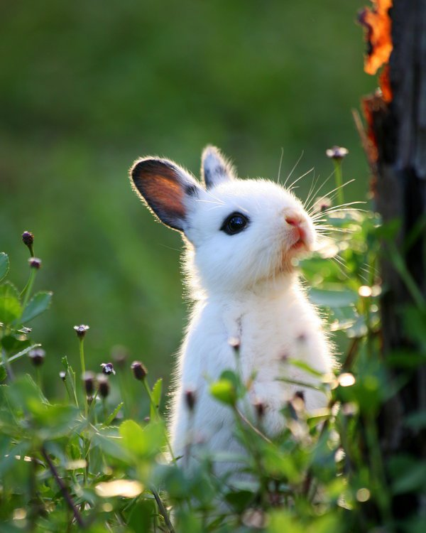
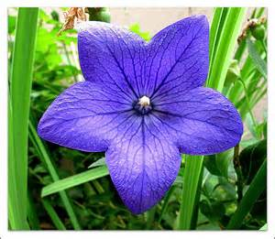
My Rhode Island ABC Book
By
Emma

Slide 2
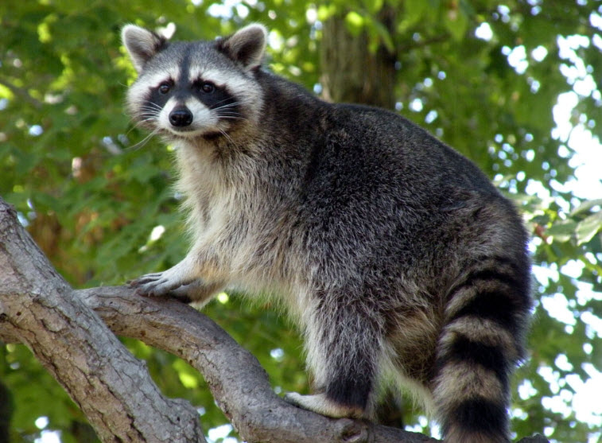
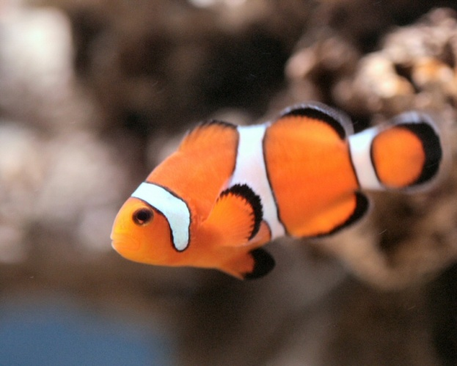
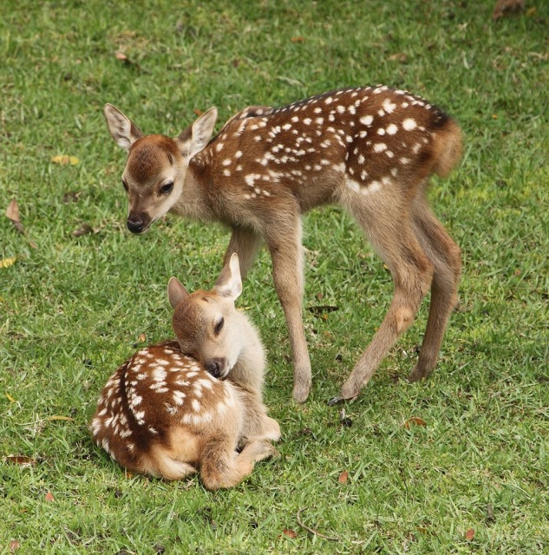
A is for Animals
Raccoons
Bunnies
Deer
Fish

Slide 3
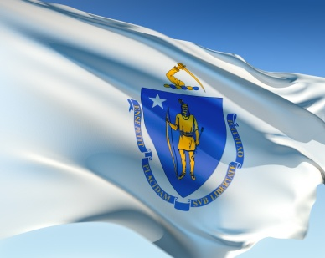
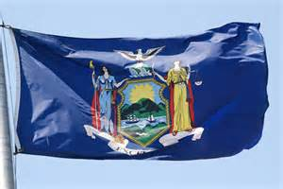
B is for Border States
Massachusetts
Connecticut
New York

Slide 4
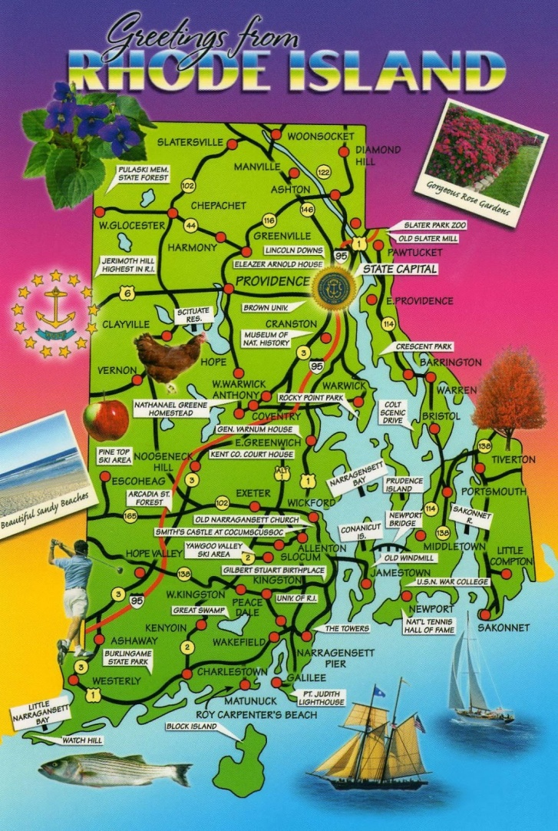
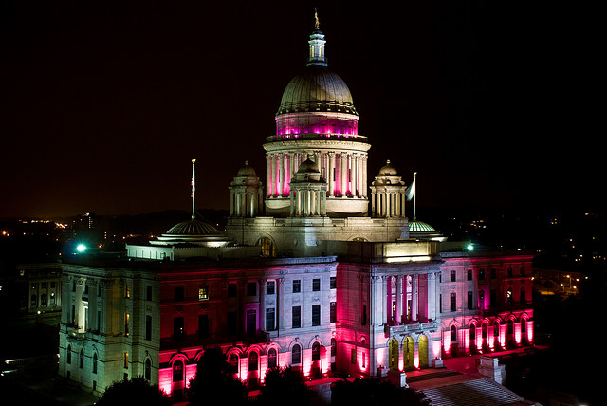
C is for Capitol
Providence

Slide 5
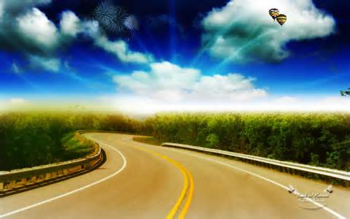
D is for Distance
1,545 square miles

Slide 6
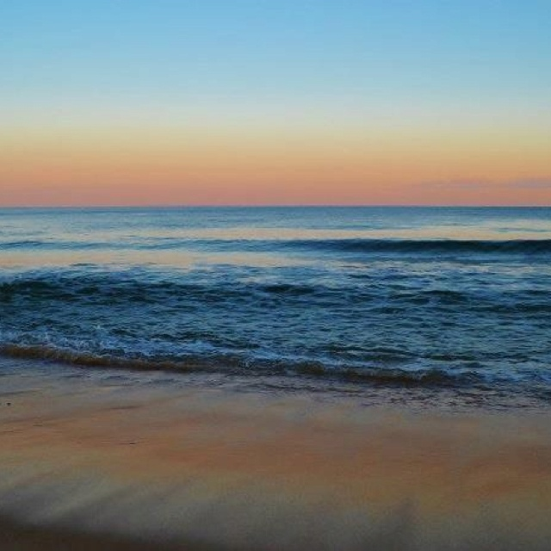
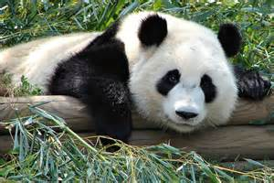
E is for Entertainment
Park
Four Corners
Zoo
South shore beach

Slide 7
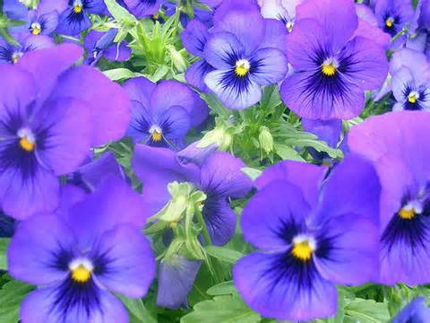
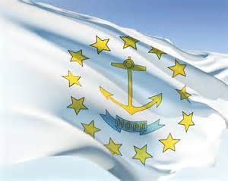
F is for Flag and Flower
Violet
State Flag

Slide 8
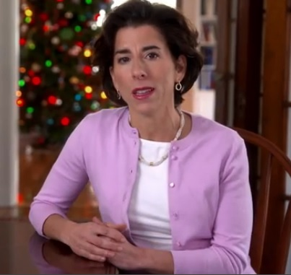
G is for Governor
Gina Raimondo

Slide 9
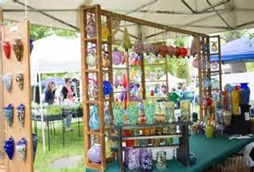
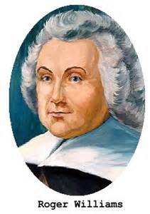
H is for History
Fort Adams
Four Corners
Roger Williams

Slide 10
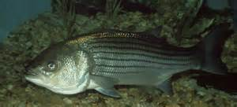
I is for Industries
Fishing Industry

Slide 11
J is for Jobs
Teacher
Fisherman
Zoo owner
Employee for DD
Chef

Slide 12
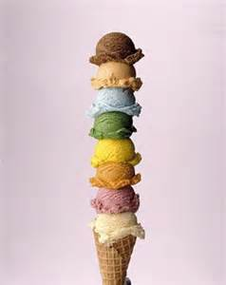
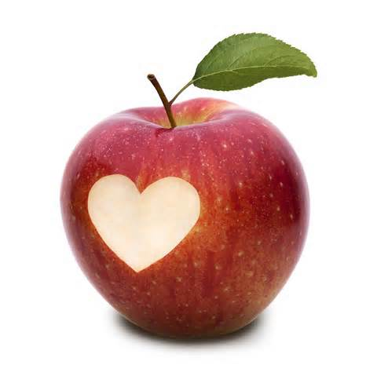
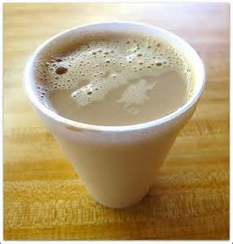
K is for Kinds of Food
Apples
Coffee Milk
Ice cream

Slide 13
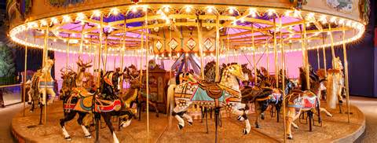
L is for Landmarks
Gov. Stephen Hopkins House
Crescent Park Looff Carousel

Slide 14
M is for Motto
Hope

Slide 15
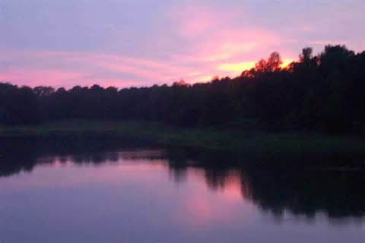
N is for Natural Resources
Water

Slide 16
O is for Origin of State
1790

Slide 17
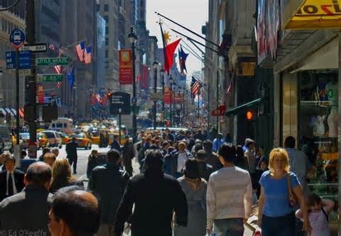
P is for Population
1,052,567 in 2010

Slide 18
Q is for Quarter

Slide 19
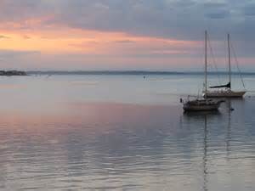
R is for Rivers and Lakes
Sakonnet River

Slide 20
S is for Sports
Providence Bruins
PawSox

Slide 21
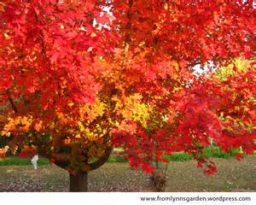
T is for Tree
Red Maple

Slide 22
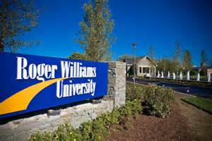
U is for University
Roger Williams University

Slide 23
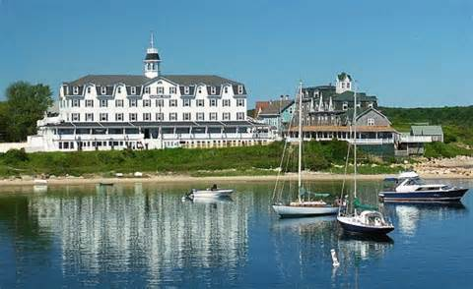
V is for Vacation Spots
Newport
Bristol
Block Island

Slide 24
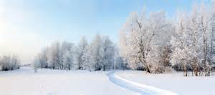
W is for Weather and Climate
Humid weather
Long winters
Short summers

Slide 25
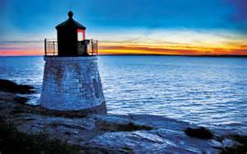
X is for eXciting Facts
State drink is coffee milk
RI has a lot of beaches.

Slide 26
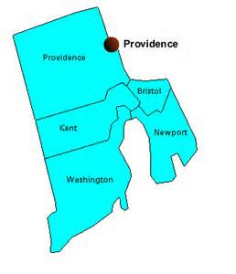
Y is for Year of Statehood
1790

Slide 27
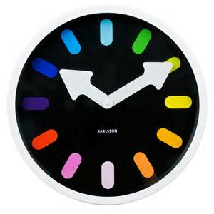
Z is for Time Zone
Eastern Standard Time

