Slide 1
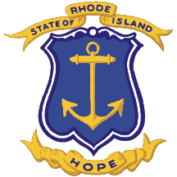
My RI ABC Book
By:
Ellery

Slide 2
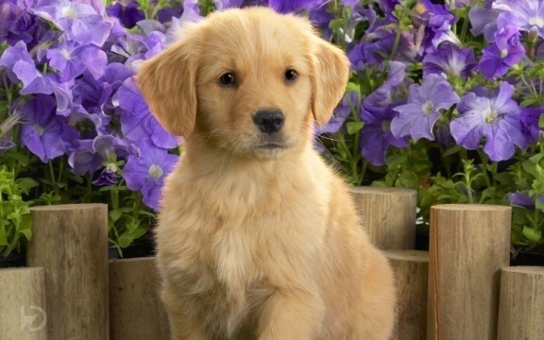
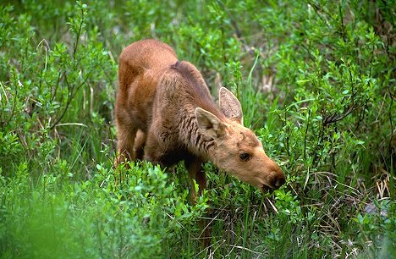
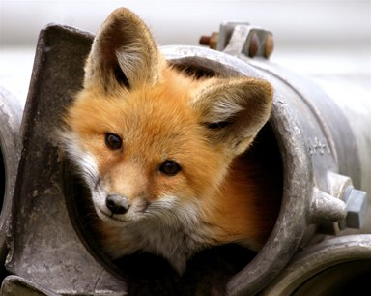
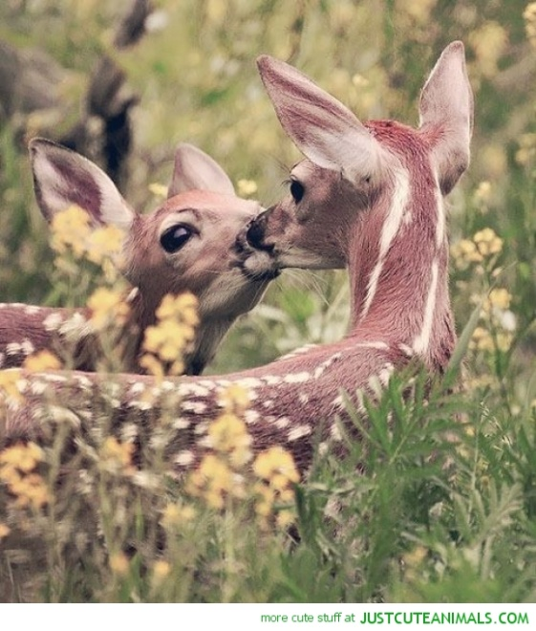
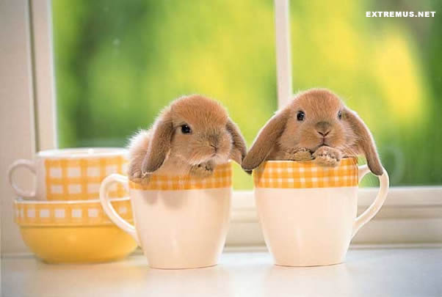
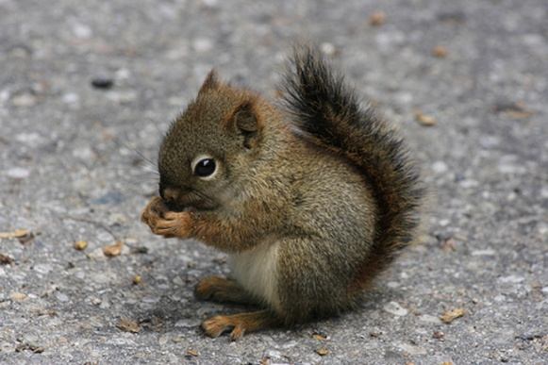
A is for Animals
Moose
Squirrels
Puppies
Bunnies
Foxes

Slide 3
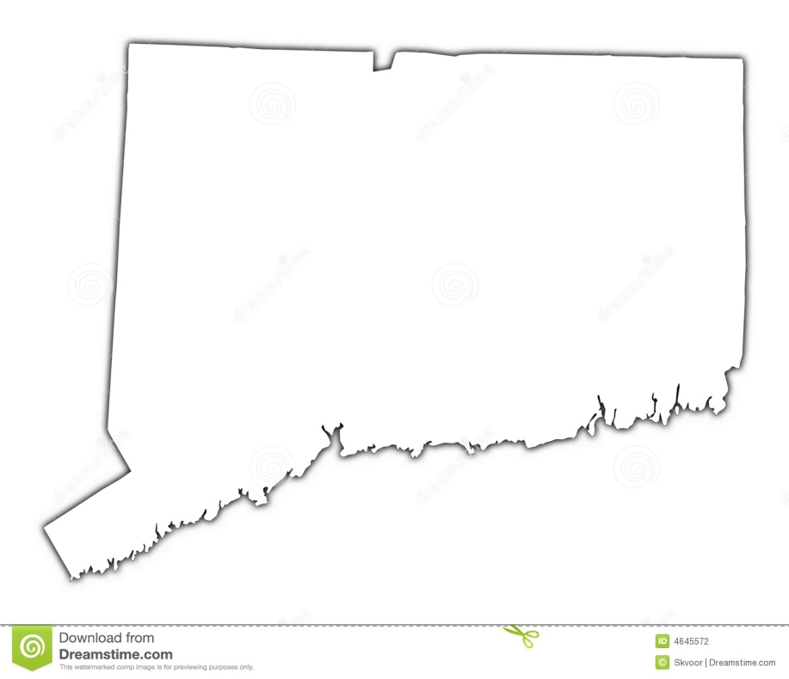
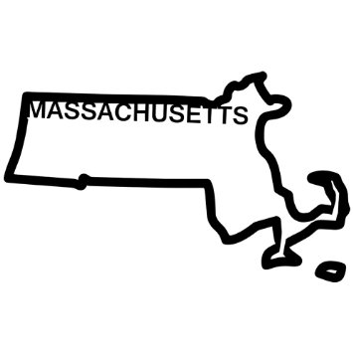
B is for Border States
Massachusetts
Connecticut

Slide 4
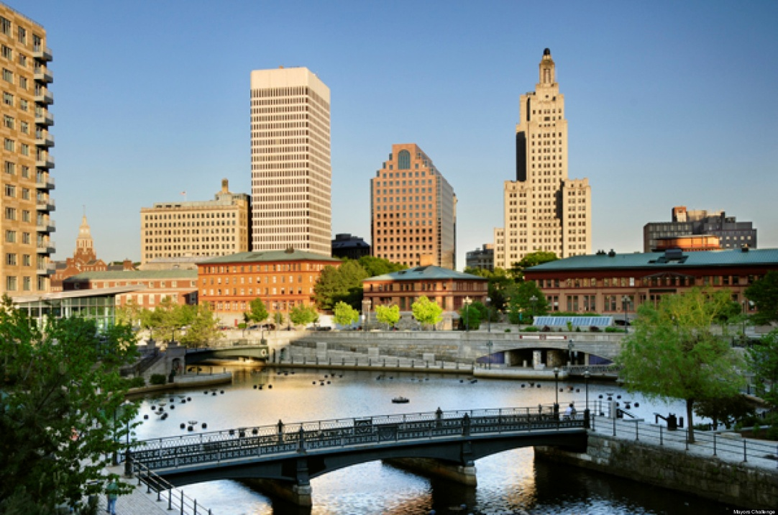
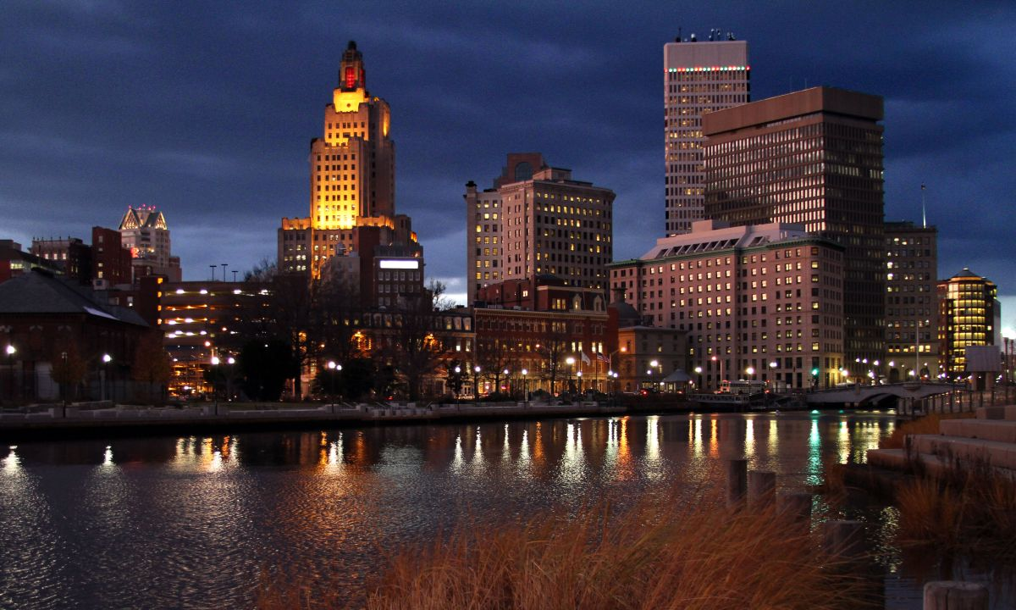
C is for Capitol
Providence

Slide 5
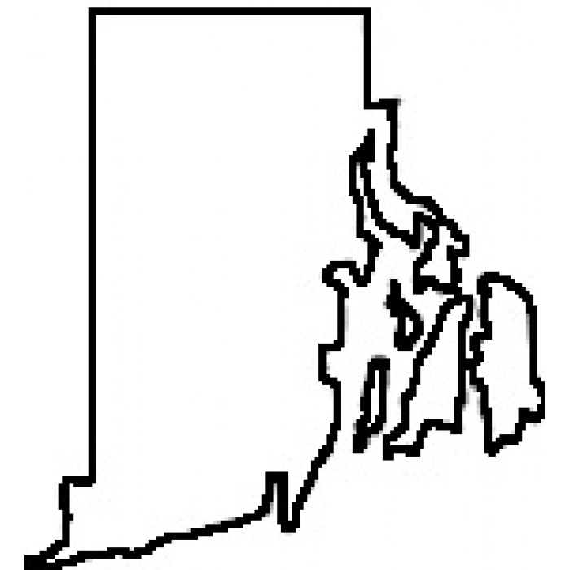
D is for Distance
1,545 square miles

Slide 6
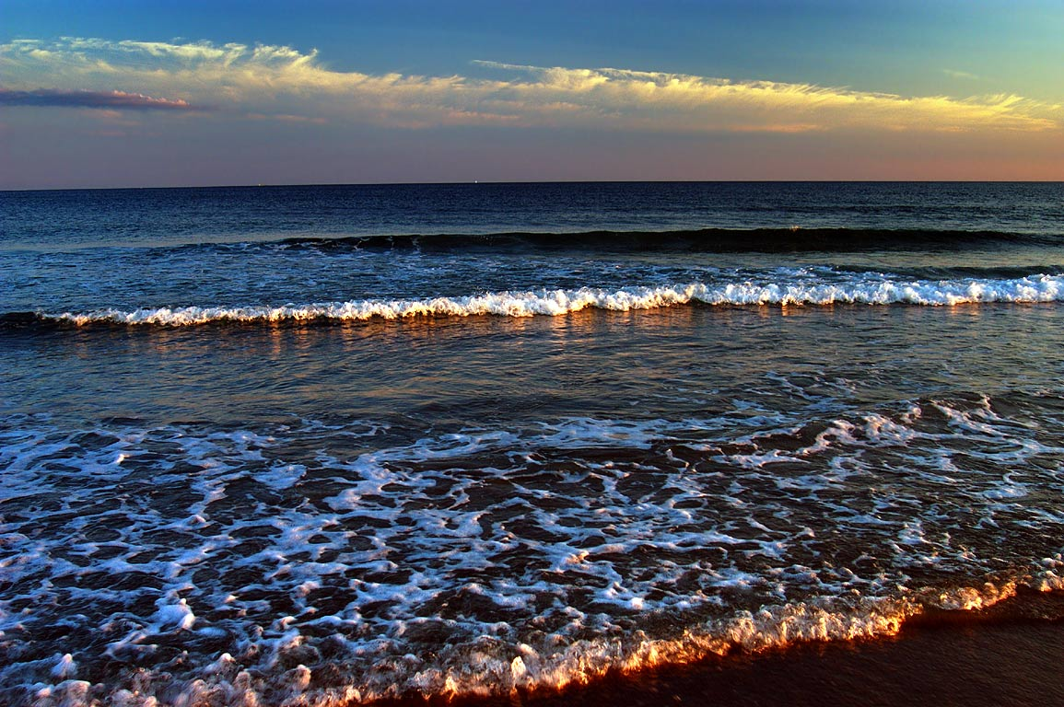
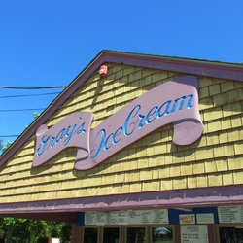
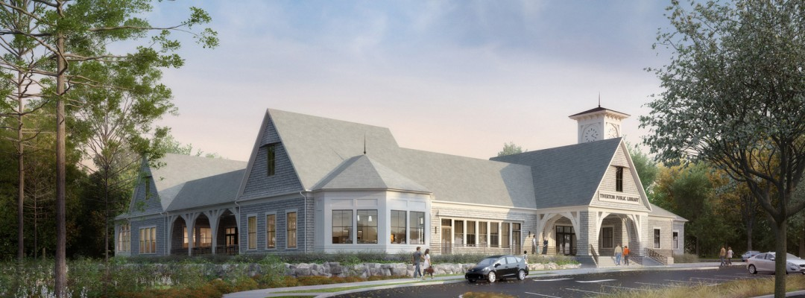
E is for Entertainment
South Shore Beach
Gray’s Ice Cream
Tiverton Library

Slide 7
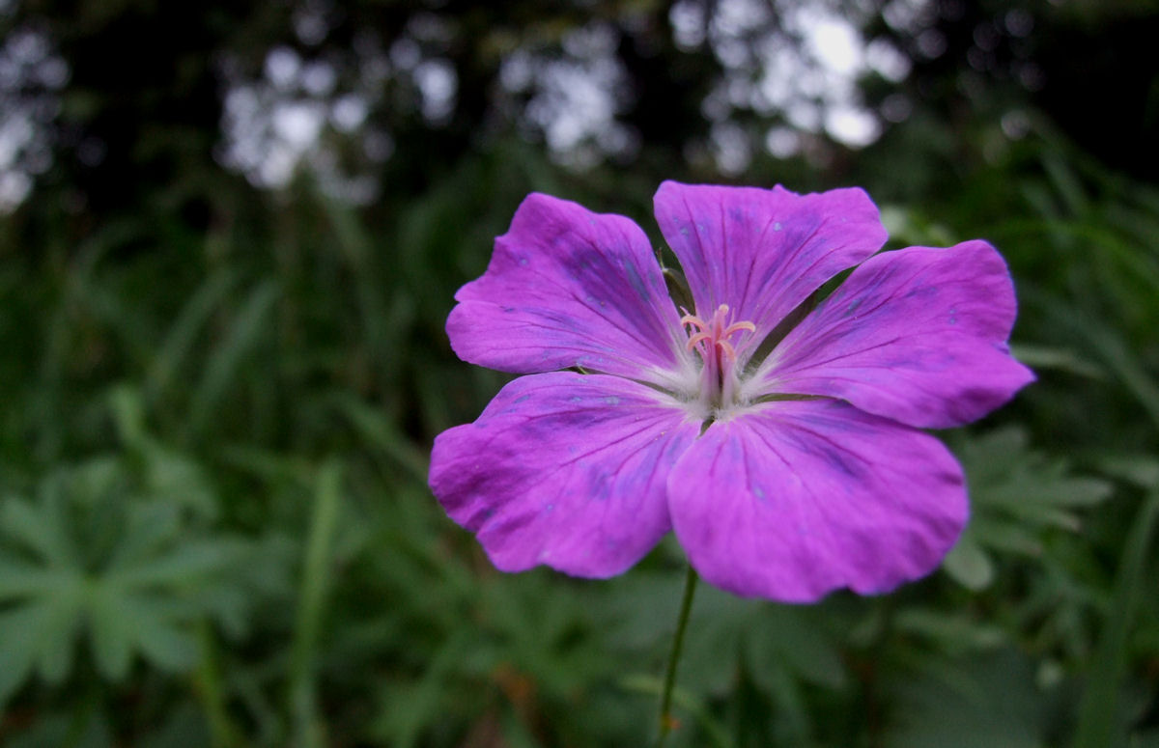
F is for Flag and Flower
The state flower is the violet.

Slide 8
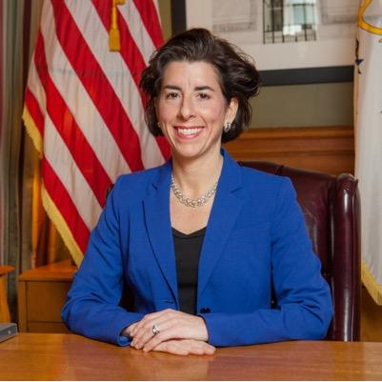
G is for Governor
The governor of Rhode Island is Gina Raimondo.

Slide 9
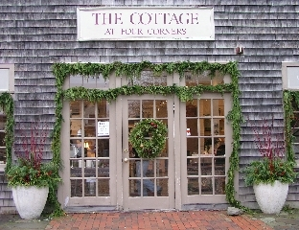
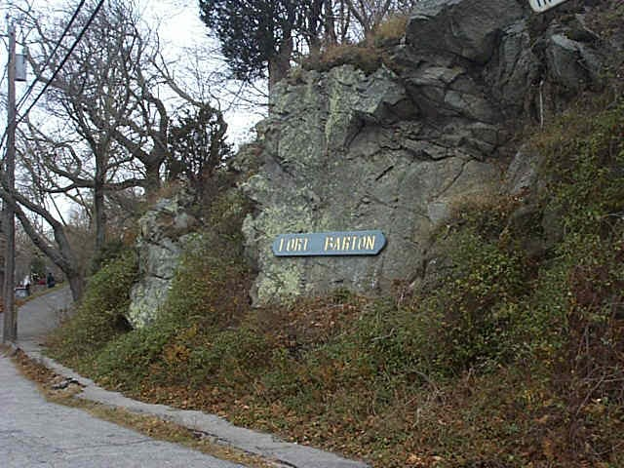
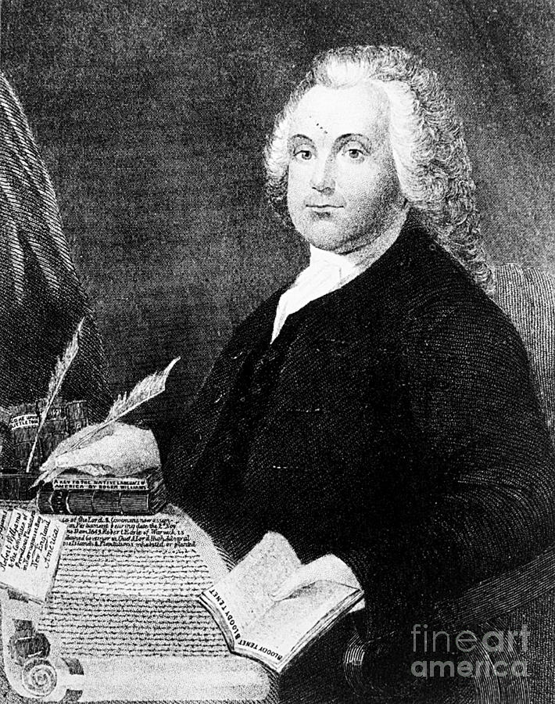
H is for History
Four corners
Roger Williams
Fort Barton

Slide 10
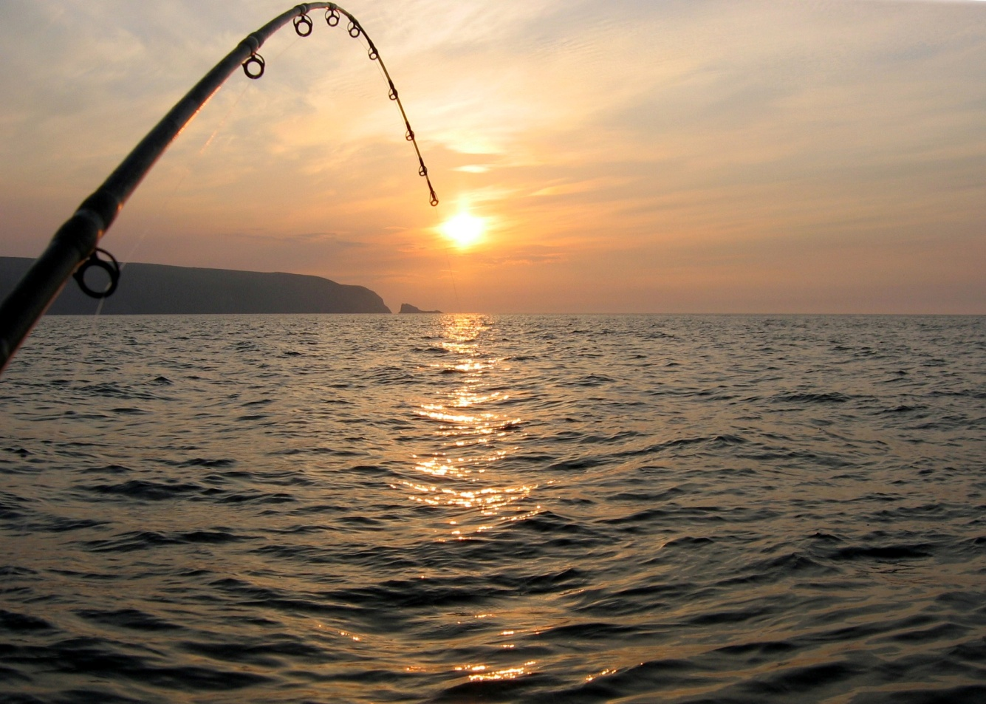
I is for Industries
Fishing

Slide 11
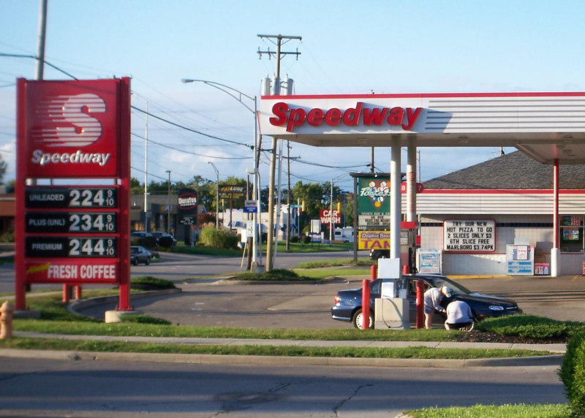
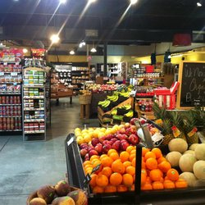
J is for Jobs
Tom’s Market
Dunkin Donuts
Speedway

Slide 12
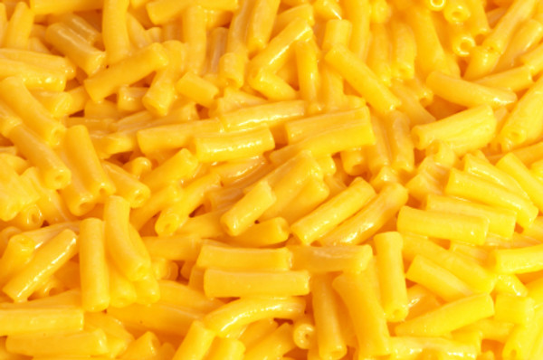
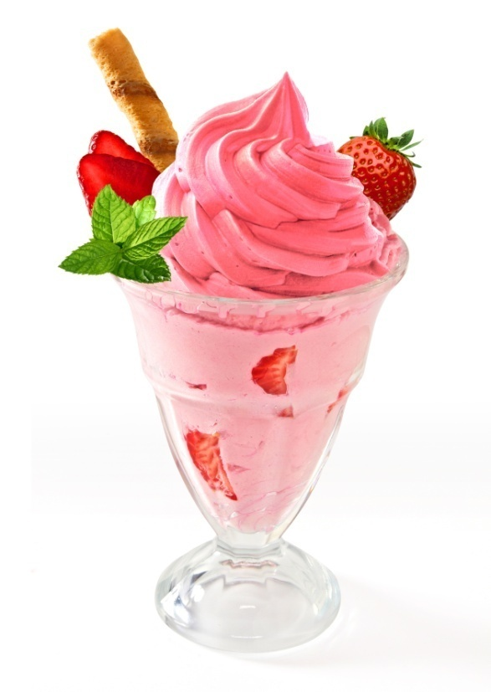
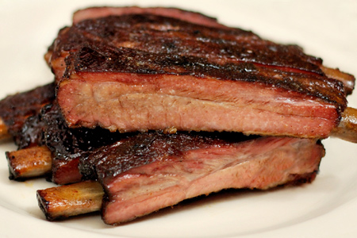
K is for Kinds of Food
Ice Cream
Mac ’n cheese
Ribs

Slide 13
L is for Landmarks
Fort Barton

Slide 14
M is for Motto
The Rhode Island state motto is hope.

Slide 15
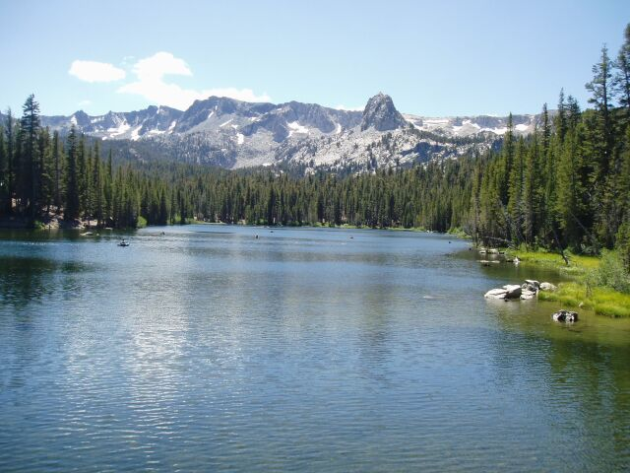
N is for Natural Resources
Water

Slide 16
O is for Origin of State
Roger Williams was Governor of the Colony 1654 through 1658.

Slide 17
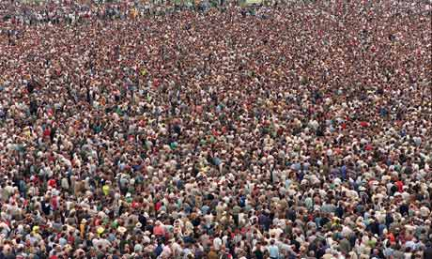
P is for Population
The population of Rhode Island is 1.055 million.

Slide 18
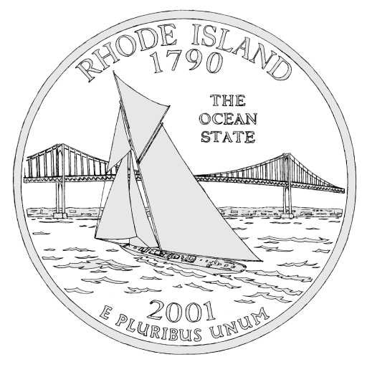
Q is for Quarter

Slide 19
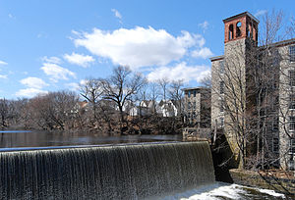
R is for Rivers and Lakes
Pawtuxet River

Slide 20
S is for Sports
New England Patriots

Slide 21
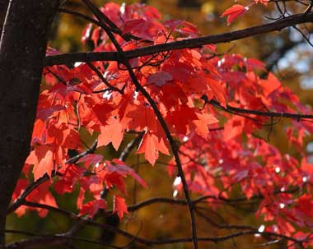
T is for Tree
The Rhode Island state tree is the red maple.

Slide 22
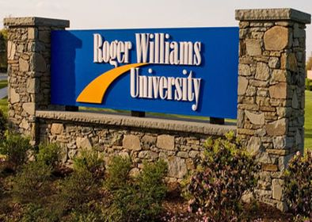
U is for University
Roger Williams University

Slide 23
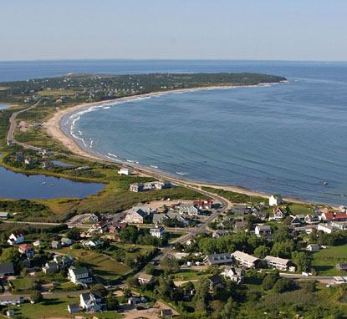
V is for Vacation Spots
Block Island

Slide 24
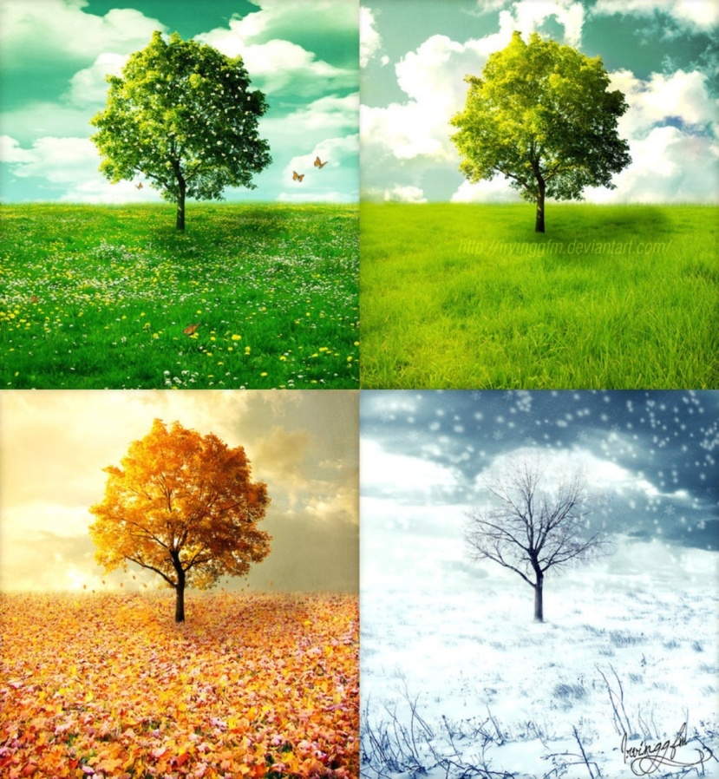
W is for Weather and Climate
The weather in Rhode Island changes as the seasons change.

Slide 25
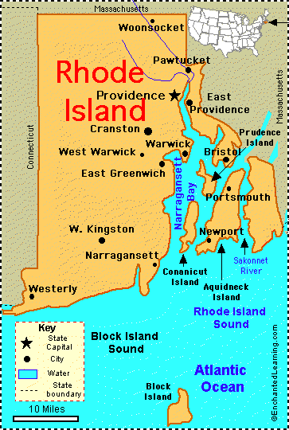
X is for Exciting facts
Roger Williams was the founder of Rhode Island.

Slide 26
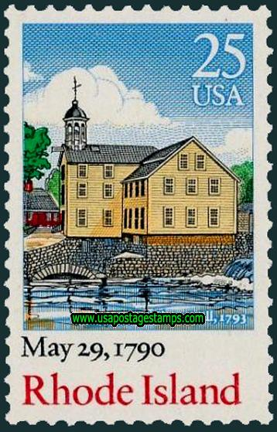
Y is for Year of Statehood
May 29, 1790

Slide 27
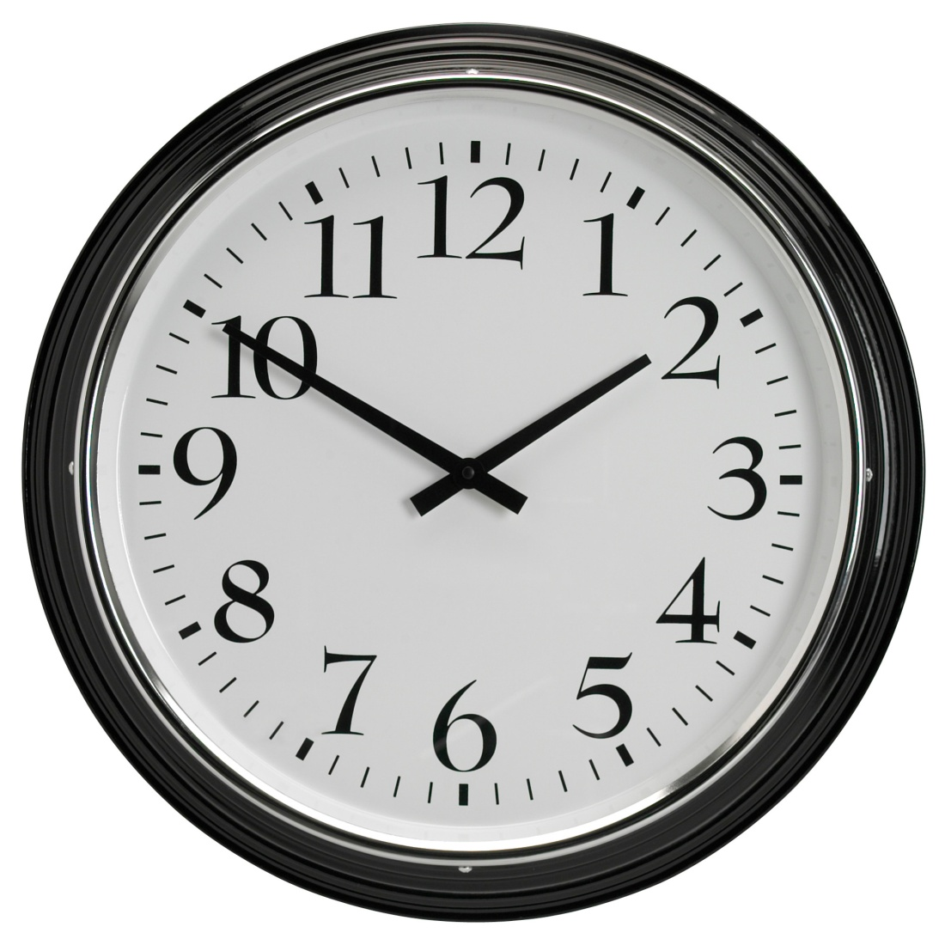
Z is for Time Zone
Eastern time zone

