Slide 1
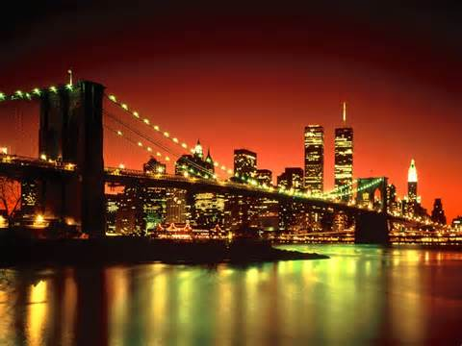
My New York ABC Book
By: Brady

Slide 2
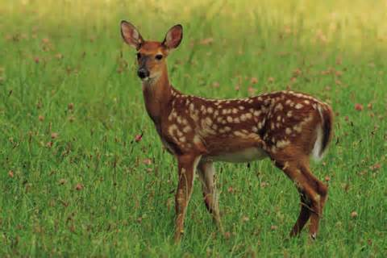
A is for Animals
Fox
Deer
Moose

Slide 3
B is for Border States
Connecticut
Rhode Island
Massachusetts

Slide 4
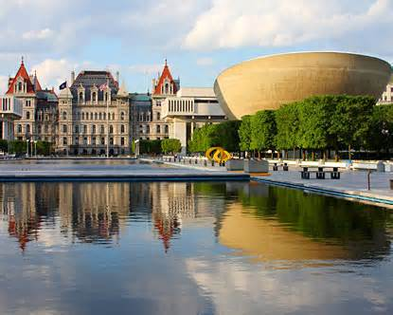
C is for Capitol
Albany

Slide 5
D is for Distance
54,5546 square miles

Slide 6
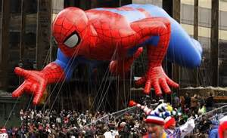
E is for Entertainment
Parades
Concerts

Slide 7
F is for Flag and Flower

Slide 8
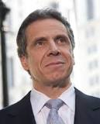
G is for Governer
Andrew Cuomo

Slide 9
H is for History
9/11

Slide 10
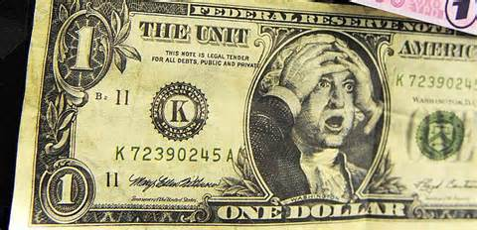
I is for Industries
Finance and services

Slide 11
J is for Jobs
McDonald’s
Teacher
Zoo worker
Store worker

Slide 12
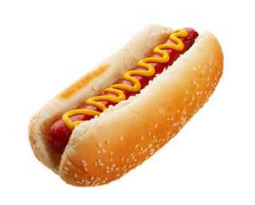
K is for Kinds of Food
McDonald’s
Hot Dogs
Turkey

Slide 13
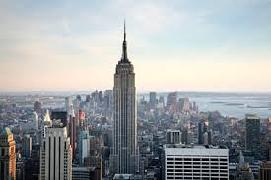
L is for Landmarks
Statue Of Liberty
Empire State Building

Slide 14
M is for Motto
“Ever Upward”, New York Motto
“Which Hope We Have As An Anchor Of The Soul.” New York State.

Slide 15
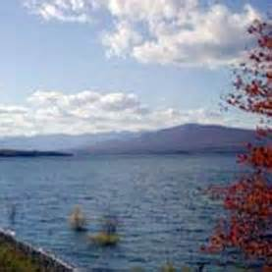
N is for Natural Resources
Water

Slide 16
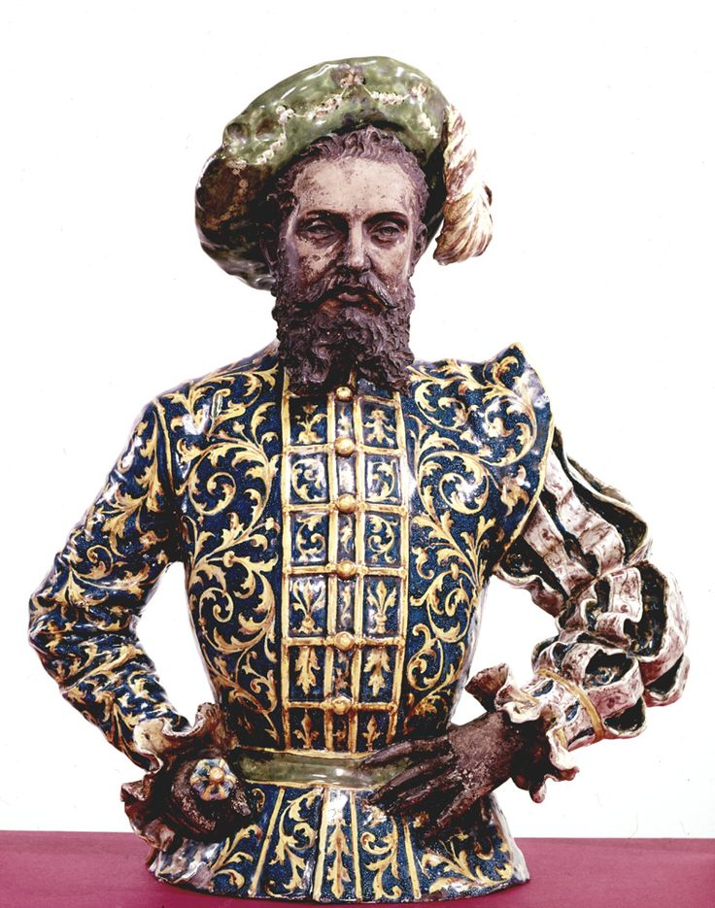
O is for Origin of State
The first European explorer to visit Manhattan was Giovanni da Verrazzano in 1524.

Slide 17
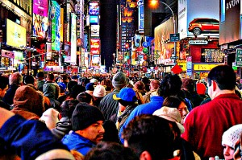
P is for Population
19,746,227

Slide 18
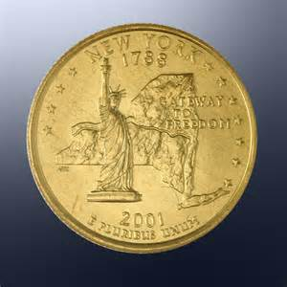
Q is for Quarter

Slide 19
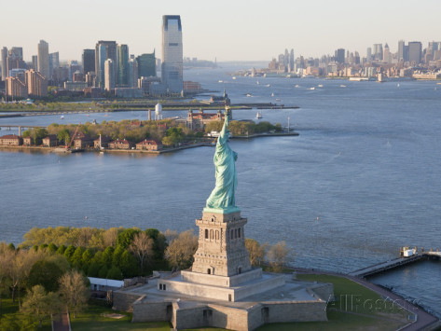
R is for Rivers and Lakes
Hudson River

Slide 20
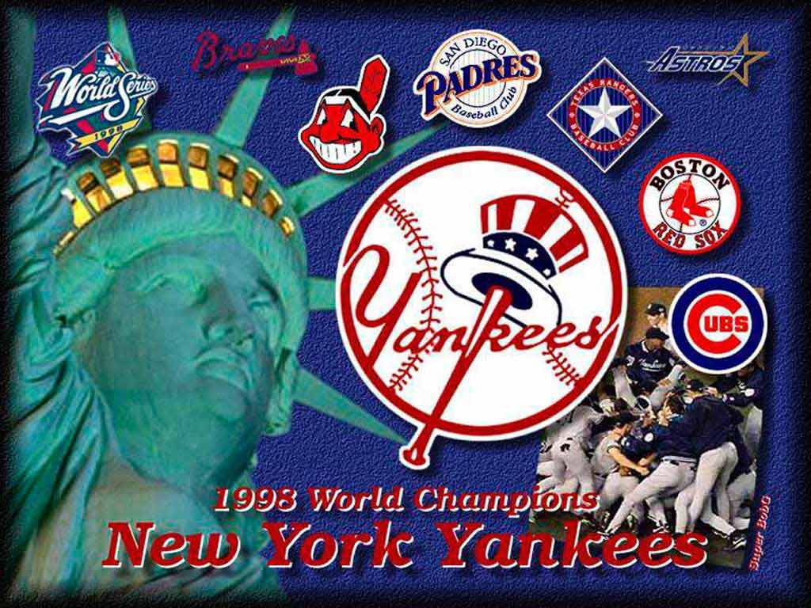
S is for Sports
New York Yankees

Slide 21
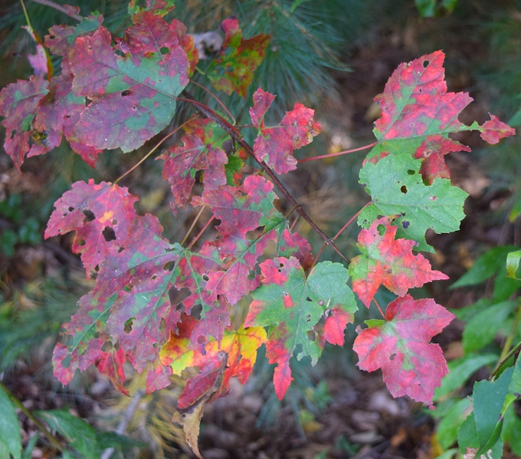
T is for Tree
Sugar maple

Slide 22
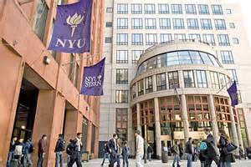
U is for University
New York University

Slide 23
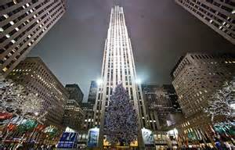
V is for Vacation Spots
New York City

Slide 24
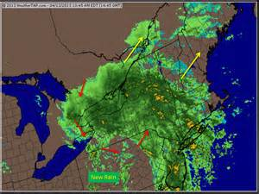
W is for Weather and Climate
It rains, snows, and is sunny.

Slide 25
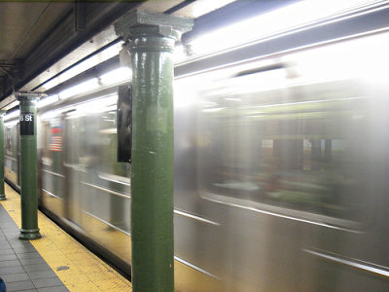
X is for exciting facts
New York is one of the safest cities in the United States.

Slide 26
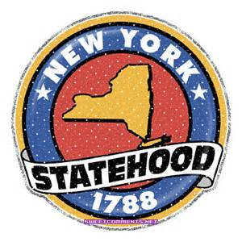
Y is for Year of Statehood
1788

Slide 27
Z is for Time Zone

