Slide 1
My Rhode Island ABC Book
By
Abi

Slide 2
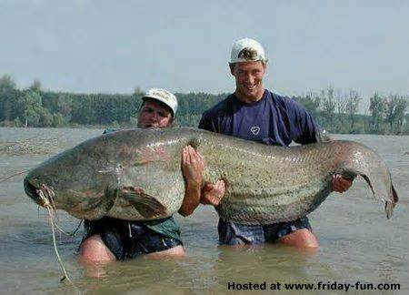
A is for Animals
Fish

Slide 3
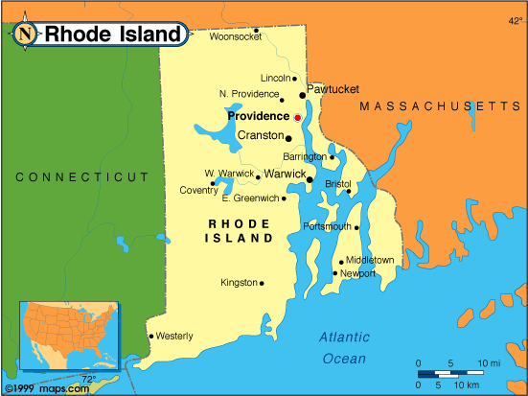
B is for Border States
Connecticut and Massachusetts

Slide 4
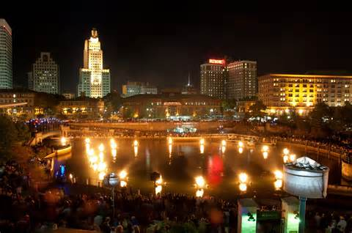
C is for Capitol
Providence

Slide 5
D is for Distance
1,045 square miles

Slide 6
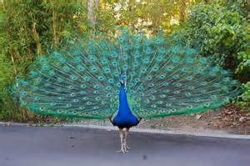
E is for Entertainment
Roger Williams Park Zoo

Slide 7
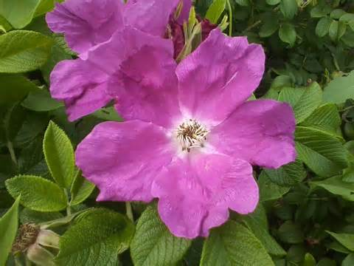
F is for Flag and Flower

Slide 8
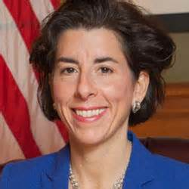
G is for Governor
Gina Raimondo

Slide 9
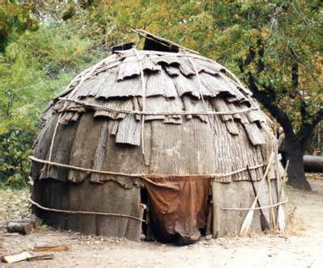
H is for History
The Wampanoag Native Americans lived in this area.

Slide 10
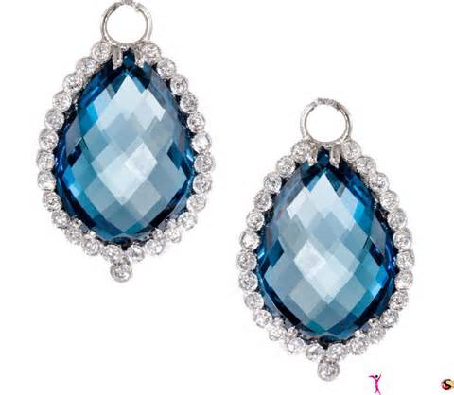
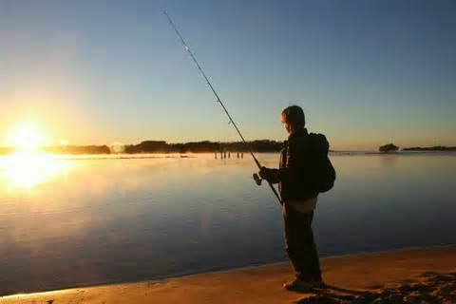
I is for Industries
Jewelry
Fishing

Slide 11
J is for Jobs
Library
Teacher
McDonald’s

Slide 12
K is for Kinds of Food
Macaroni and cheese
Pasta
Cheese pizza

Slide 13
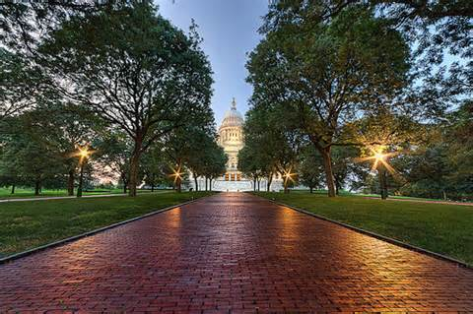
L is for Landmarks

Slide 14
M is for Motto

Slide 15
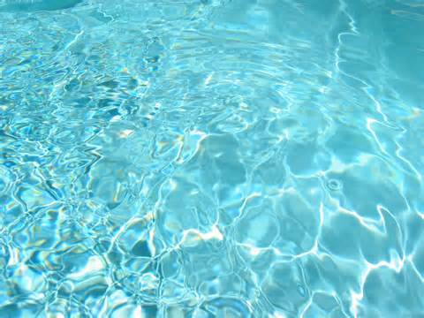
N is for Natural Resources
Water

Slide 16
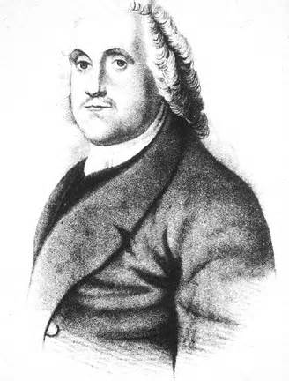
O is for Origin of State
In 1636, Roger Williams began the colony of the Providence Plantations.

Slide 17
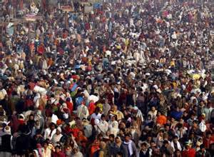
P is for Population
1,055,173

Slide 18
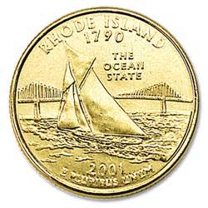
Q is for Quarter

Slide 19
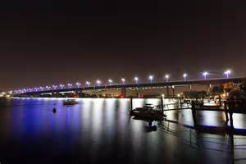
R is for Rivers and Lakes
Sakonnet River

Slide 20
S is for Sports
Soccer

Slide 21
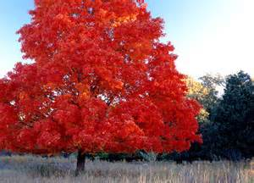
T is for Tree
Rhode Island red maple

Slide 22
U is for University
Roger Williams University

Slide 23
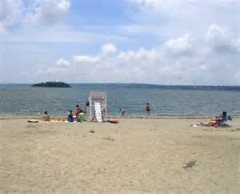
V is for Vacation Spots
Grinnell’s beach

Slide 24
W is for Weather and Climate
Cold Winters
Sunny Summers
Rainy
Windy

Slide 25
X is for eXciting facts
Lots of Water

Slide 26
Y is for Year of Statehood
1790

Slide 27
Z is for Time Zone
Eastern Standard Time

