Slide 1
My Massachusetts ABC Book
By
Autumn

Slide 2
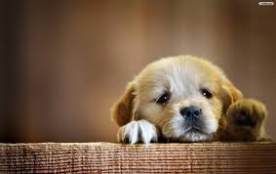
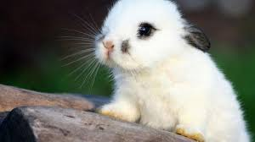
A is for Animals
Bunnies
Puppies

Slide 3
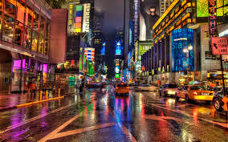
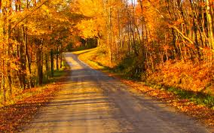
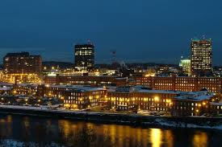
B is for Border States
New York
New Hampshire
Vermont

Slide 4
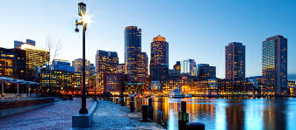
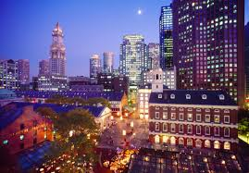
C is for Capitol
Boston

Slide 5
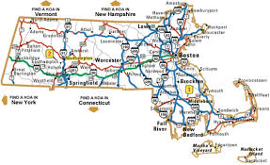
D is for Distance
10,555 square miles miles

Slide 6
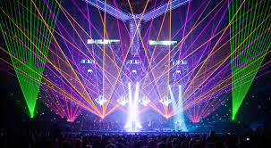
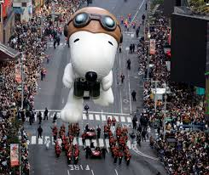
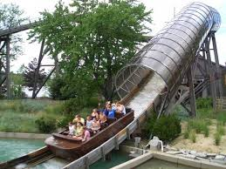
E is for Entertainment
Music/concerts
Parades
Theme parks

Slide 7
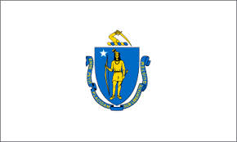
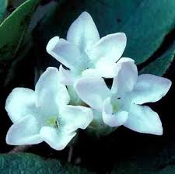
F is for Flag and Flower

Slide 8
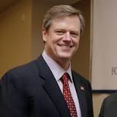
G is for Governor
Charlie Baker

Slide 9
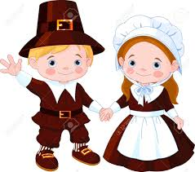
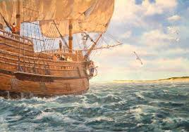
H is for History
Pilgrims
Mayflower

Slide 10
I is for Industries
Fashion
Art
Music
Science

Slide 11
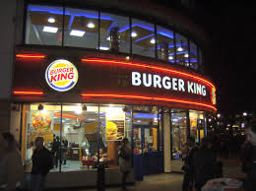
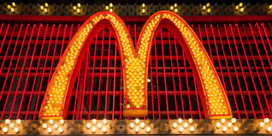
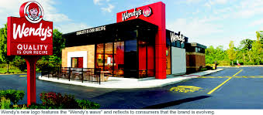
J is for Jobs
McDonald’s
Burger King
Wendy’s

Slide 12
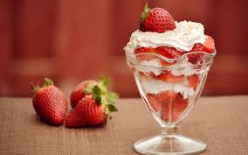
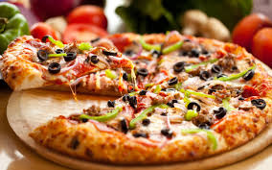
K is for Kinds of Food
McDonald’s
Dunkin Donuts
Pizza
Ice cream

Slide 13
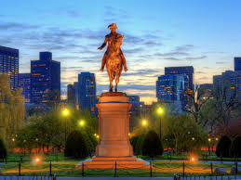
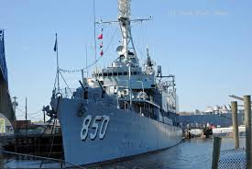
L is for Landmarks

Slide 14
M is for Motto

Slide 15
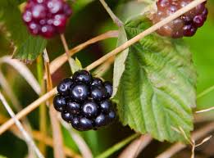
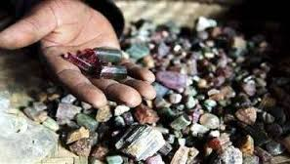
N is for Natural Resources

Slide 16
O is for Origin of State
The first settlers landed in Plymouth in 1620.

Slide 17
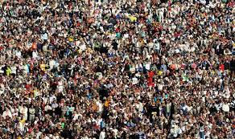
P is for Population
6.745 million people

Slide 18
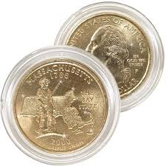
Q is for Quarter

Slide 19
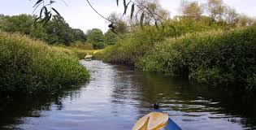
R is for Rivers and Lakes
Taunton River

Slide 20
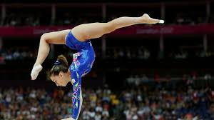
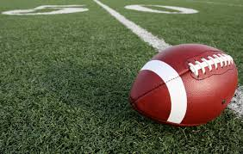
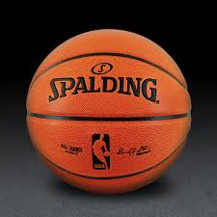
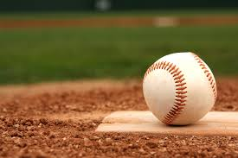
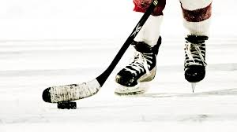
S is for Sports
Basketball, baseball, hockey, football, gymnastics

Slide 21
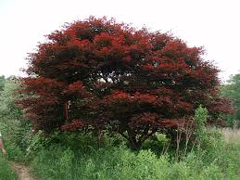
T is for Tree
American elm

Slide 22
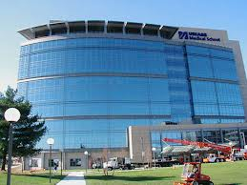
U is for University

Slide 23
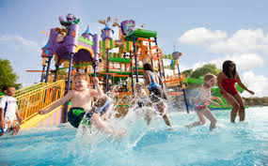
V is for Vacation Spots

Slide 24
W is for Weather and Climate
Summer: hot
Spring: warm/ chilly
Fall: chilly
Winter: cold

Slide 25
X is for exciting facts
6th state in the USA

Slide 26
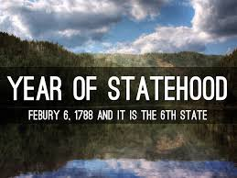
Y is for Year of Statehood
February 6, 1788

Slide 27
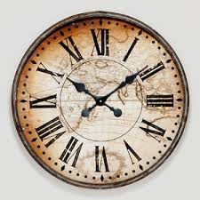
Z is for Time Zone
Eastern Time Zone

